Slide 1

Classroom Management
Professional Development Workshop – January 7, 2020
Terry Unruh – College of Business

Slide 2



Let’s get to know one another
Introduce yourself to the person on either side of you
Tell them
1. What you teach
2. Where you spent Christmas

Slide 3
Classroom Management begins way before the first day of class.
Know your subject matter
Context of your class
1. General Education
2. Principles Level
3. Upper Division

Slide 4
Classroom Management begins way before the first day of class.
Know your students
1. Freshmen
2. Majors
3. Adult Learners

Slide 5
Classroom Management begins way before the first day of class.
Get to know your students
1. Names
2. Majors

Slide 6
Classroom Management also happens outside the classroom
Look for your students
1. In the hallways
2. At events
Participate in their activities

Slide 7


First Day of Class . . . set the tone for the semester
1. Attitude
2. Expectations
3. Appearance

Slide 8
First Day of Class . . . set the tone for the semester
4. How students will be assessed
5. Provide clear instructions

Slide 9
First Day of Class . . . set the tone for the semester
6. How this class fits in the curriculum
7. How this class impacts their future/career

Slide 10
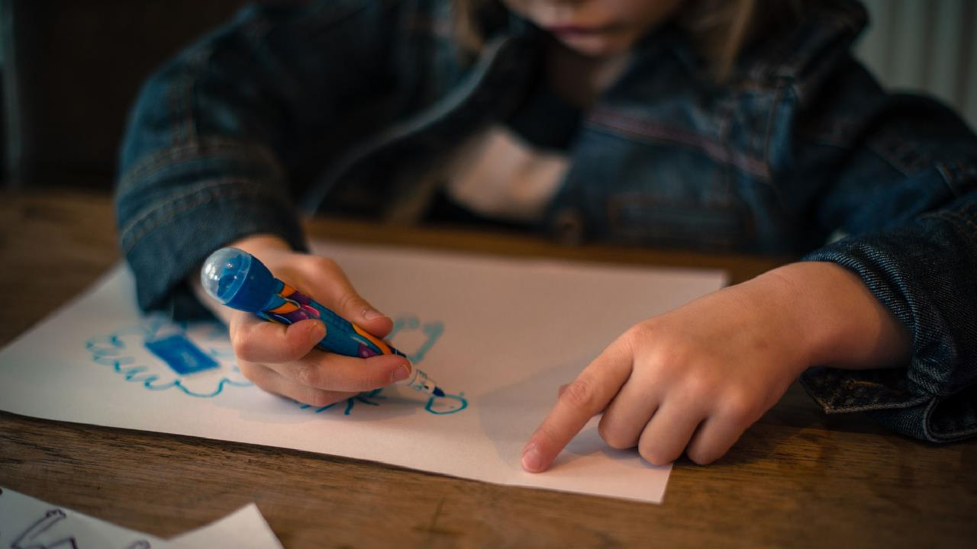



Beginning the class each day
Get their attention
Prayer / devotions
Comment on current event

Slide 11
Beginning the class each day
Capture their interest
Compliment on past event
Connection / review of previous classes
Importance of the day’s material

Slide 12
Beginning the class each day
Attendance
First two weeks of classes
Remainder of the semester

Slide 13
Classroom participation
Ask questions
Involve everyone
Assume less knowledge rather than more

Slide 14
Classroom participation
Encourage sharing of ideas
Manage and validate responses
Maintain control

Slide 15




You are the coach
Provide plenty of practice
Prepare for game time.

Slide 16


Distractions in the Classroom
Laptops and Cell Phones
Disruptive Behavior

Slide 17



If you want your students to enjoy your class
YOU have to enjoy your class
Be yourself
Be transparent
Build lasting relationships

Slide 18



Future – keep the end goal in mind
Encourage
Challenge
Share

Slide 19
Classroom Management
Questions?

