Slide 1
Integration of Technology into the Classroom
Dr. Terry Shannon

Slide 2
Presentation Key Points
The age of technology in education
What we use in the ORU Sport Management Program
What we were challenged to do
How we did it
Tour and Discussion

Slide 3

Family Time

Slide 4

Kids Growing Up Today

Slide 5

What Students Use in Class

Slide 6


How Do We Handle It?

Slide 7


Integrated Technology

Slide 8


Integrated Technology

Slide 9


Integrated Technology

Slide 10

Sport Facility Class

Slide 11
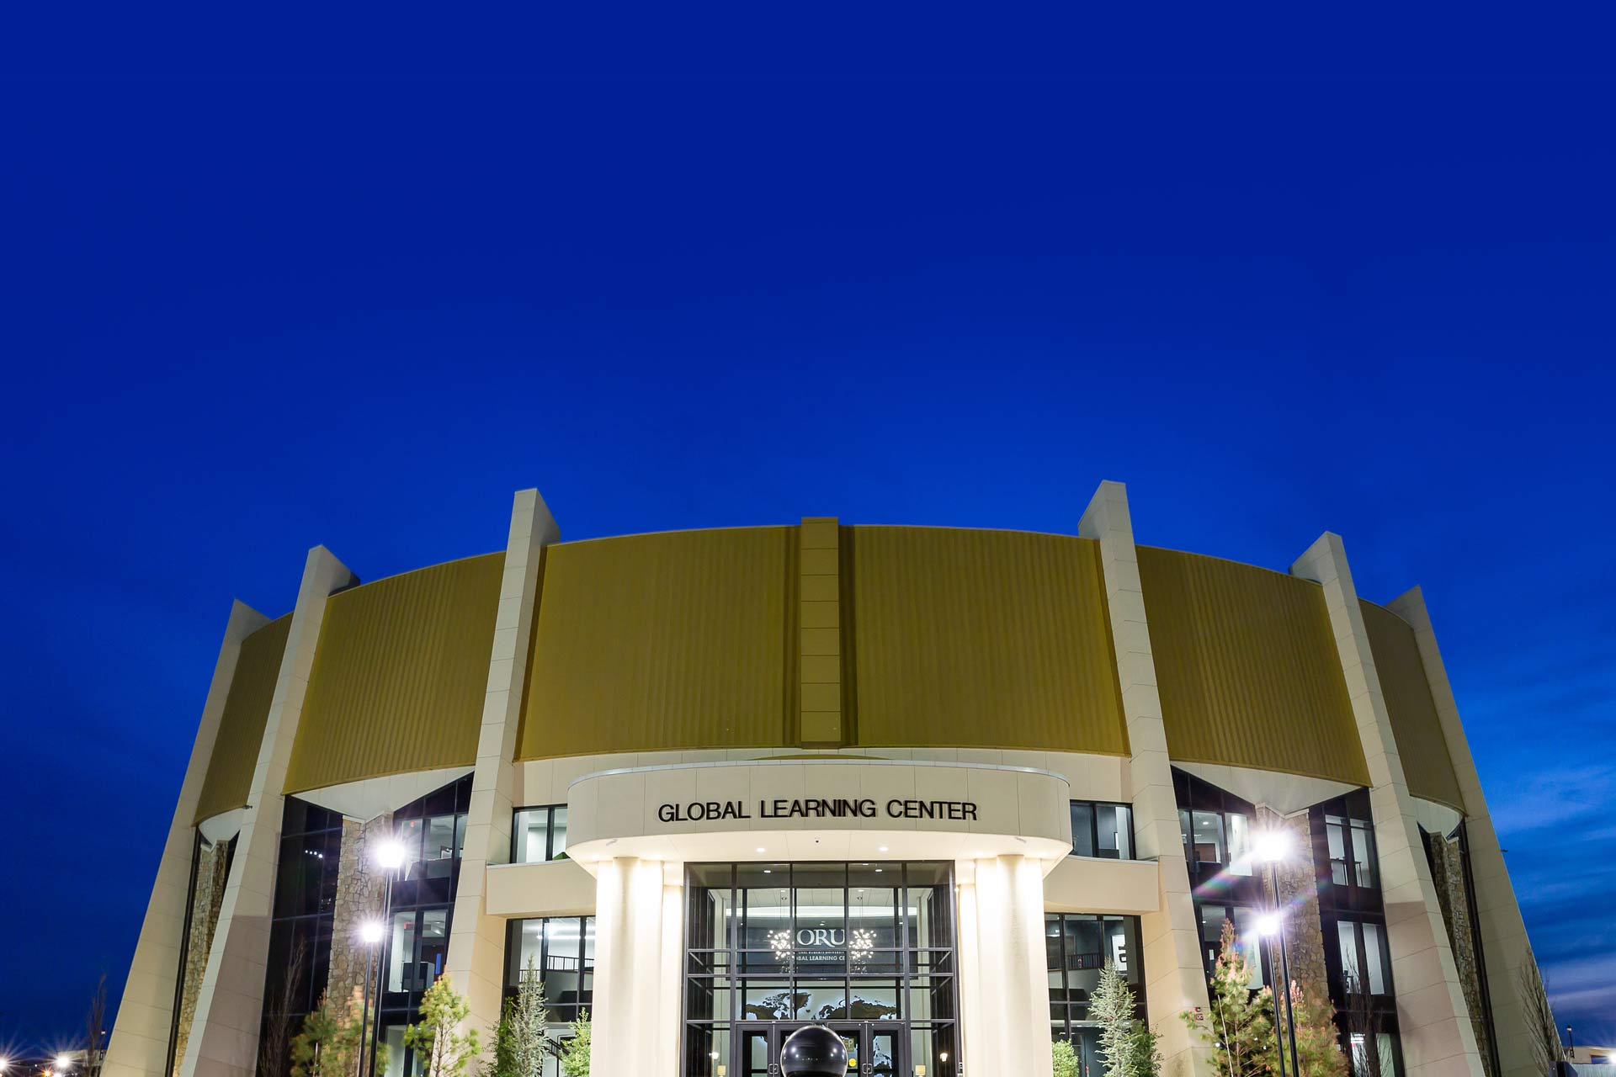
Global Learning Center

Slide 12

Example Project

Slide 13
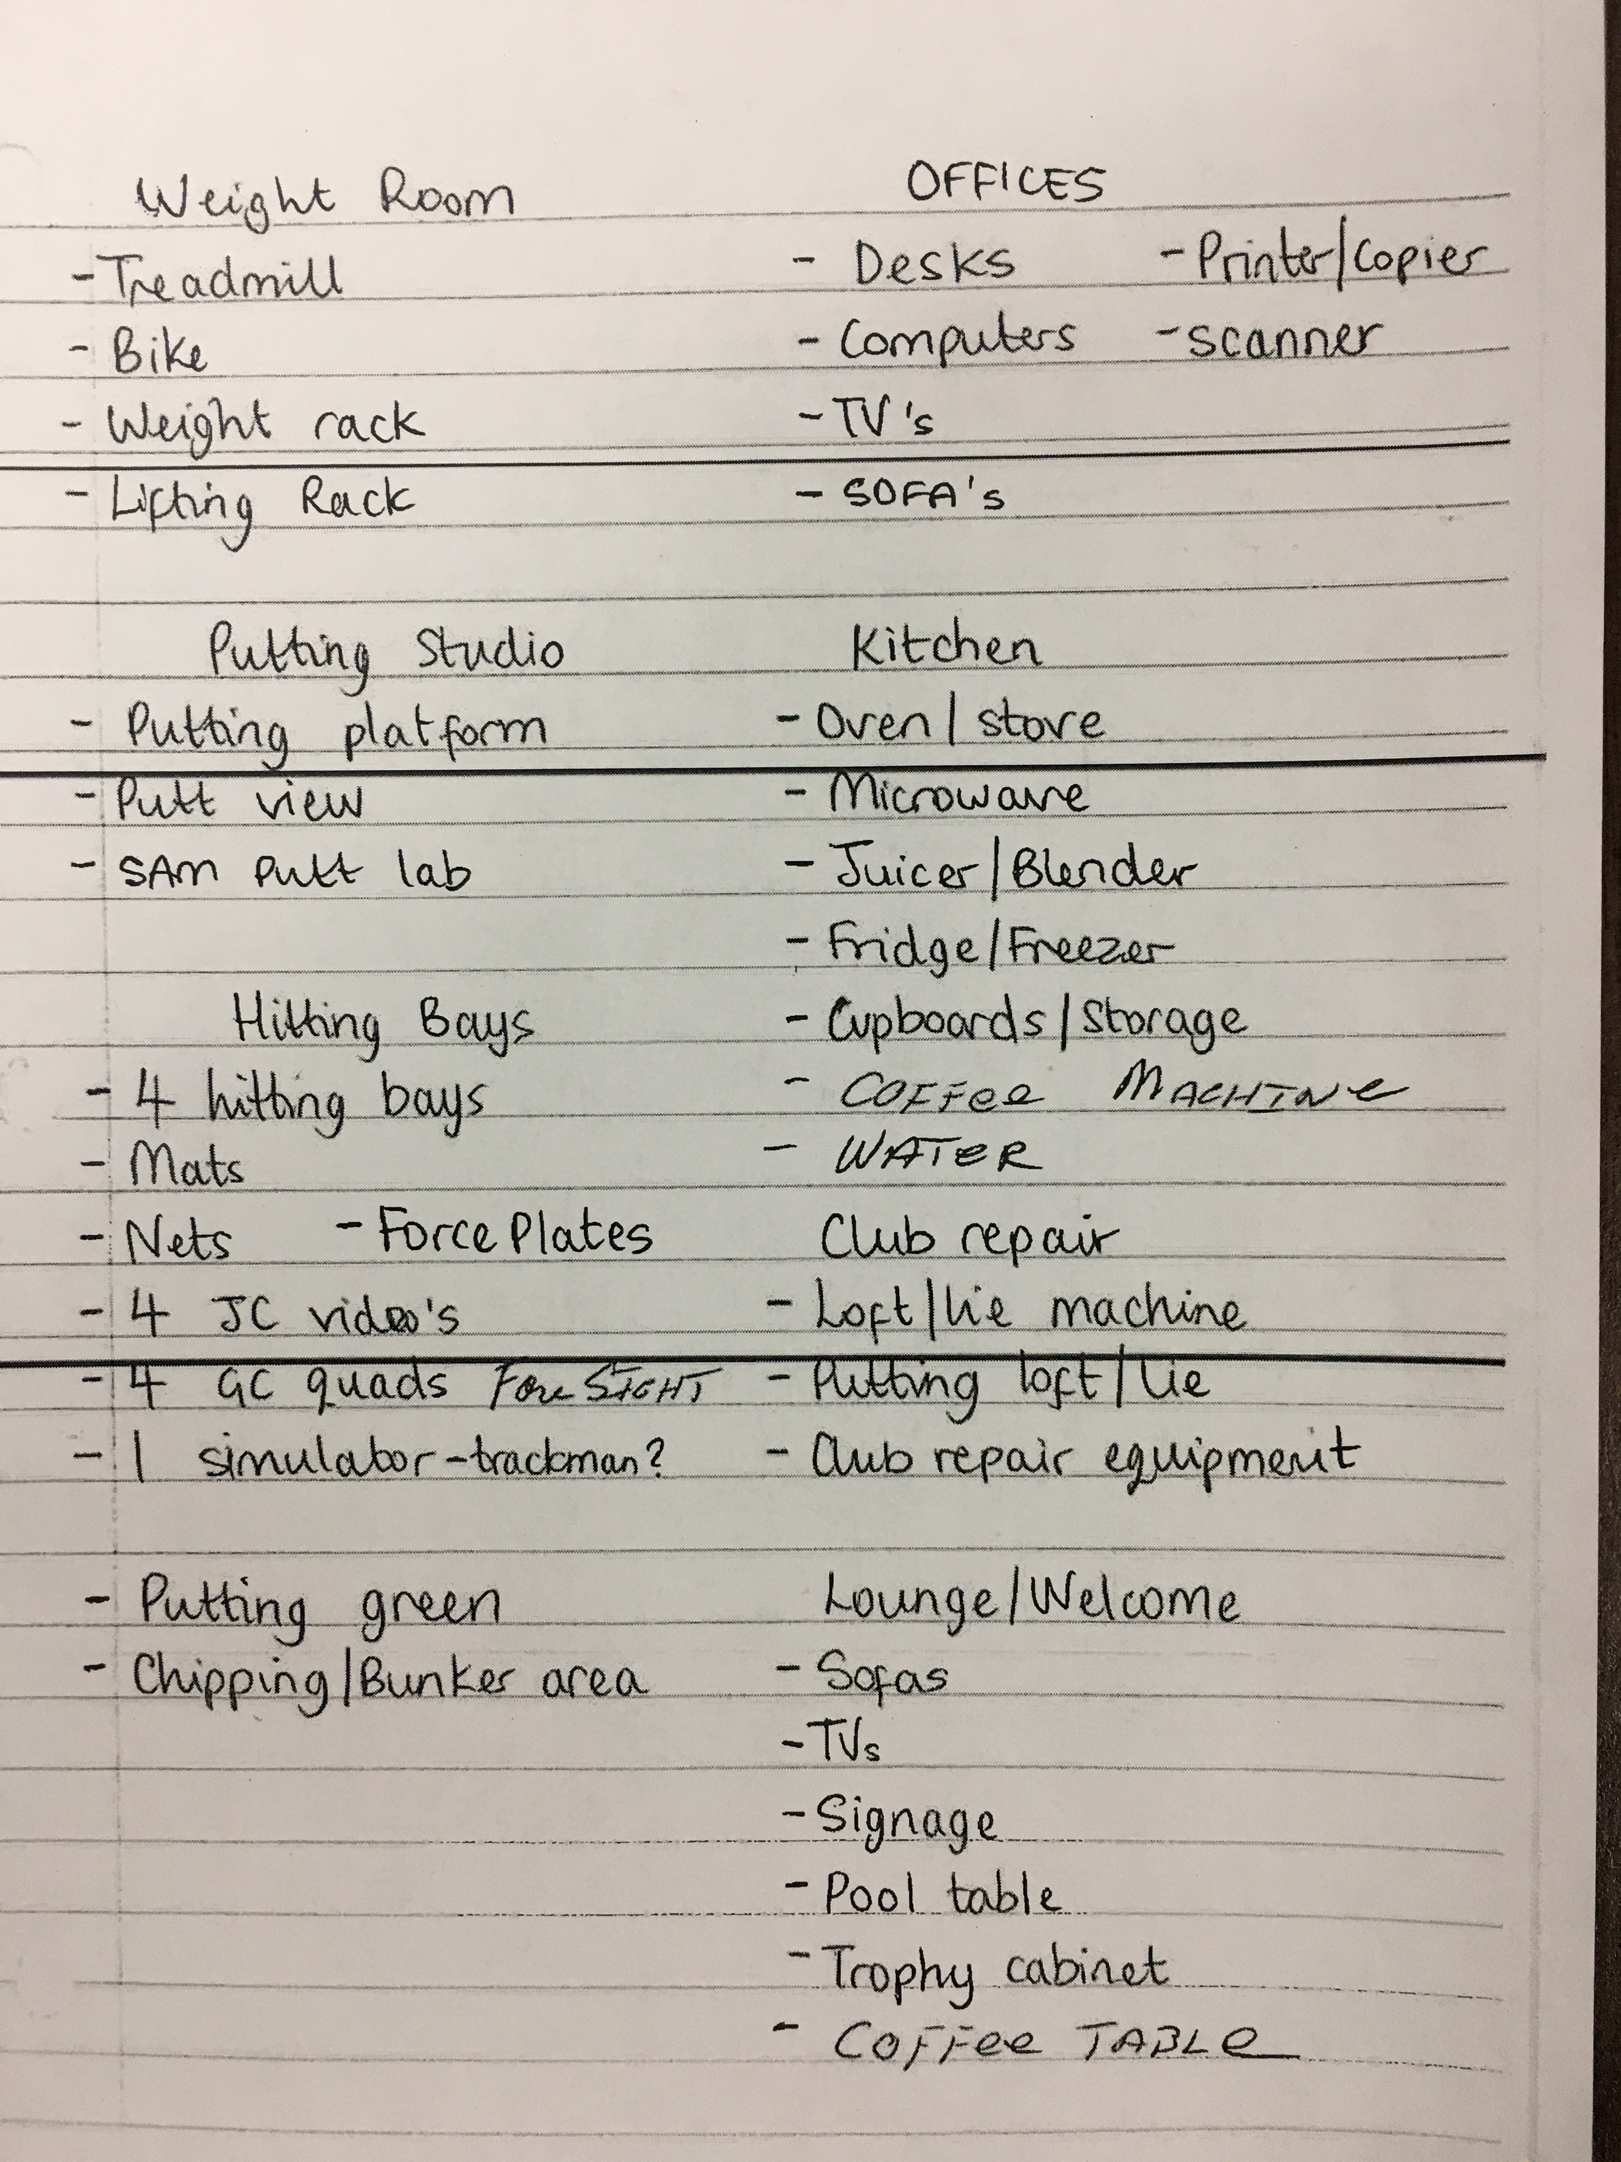
Golf Facility Wish List

Slide 14
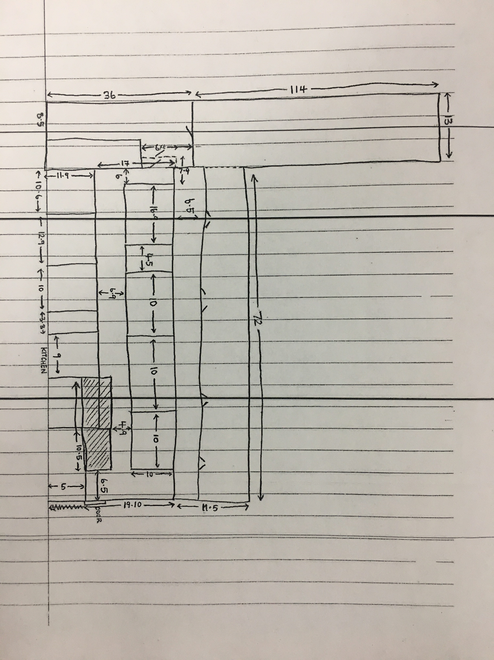
Golf Facility Layout

Slide 15

ORU Golf Project

Slide 16

Tour and Discussion

Slide 17
Group Discussion
What technology do you use in your classroom?
How can you integrate technology in your classroom?
What ideas do you have for your classroom, that technology can aid in?

Slide 18
Thank You
Dr. Terry Shannon
Aerobic Center 165
tshannon@oru.edu
918-495-6787

