Slide 1
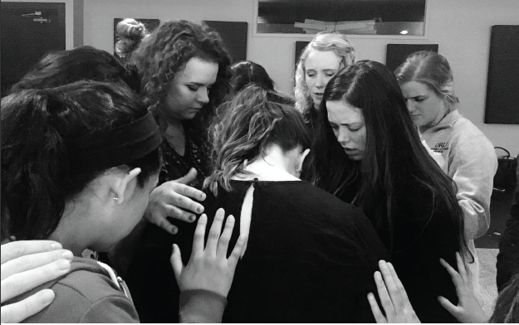
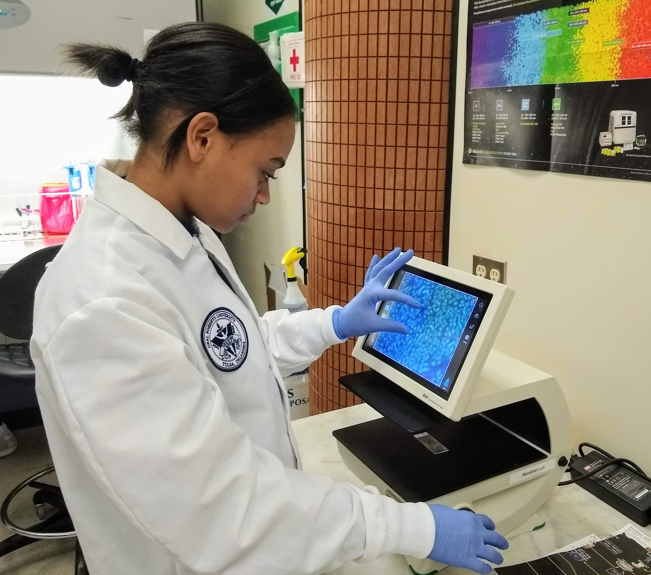
Engaging Honors Students
Keeping our gifted students engaged in the learning process isn’t always easy. Learn and share strategies and techniques to use in your classroom for engaging honors/gifted learners, no matter what your discipline, and learning environment.

Slide 2
Honors Program
Currently there are about 270 students. They are from all colleges.

Slide 3
Honors Program
Many HP students represent the best of the Colleges at gradation.
At last April’s Academic Awards Reception, 11/59 awardees were HP Scholars or Fellows.

Slide 4
Honors Program
Basic Philosophy: “Different not more”
Feedback from students (thinking outside the paper):
Disengaged by:
Writing additional pages
Engaged by:
Meeting with professors
Discussion-based learning
Hands-on research and scholarly work
HONR courses as a model

Slide 5
HONR Courses
Began in 2001, these courses use the skeleton of their GE equivalent but expand the content with interdisciplinary foundations.
General approaches:
Replace heavy lecturing with more group discussion.
Outside speakers.
Group tasks.

Slide 6
Ideas for your classes
Imagine that the honors student, in your class, has a major in your area: What task/project/object would you like to see from her and how might you naturally add more support in the learning process?
How can a current assignment be altered to be a deeper experience with your course content?
If you had a first semester graduate student in your course, how would you elevate your content and expectations?

