Slide 1

The Do’s and Don’ts of Accommodating Students with Disabilities in Higher Education
Cynthia McFarland - Director of Student Support Services
Dr. Evie Lindberg – College of Education – Special Education

Slide 2

While You Are Waiting Please Do The Following:
Please sit with others from your College/Department
Login into Kahoot
https://kahoot.com

Slide 3
STUDENT SUPPORT SERVICES (SSS)
Cynthia McFarland – Director
918-495-6655 * cmcfarland@oru.edu
Main Office – LRC 510
918-495-6689
disabilityservices@oru.edu

Slide 4
Student Support Services’ Mission
To ensure that qualified students with disabilities have equal access to educational opportunities at ORU by eliminating physical and educational barriers. Each student will then be able to participate freely and actively in all facets of University life under the American with Disabilities Act (ADA) and Section 504 of the Rehabilitation Act of 1973.

Slide 5


Two Laws That Protect Students With Disabilities in Higher Education
Americans With Disabilities Act (ADA)
Section 504 of the Rehabilitation Act of 1973

Slide 6

Who is Protected by the ADA?
Anyone with a disability that substantially limits one or more major life activity
  As a rule of thumb, a major life activity is something that contributes to the proper functioning of the human body (seeing, sleeping, hearing, talking, moving) or the proper functioning of internal organs. The ADA does not specifically name all the impairments that are covered.
  The 2008 amendments to the ADA expanded major life activities to include self-care, the ability to perform manual tasks, learning, thinking, and working, among others.
People who have a record or history of having a substantially limiting impairment
People perceived by others as having such an impairment
Those who associate with people who have disabilities
*www.ada.gov

Slide 7



“No otherwise qualified individual with a disability in the United States, shall, solely by reason of his or her disability, be excluded from the participating in, be denied the benefits of, or be subjected to discrimination under any program or activity receiving Federal financial assistance…”
It goes on to explicitly say that this applies to “a college, university, or other postsecondary institution, or a public system of higher education.” Essentially, if an agency, institution, or entity accepts federal financial assistance, or accepts students who receive federal financial aid, it is prohibited from discriminating against anyone based on their disability.
*www2.ed.gov

Slide 8

Student Support Services’ Responsibilities
To assess students’ requests for accommodations
To provide information regarding policies, procedures, rights, and responsibilities to students with disabilities, faculty, and staff
To assist students in communicating with faculty about their disabilities and required accommodations, if needed
To provide a letter of accommodation to faculty and students at the beginning of each semester (via email)
To provide testing facilities and accommodations

Slide 9
Example of Accommodations Offered at ORU
Extended time (x 1 ½) on exams
Extended time on assignments and deadlines for disability-related delays
Taking exams in a distraction-reduced environment
Course information and reading list in advance of classes
Flexibility in the attendance requirements in case of disability-related absences
  Documentation of ongoing medical absences required
Copies of Instructor’s notes and presentations
Ability to use a Calculator
Customized physical education class activities that allow the student to participate based on the parameters set forth by the student’s physician
Service Animals (dog or miniature horse)
Emotional Support Animals

Slide 10

Student’s Responsibilities
To self-identify (best interest, but not required)
To provide up-to-date documentation from a qualifying medical professional that explains the disability
To request academic accommodations that will ensure access to information and testing on an equal level with students who do not have disabilities
To remind faculty one week in advance of academic accommodations for test and assignments
Note: Accommodations must be renewed with SSS at the beginning of each semester

Slide 11
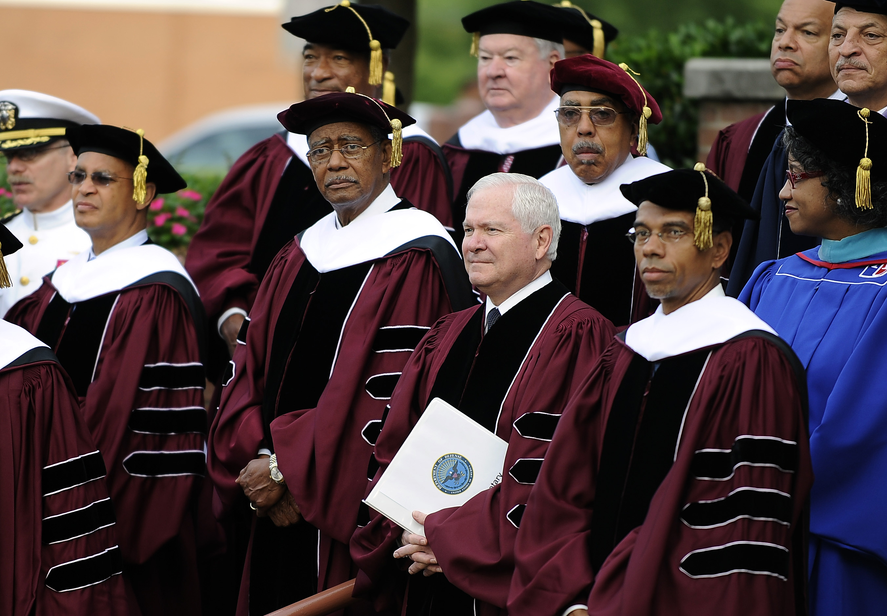
Faculty’s Responsibilities
To acknowledge the rights of students with dignity and respect
To maintain the integrity of academic standards
To always maintain student confidentiality at all times
To allow students to disclose their disabilities in an appropriate and confidential place
To let them Drive:
  D2L
  Testing Request Link & Process
  https://oru.edu/current-students/my-services/disability-services/test-proctoring-procedure.php

Slide 12

The Importance of Adding an ADA Statement To Your Syllabus and What To Do With It
Importance:
Informs students of university resources and policies for accommodating students with different learning needs
Shows instructor’s commitment to provide an inclusive learning environment to all students
Helps a student with disabilities who may not know or forgot they need to self-disclose to receive accommodations
Helps the student to understand the importance of disclosing their disability to Student Support Services
What to do:
Read the statement to students on the first day of class
Remind them throughout the semester of your commitment to access
Look for ways to practice access throughout the semester

Slide 13
Example Syllabus Statement - A
ORU is committed to providing equitable access to learning opportunities for all students. If you experience educational barriers and have, or think you may have, a disability that qualifies under the American with Disabilities Act (ADA) and Section 504 of the Rehabilitation Act, visit Student Support Services in LRC 510, call 918-495-6689, or email disabilityservices@oru.edu for special accommodations and information on appropriate policies and procedures.
Disabilities may include but are not limited to attentional, learning, mental health, sensory, physical, or chronic health conditions. All students are encouraged to discuss their disability-related needs with Student Support Services and their instructors as soon as possible. Students must renew accommodations with Student Support Services each semester and all information is strictly confidential.

Slide 14
Example Syllabus Statement - B
Usability, disability, and design: I am committed to creating a course that is inclusive in its design. If you encounter educational barriers, please let me know immediately so that we can determine if there is a design adjustment that can be made or if an accommodation might be needed to overcome the limitations of the design. I am always happy to consider creative solutions if they do not compromise the intent of the assessment or learning activity. You are also welcome to visit the Office of Student Support Services in LRC 510, call 918-495-6689, or email disabilityservices@oru.edu to begin this conversation or to establish accommodations for this or other courses.

Slide 15
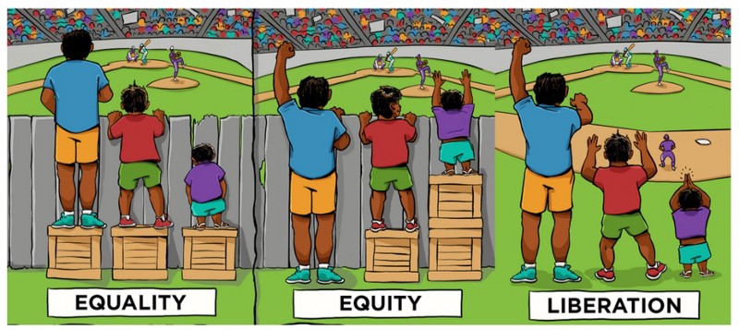
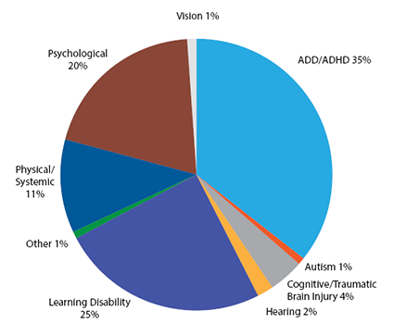
Roundtable Discussion
Scenarios and Accommodations
*National Center for Education Statistics 2018

Slide 16
ORU RESOURCES
  Student Support Services - https://oru.edu/current-students/my-services/disability-services/index.php
  Dr. Evie Lindberg – https://oru.edu/faculty/evie-lindberg.php
  Counseling Center - https://oru.edu/current-students/my-services/counseling-services/
  Writing Center - https://oru.edu/current-students/my-services/writing-center/
  Sharla Roach – Tutoring – x 6036 or tutors@oru.edu

Slide 17
Assistive Technology
Chrome Tools
1. Snap&Read Universal – Reads words that are clicked on
2. Read&Write for Google Chrome
3. SpeakIT – Text-to-Speech (TTS) Free
4. Google Scribe – Note-taking tools
5. Bookshare – Audiobook available free through Student Support Services
6. Read Mode – (clears visual clutter from web pages, Free)
7. Web Clipper – (Save web information directly to OneNote, Free)
8. VoiceNote II – Does dictation (Free)

Slide 18

QUESTIONS

