Slide 1
HONR 203 Science and Global Sustainability
Co-taught every other year by Dr. John Korstad (Biology) and Dr. Jeff Lamp (Theology)
This course is designed as an interdisciplinary exploration of issues related to scientific considerations in the study of global sustainability.
S2019 class of 17 students resulted in 5 professional publications:
“Pro-Life or Anti-Abortion?: A Christian Defense of Creation Care” to be submitted to the journal Spiritus in 2020
Three Chapters in “Ecologically Sound and Practical Applications for Sustainable Agriculture” (co-edited by John Korstad & 3 ‘colleagues in India) will be published by Springer Nature in Feb 2020:

Slide 2
  “Case Studies on Dead Zones—Watersheds around Large Rivers That Empty into Oceans or Seas and Create Growing Patches of Hypoxia”
  “Case Studies on Cultural Eutrophication—Watersheds around Lakes That Contribute to Toxic Bluegreen Algal Blooms”
  “Ecologically Sound and Practical Applications for Sustainable Agriculture”
“Phytorestoration of abandoned mining and oil drilling sites” will be published by Elsevier in Mar. 2010.”

Slide 3
Honors Resrach Assistantships
Dominic Halsmer and David Meddaugh, “How Oral Roberts’ Views on Science and Faith Influenced the Character of Christian Higher Education in America’s Bible Belt,” presented at the Annual Meeting of the American Scientific Affiliation, Wheaton
College, July 20, 2019.
Dominic Halsmer and Chloe Busse “Reverse Engineering of Biological Systems Uncovers Nested Affordances that Evince Purpose,” Proceedings of the Christian Engineering Conference (CEC), Dordt University, July 13, 2019.
Both David and Chloe conducted extensive research in the areas described above. They summarized pertinent books and articles, and formulated portions of the published paper and/or presentation. These are challenging areas of research because they attempt to synthesize results from multiple fields of study. They both did a good job of handling this diversity. David was able to attend the ASA Meeting with me at Wheaton and co-present. He did a great job during the presentation as we shared the podium. Because of a prior commitment, Chloe was not able to attend the CEC, but he provided me with excellent input for the required paper and presentation.

Slide 4
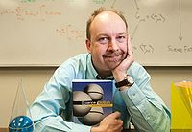

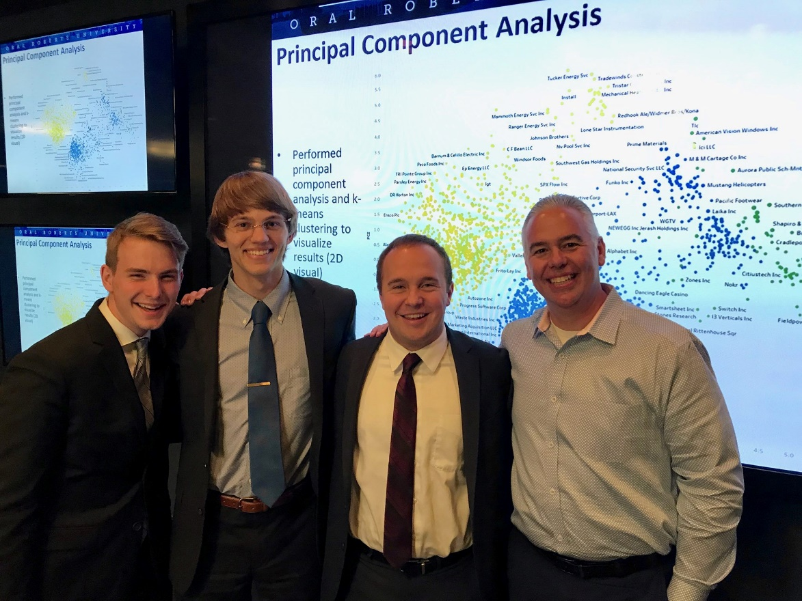
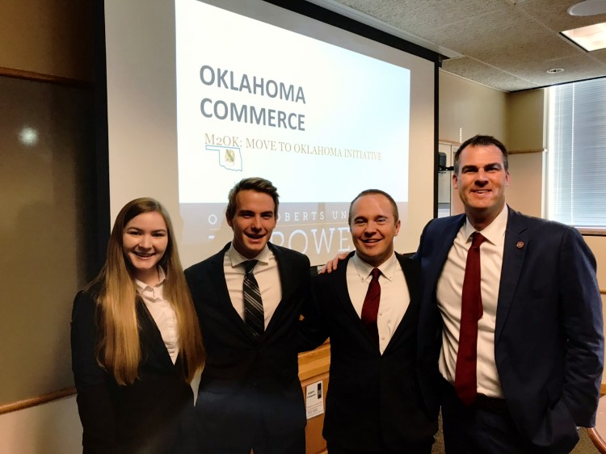
Honors Research Assistant Mentor – Andy Lang
DR. ANDY LANG

Slide 5
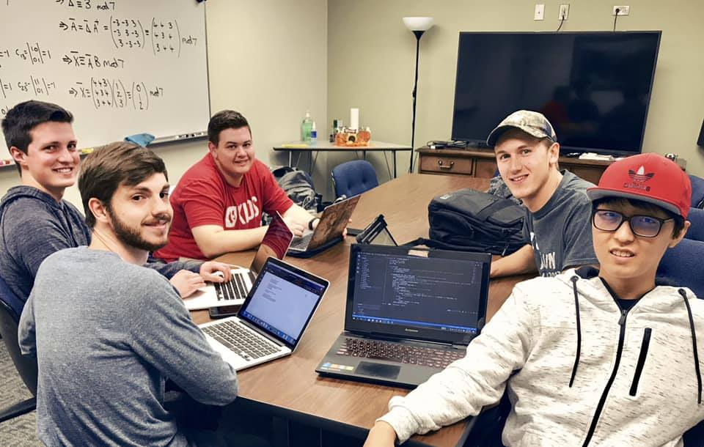
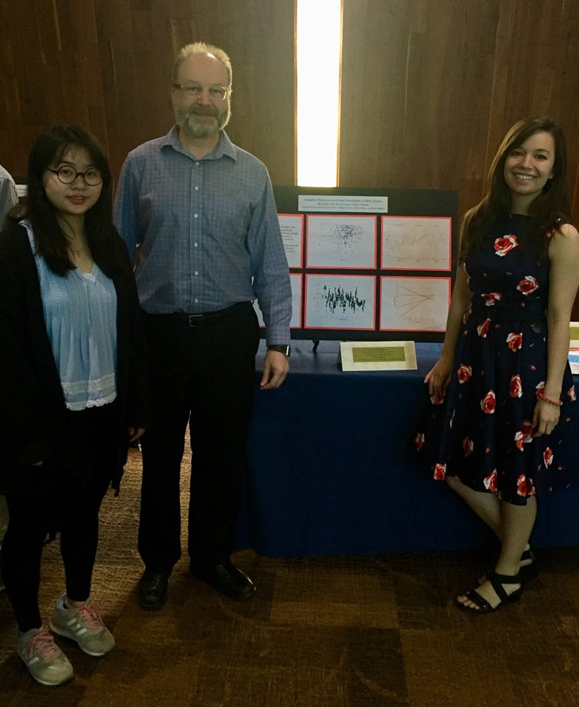
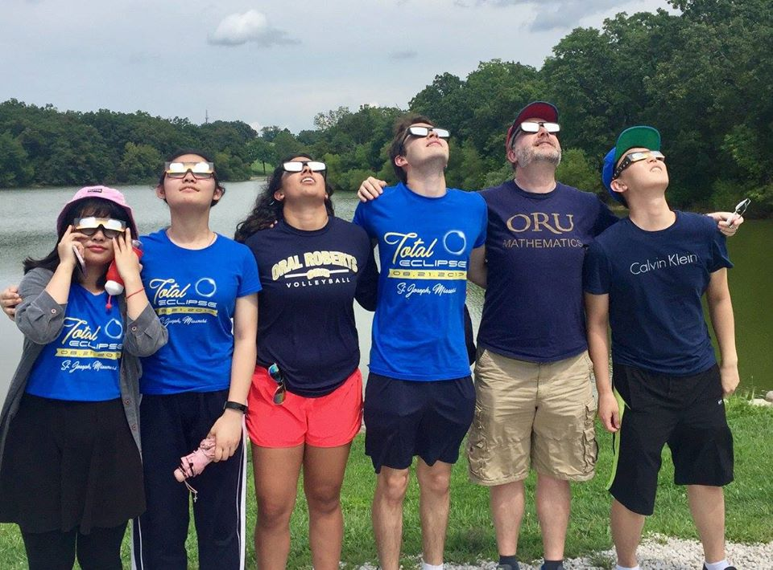
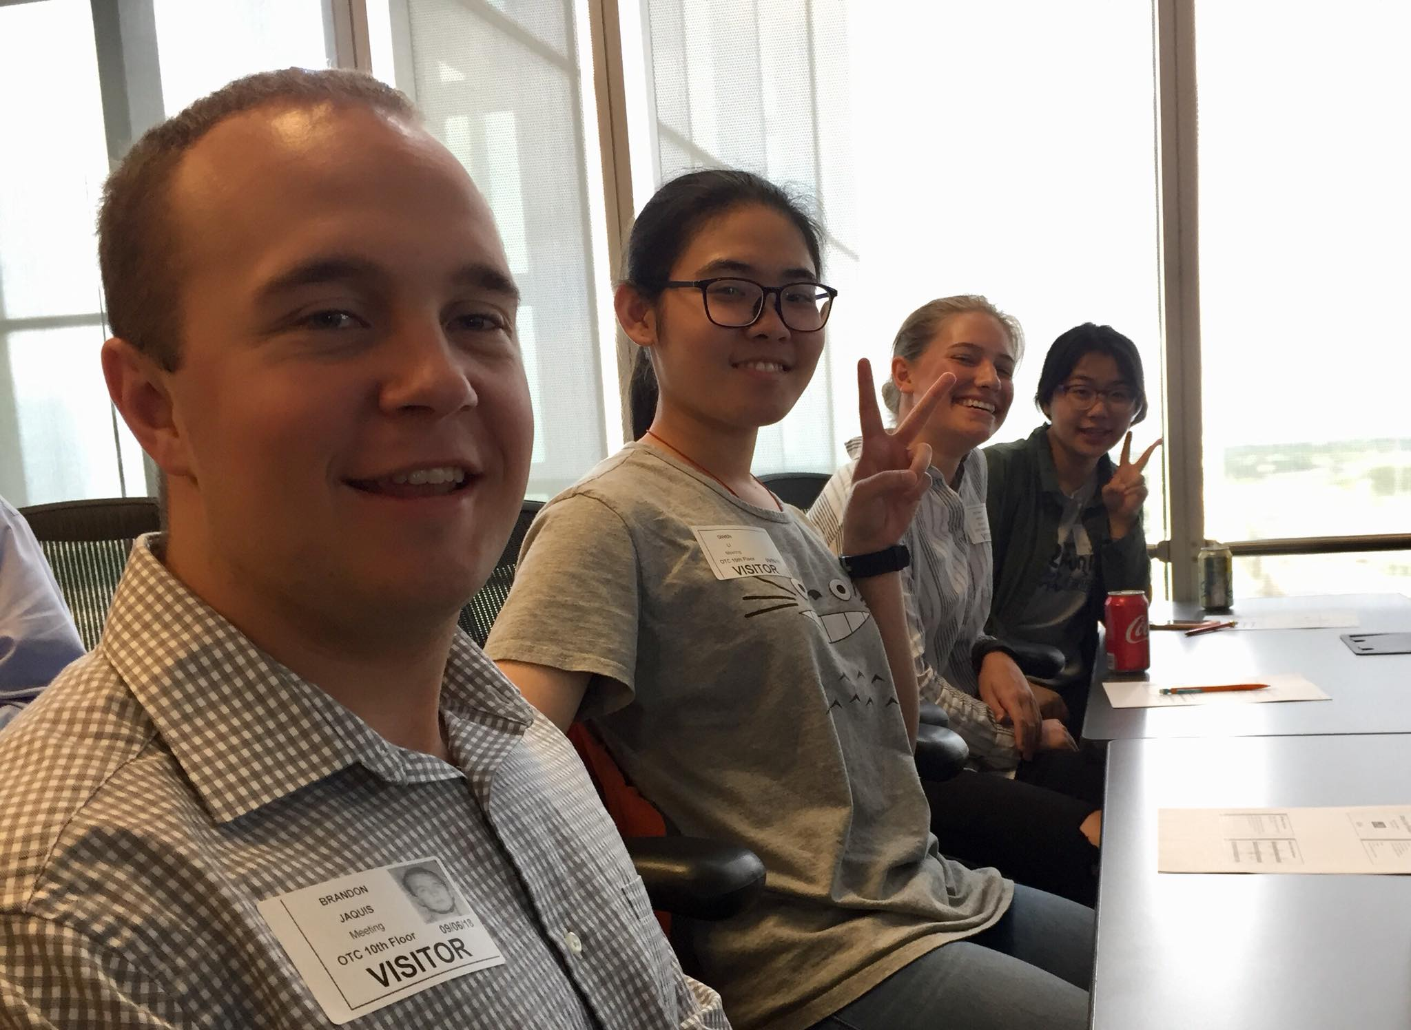
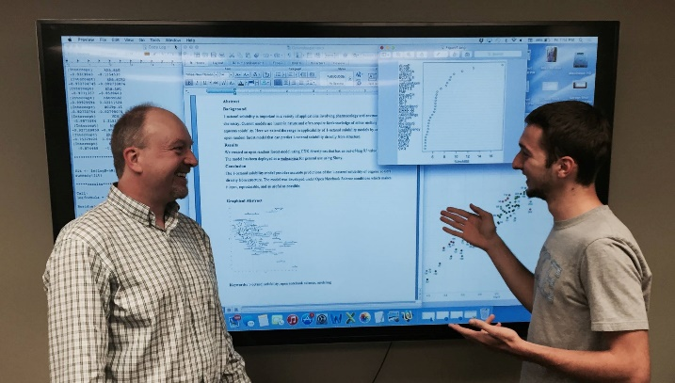
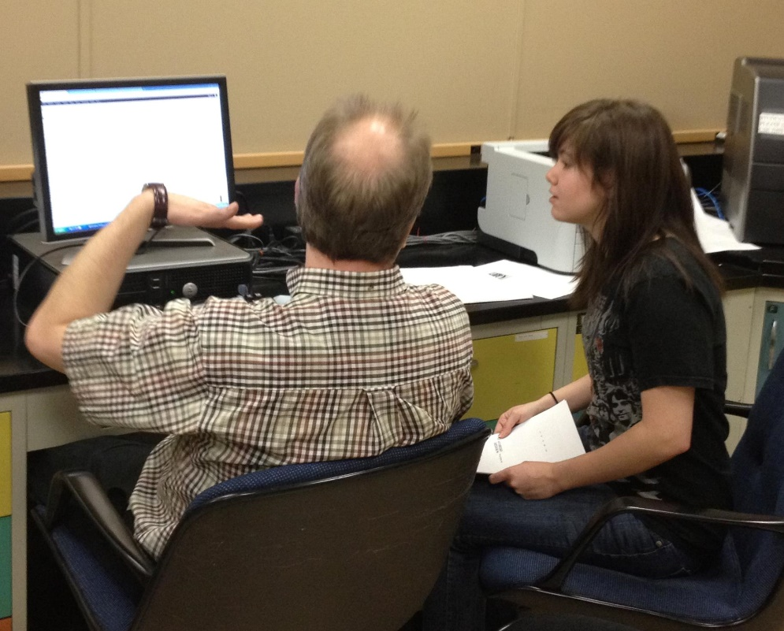
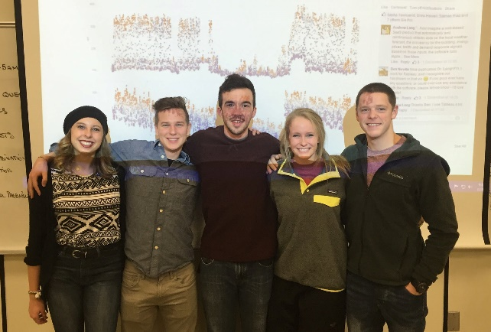

Slide 6
List of recent peer-reviewed publications by Andy Lang co-authored with students* (honors students in bold):
2019 Fitbits, field-tests, and grades: The effects of a healthy and physically active lifestyle on the academic performance of first year college students. Allie M. Broaddus*, Brandon J. Jaquis*, Colt B. Jones*, Scarlet R. Jost, Andrew S.I.D. Lang, Ailin Li*, Qiwen Li*, Philip P. Nelson and Esther M. Spear*. International Journal of Sport and Exercise Psychology. doi:10.1080/1612197X.2019.1623062
2019 Using Machine Learning to Predict Enthalpy of Solvation. Brandon J. Jaquis*, Ailin Li*, Nolan D. Monnier*, Robert G. Sisk*, William E. Acree Jr., and Andrew S. I. D. Lang. Journal of Solution Chemistry. doi:10.1007/s10953-019-00867-1
2018 Ferguson, C., Kaneta, L., Li, A., Nelson, P., Satralkar, M., & Lang, A.S.I.D. Chronotype as a Predictor of Academic Success of University Freshmen. International Journal of Psychology and Neuroscience, 4(2), 37-48. ISSN: 2183-5829
2018 The Number of Credit Hours Required for Bachelor’s Degrees at Christian Colleges and Universities. Andrew SID Lang, Enrique F Valderrama, and Clare R Holt*. Journal of the Scholarship of Teaching and Learning for Christians in Higher Education 8:1, Article 4
Also note: Caleb Mazzei (honors math major) is at Oxford this year - out first STEM student with SCIO

Slide 8
Participants’ Takeaways from today

