Slide 1
Student-Centered Teaching in Large Classes
ORU Faculty Development
Presented by Dr. Catherine Klehm

Slide 2
Challenges of managing the classroom
  In large classes, a few students skipping class likely goes unnoticed so attendance is a graded factor
    Why does attendance matter since it is no longer a University policy?
    Can’t the student still understand the content without sitting through class?
  Grading/entering data
    Grades are private and can no longer be done by student workers
    Seek auto-graded systems that sync with D2L or work out a way to easily match the attendance roster with D2L (alphabetical order at least)

Slide 3
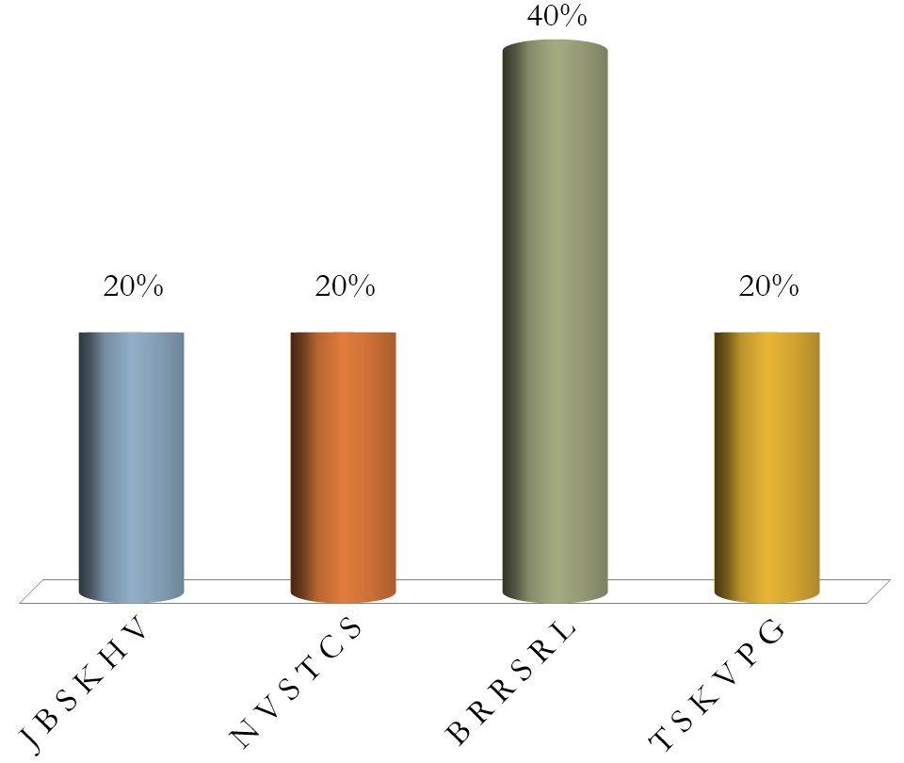
O_A_ _O_E_T_
J B S K H V
N V S T C S
B R R S R L
T S K V P G

Slide 4
Results for Scoring/Recording

Slide 5
Challenges of managing the classroom
  Knowing student’s names
    to call on them by name in class
    knowing when you have communicated with them (“Did you get my email?”)
    nameplates might help but have challenges too
  Connecting students to their misspelled/multiple name
    This is especially true for freshmen and International students
    Try to connect with the student to have them “fix” the problem on their registration end for you
  Heat – the room’s AC cannot keep up with the body heat

Slide 6

Please type your full name as it appears on Vision (the ORU course registration system)
Rank | Responses

Slide 7
Results for Scoring/Recording

Slide 8
Ways to take attendance quickly
  Roll sheet –
    too much room for dishonesty when attendance counts for a grade
  Smart phone attendance
    What student would “loan their phone” to a friend for an entire class period so they could skip class fraudulently?
  Use a daily quiz, class participation or a polling question to measure attendance
  Consider using this attendance plan at various times throughout the class
    This helps ensure students don’t just come to class, take the quiz and leave

Slide 9
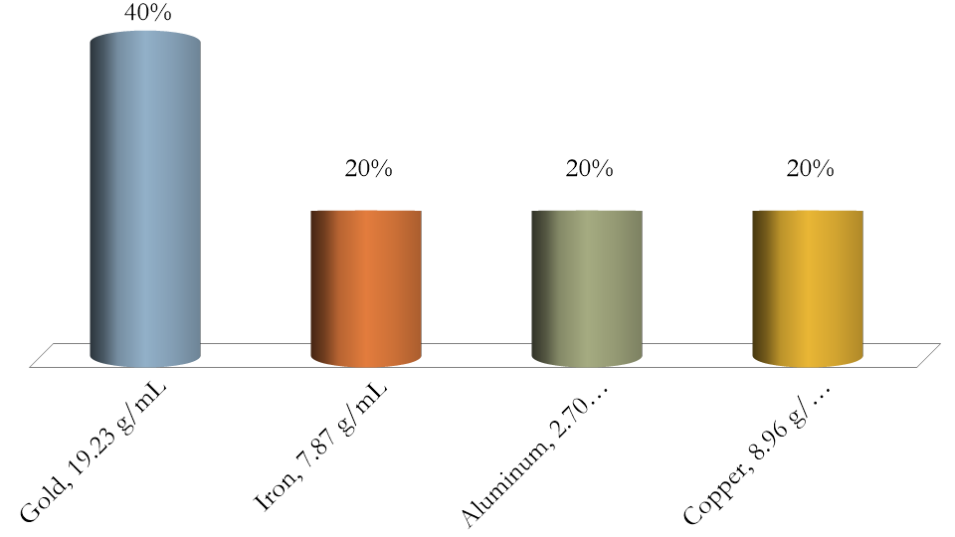
From homework question 6.23, use the density of the metal to identify it based on known metal densities given below.
Gold, 19.23 g/mL
Iron, 7.87 g/mL
Aluminum, 2.70 g/mL
Copper, 8.96 g/mL

Slide 10
Results for Scoring/Recording

Slide 11
Strategies to formatively assess student understanding in a low-threat environment
  Give frequent measures of their understanding of the course material
    This is useful and informs them whether or not they are adequately prepared, skilled and keeping up
    Especially true for freshmen who are still learning how to study
  Show formative assessment results
    Results shown are anonymous
      This helps students be honest in answering
      Helps them gauge their level of understanding
      Gives students a starting place to ask questions during tutoring or office hours

Slide 12
Strategies for using summative assessments where time-sensitive grading is a factor
  In large classes, a quick turnaround time for graded exams is tough unless the exams are partially auto-graded
    D2L has this feature but would allow internet access (take-home exam?)
  A possible solution - give exams partially or sometimes entirely on clickers with adjusted points preset on each question and always two versions of the same exam
    The time required to write, score, frontload and test the clicker exams is large and fraught with potential for human error
    The payoff is that students can get immediate exam scores upon exam completion, and the instructor can check for question reliability and statistical outcomes, and quickly determine who missed/skipped the exam

Slide 13
Practice Exam

Slide 14
Results for Scoring/Recording

Slide 15
Questions?

