Slide 1

ORU All Faculty
Professional Development
Tuesday, January 7, 2020
The Academy for Exceptional Teaching

Slide 2

Humanizing your
Online Course
http://bit.ly/ORUhumanize
Dr Jay Gary & Ms. Sasha Turtova
Online & Lifelong Learning, Oral Roberts University
Notes:
My name . . .
Role at ORU . . .

Slide 3
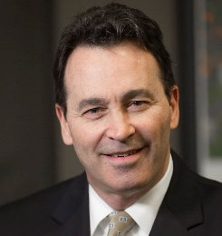

Your Presenters
Dr. Jay Gary
Ms. Sasha Turtova

Slide 4
Humanizing Your Online Course
Research suggests that building a strong sense of connectedness in an online course promotes student success, engages students, and retains students. This requires that you establish a strong teaching presence within the course, and that you create structures for students to form a community. In this workshop, we discuss strategies to make your online course more personal and techniques to build faculty and student presence in your online course.

Slide 5
Offline to Online
Definitions
Type of Course | Proportion Online | Description
Offline Traditional | 0% | Classroom, no online technology
Web Assisted | 1 to 29% | Web technology posts syllabus and grades
Blended / Hybrid | 30 to 79% | Enhance offline with online delivery, reduced meetings.
Online Learning | 80+% | Most or all content & discussions online. Flexible Interaction.
http://blogging.snhu.edu/leblanc/2018/10/unveiling-snhus-2018-2023-strategic-plan/

Slide 6
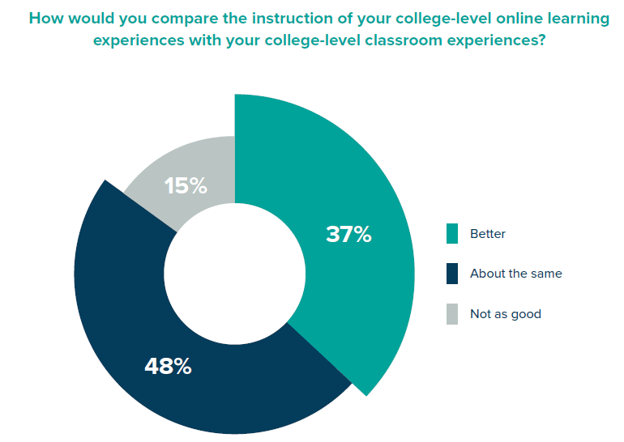
Comparing Offline to Online
Definitions
Learning House and Aslanian Market Research, June 2018

Slide 7
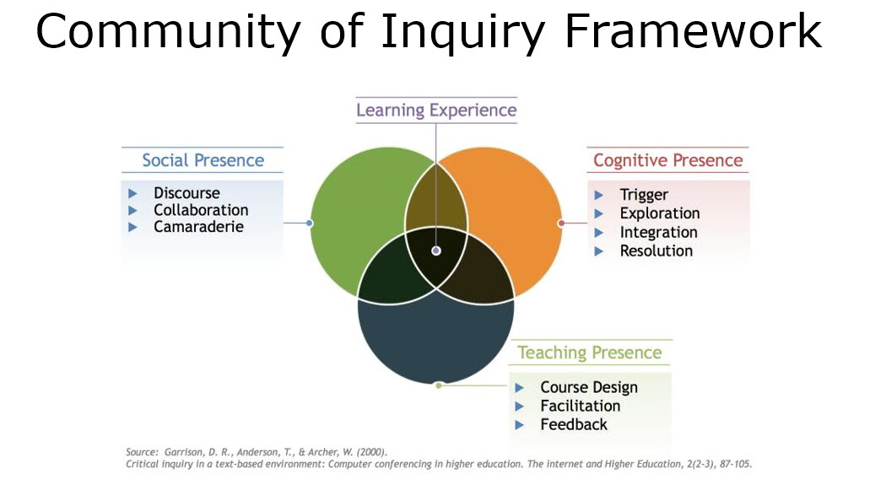
Community of Inquiry Framework
Research

Slide 8
Humanizing Your Online Course
1. How do we establish teaching presence in online courses?
2. How do we enhance off-line courses with online features?
3. How do we best scaffold learning in all courses?

Slide 9

Establishing Teaching Presence
Video
https://youtu.be/6HUIHMAIBS8
Notes:
https://youtu.be/6HUIHMAIBS8
Note: do not play the video from within the PP presentation itself. Instead, play it straight from YouTube or from where the video is located. When we played it from inside the PP presentation, it kept re-starting.

Slide 10
Interaction
How do we create teacher presence in online courses?
Notes:
Break into partners and come up with ideas, and then the gather them up front.

Slide 11
Offer a Course Calendar
Best Practices
Module 1 | Leadership Types | Hours | Weight
Wk. 1-2 | Study 1: DeGraff, Chp. 1-11 | 11 | --
 | Forum 1: Self-Assessment | 6 | 7%
 | Meet Up 1: Leader Workshop | 3 | 3%
 | Project 1: Leadership Action Plan | 16 | 15%
Module 2 | Leadership Teams | Hours | Weight
Wk. 3-4 | Study 2: Hartwig, Chp. 1-6; Cole, Chp. 1-2 | 11 | --
 | Forum 2: Team Building | 6 | 7%
 | Meet Up 2: Team Systems | 3 | 3%
 | Project 2: Team Functions | 16 | 15%
Module 3 | Leadership Challenges | Hours | Weight
Wk. 5-6 | Study 3: Hartwig, Chp. 7-11; Cole, Chp. 3-10 | 11 | --
 | Forum 3: Missional Structures | 6 | 7%
 | Meet Up 3: Community Ministry | 3 | 3%
 | Project 3: Team Ministry Proposal | 19 | 38%
Module 4 | Leadership Reflection | Hours | Weight
Wk. 7 | Study 4: Hartwig, Chp. 12-14; Cole, Chp. 11 | 5 | --
 | Forum 4: The Enlivened Self | 4 | 3%
 | Meet Up 4: Group Presentations | 2 | 3%
 | Project 4: Teaming Reflection | 9 | 8%
Course Total | Total estimated hours based upon average of 19 hours per week for 7 weeks. | 133 | 100%
Include Hours
& Weights

Slide 12
Maximize Student Engagement
Definitions
Level | In-Class Equivalents | Outside Study | Total Student Study Hrs.
Undergraduates (1 to 2) | 37.5 | 75 | 112.5
Master Level (1 to 2.5) | 37.5 | 93.75 | 131.25
Doctoral Level (1 to 3) | 37.5 | 115 | 152.5
= 16 hours a week for a 7-week Undergrad Level course.

Slide 13
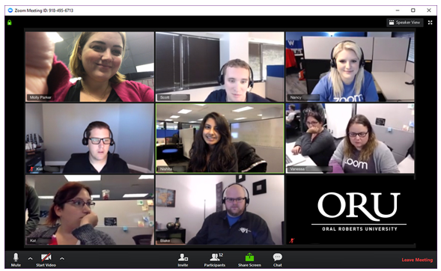
Host Live Zoom Meetings
Best Practices
Include Break Outs
Notes:
https://youtu.be/6HUIHMAIBS8
Note: do not play the video from within the PP presentation itself. Instead, play it straight from YouTube or from where the video is located. When we played it from inside the PP presentation, it kept re-starting.

Slide 14
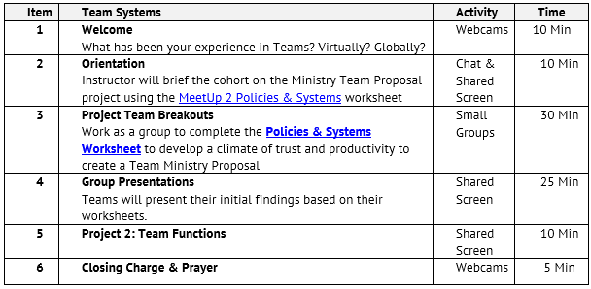
ZOOM Meeting - Example
Best Practices
Include Break Outs

Slide 15
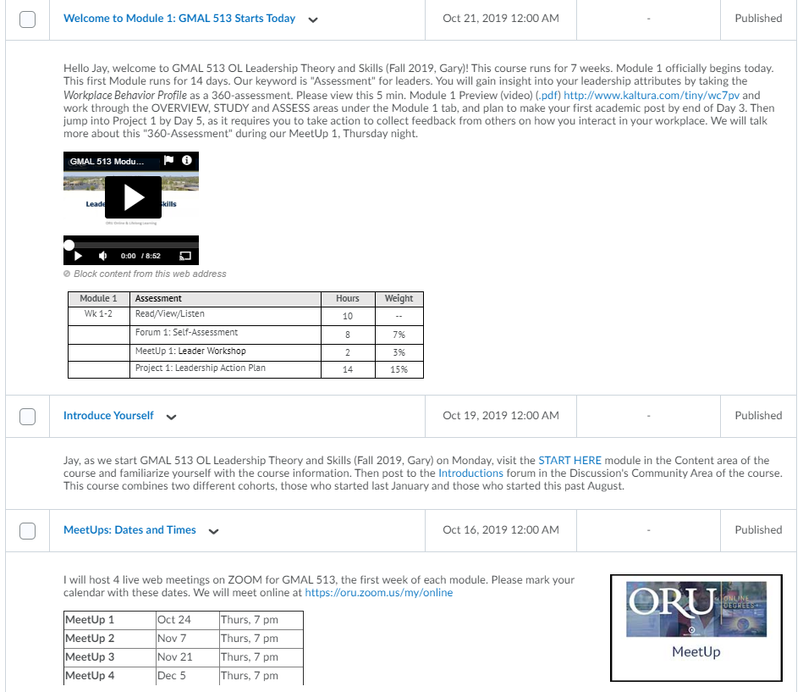
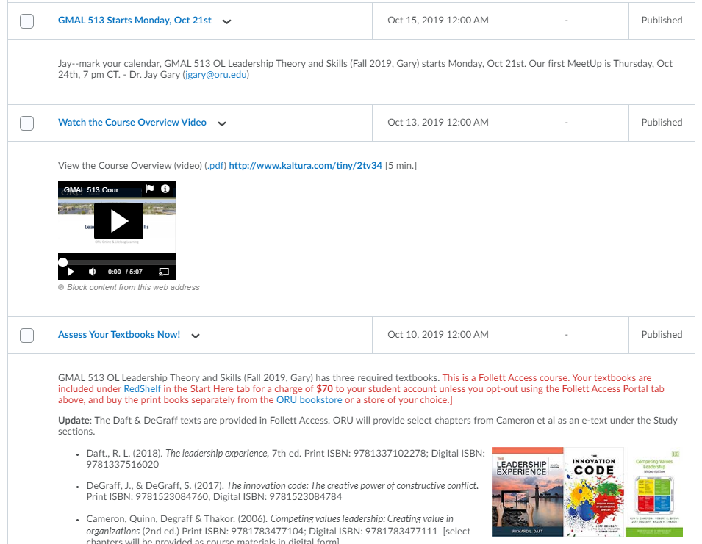
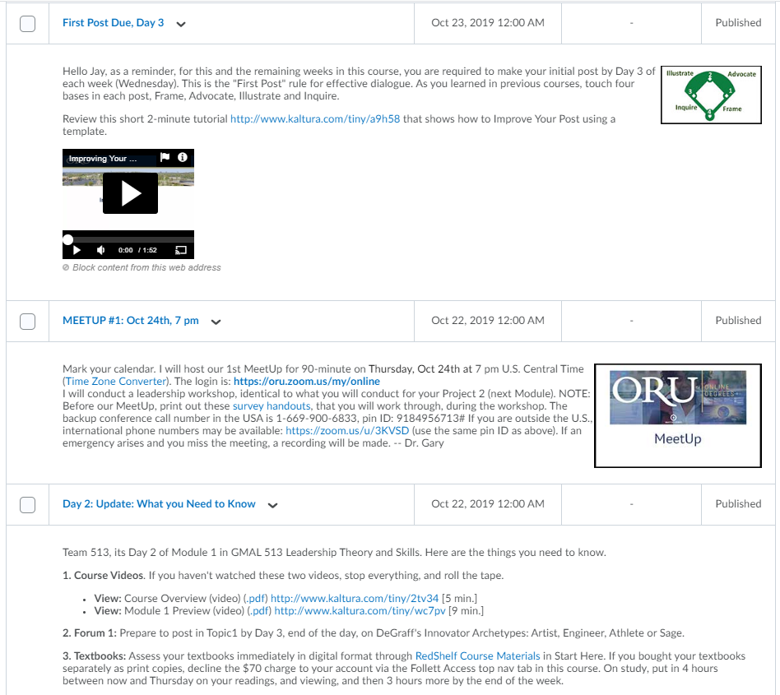
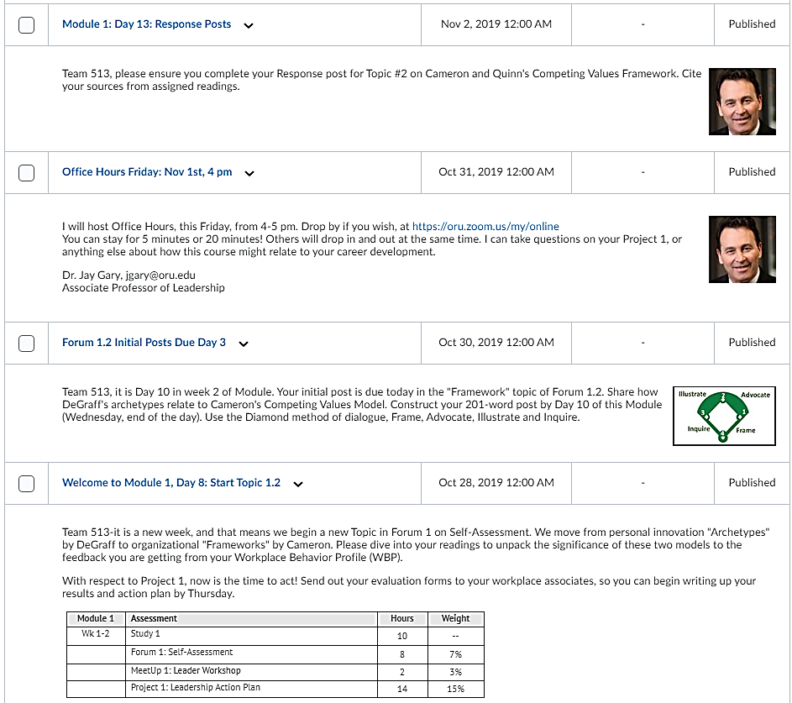
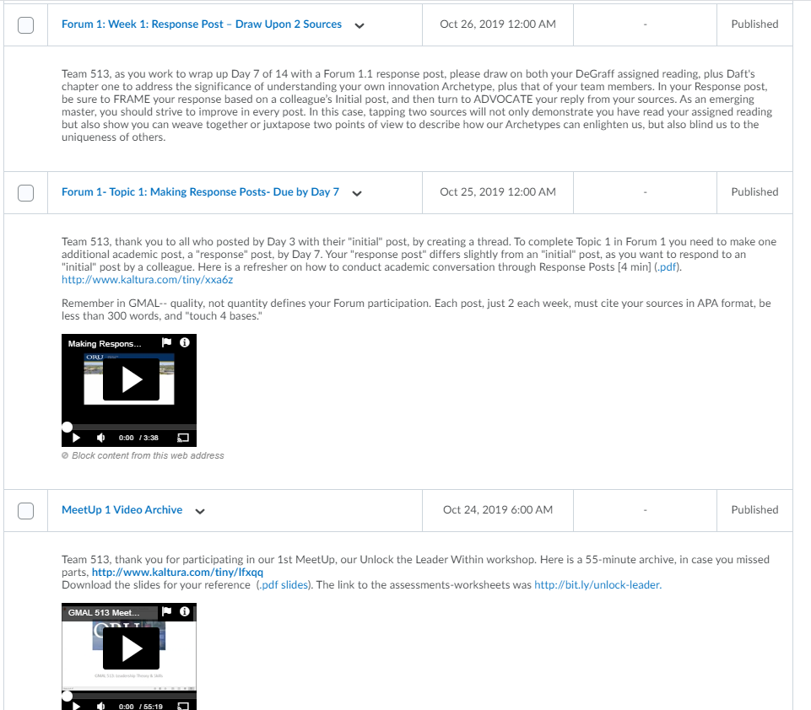
Teaching Presence: Using the News Tool
Best Practices
Use the News Tool

Slide 16
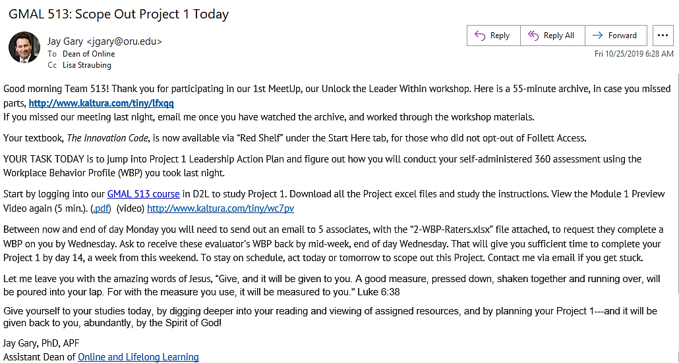
Teaching Presence: Using the Email Tool
Best Practices
Use the Email Tool

Slide 17
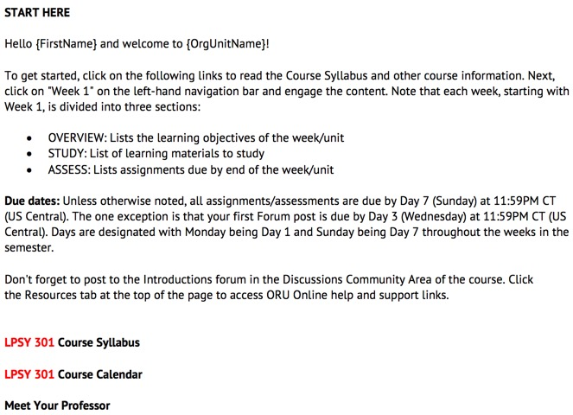
Curriculum Alignment
Include START HERE
tab.
Notes:
SRS 1.1 – Instructions make clear how to get started and where to find the various components.

Slide 18
Create Instructional Modules
Curriculum Alignment
Define a Learning Cycle
Learning Objectives
Instructional Content
Assessments
.
Notes:
Lunar Module

Slide 19
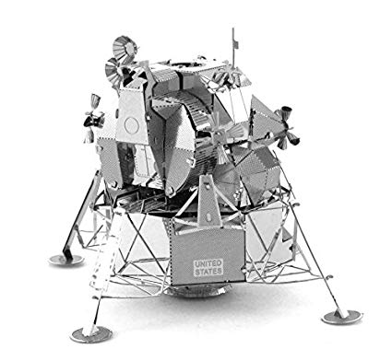
What is a Module?
Curriculum Alignment
An instructional module is a self-contained and self-sufficient unit of instruction for the learner to achieve a set of objectives.
Notes:
Lunar Module

Slide 20
Learning Objectives
Curriculum Alignment
Learning objectives are stated clearly, are written from the learner’s view, and are prominently located in the module.
Unit 2: OVERVIEW
This unit begins with assigned readings exploring the founding and structure of the American government system. We continue looking for evidence of Biblical Christian influence in American government by examining the Declaration of Independence and the Constitution (Gaddie and Dye 2018, Chapter 3). Then, we begin to dig more deeply into the details of the unique system of government in the United States by exploring federalism (Gaddie and Dye 2018, Chapter 4). Additionally, you will engage with primary sources of American history in order to comfortably examine historical facts for yourself, not simply through the interpretation of others.
After successfully completing this unit’s assignments, you should be able to:
2.1. Identify the Biblical principles embedded in the Bill of Rights (Forum 2).
2.2. Recall the basic structure of federalism in American government (Quiz 2).
2.3. Examine primary sources relevant to the Constitution and federalism
(Project 2a).
2.4. Select appropriate civic engagement activity (Project 2b).

Slide 21
Instructional Content
Curriculum Alignment
Module 1: STUDY
View: Course Overview Preview (video) (.pdf) http://www.kaltura.com/tiny/2tv34 [5 min.]
View: Module 1 Preview (video) (.pdf) http://www.kaltura.com/tiny/wc7pv [9 min.]
Read: DeGraff, J. & DeGraff, S. (2017). Innovation code. Chp. 1-11, pgs. 1-128. [4 hrs.]
Read: DeGraff, J. (2017). “How to lead innovation like superheroes. (.pdf) 12 pp. [10 min.]
View: Jeff DeGraff & Staney DeGraff. (2018). “The Innovation Code: The Creative Power Talks at Google" (Video) https://youtu.be/SEpIwlAvLLA [77 min]
Read: Daft, R. (2018). Leadership experience. Chp. 1-2, pp. 2-63 [2 hr.]
Read: Daft, R. (2018). Leadership experience, PowerPoints, Chp 1-2, (.pdf) [30 mins.]
View: Part-Time Economist. (2018), “Leadership Experience,” Part 1, Chp 1-3, (Video) https://youtu.be/9WRz3SdDdjY [16 min.]
View: Jeff DeGraff. (2012). “Competing Values Framework Introduction.” (Video) https://youtu.be/45veR-Se-rI [7 min.]
Read: Cameron, Quinn, Degraff & Thakor, Competing values leadership. (2nd Ed). Chp. 1-3, pp. 3-50. (.pdf) [1.5 hrs.]
View: Jeff DeGraff. (2010). “Competing Values Framework" (Videos)
-Yellow (Part 1) https://youtu.be/UUlE44242kU [14 min.]
-Blue (Part 2) https://youtu.be/sLp2FG_X12Y [13 min.]
-Red (Part 3) https://youtu.be/wUCUJoZTzPA [11 min.]
-Green (Part 4) https://youtu.be/Vg16T85-Z_Y [15 min.]
Study Items are listed, with study times and links, including videos.

Slide 22
Assessments
Curriculum Alignment
The assessments measure the achievement of the stated learning objectives.
After successfully completing this week’s assignments, you should be able to:
4.1. Examine how electoral structures influence campaign strategies and interest group activity (Forum 4)
Forum 4: Electoral College Reform
On four occasions in American history, the winner of the Electoral College vote, and thus the presidential election, did not with the popular vote – 1876, 1888, 2000, and 2016. Each time, discussions of reform are prompted by those who did not prefer the final result – in the name of democracy, of course. Some of the suggested possibilities for reform are discussed at the end of Chapter 8 (Gaddie and Dye 2018).
In your thread, consider the following questions: Should the Electoral College be reformed or eliminated? If not, why not? If you believe reform should take place, share your preferred reform and explain your reasoning. Remember to use appropriate evidence to justify your position. Chapters 2 and 3 (Gaddie and Dye 2018) may also be helpful in your search for evidence.

Slide 23
Assessments
Curriculum Alignment
After successfully completing this week’s assignments, you should be able to:
4.3 Evaluate a manager’s approach to leadership based on theory (Project 4).
The assessments measure the achievement of the stated learning objectives.
Project 4: Leadership Interview
Introduction: In this project, students will develop and conduct an interview with someone at least one level above their position to determine the individual’s approach to leadership.
Directions: Students will evaluate an interview with a leader, based on leadership theory. If you need to do a remote interview, use your ORU Zoom account to meet and record the session.
Using the questions you develop, create a short interview guide of 7 questions to help you understand your selected leader’s primary approach and philosophy of leadership.
Conduct the interview. Determine their leadership orientation and consider how that has influenced their managerial skills. Take good notes.
Write a 4-page essay to describe the leader, the interview, and key quotes that allow you to explain how events, opportunities, and/or crisis may have shaped this leader’s theory and influenced their team’s development.
Describe how that leader operates within the models and theories of leadership they have learned in this course.
Include your interview questions an Appendix to your report.
Your paper should be 4-pages in length, written in APA Style, with at least 3 citations.

Slide 24
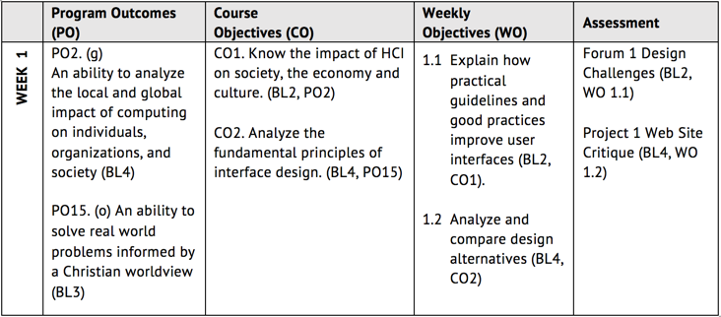
Alignment Grid
Curriculum Alignment
Assessments should be sequenced, varied, and suited to the level of the learners.
Notes:
3.1 The assessments measure the achievement of the stated learning objectives or competencies.
Alignment: Course assessments (ways of confirming learner progress and mastery) are consistent with the course and module/unit-level learning objectives or competencies (2.1 and 2.2) by measuring the accomplishment of those objectives or competencies. Instructional materials (4.1), learning activities (5.1), and course tools (6.1) support the learning objectives or competencies and enable learners to be successful on the assessments.
From the types of assessments chosen, it is clear that learners can successfully complete the assessments if they have met the objectives or competencies stated in the course materials and learning activities.

Slide 25
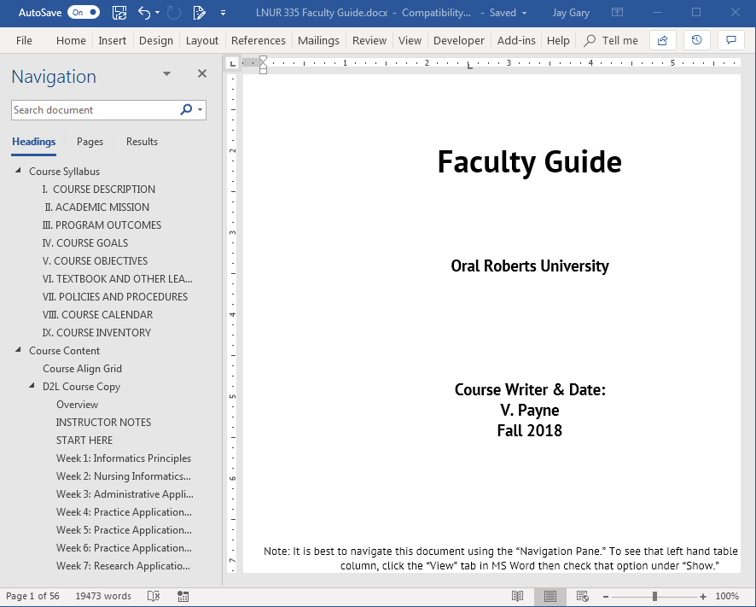
Faculty Guide
Curriculum Alignment
At ORU, we use one document to write a curriculum, that is turned into an online course.

Slide 26
Let’s pause . . .
Questions?
Comments?

Slide 27
Humanizing Your Online Course
1. How do we establish teaching presence in online courses?
2. How do we enhance off-line courses with online features?
3. How do we best scaffold learning in our courses?

Slide 28
Offline to Online
Definitions
Type of Course | Proportion Online | Description
Offline Traditional | 0% | Classroom, no online technology
Web Assisted | 1 to 29% | Web technology posts syllabus and grades
Blended / Hybrid | 30 to 79% | Enhance offline with online delivery, reduced meetings.
Online Learning | 80+% | Most or all content & discussions online. Flexible Interaction.
http://blogging.snhu.edu/leblanc/2018/10/unveiling-snhus-2018-2023-strategic-plan/

Slide 29
Interaction
How could we use Online to enhance our Offline course?
Notes:
Break into partners and come up with ideas, and then the gather them up front.

Slide 30
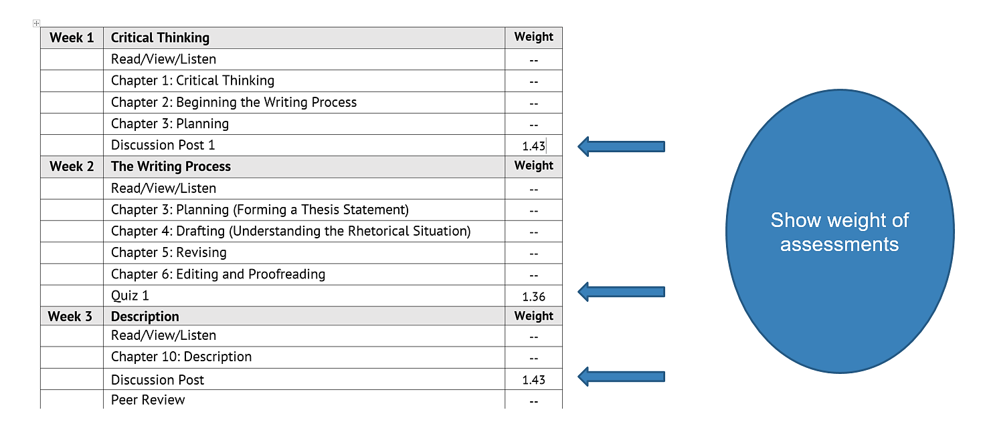
Build Course Calendar

Slide 31
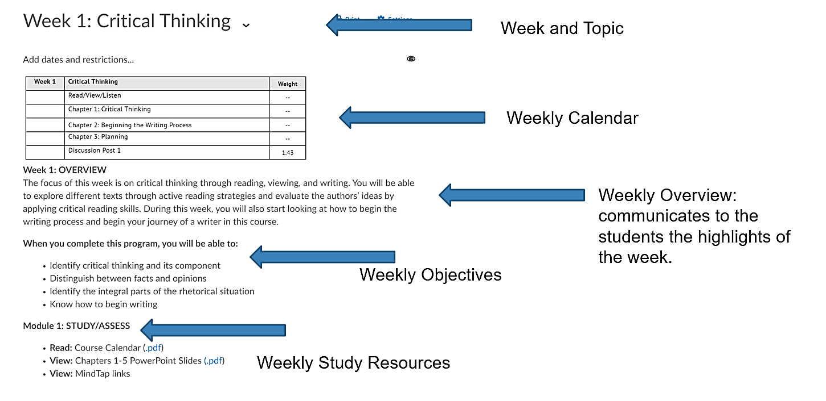
Build Weekly Course Content

Slide 32
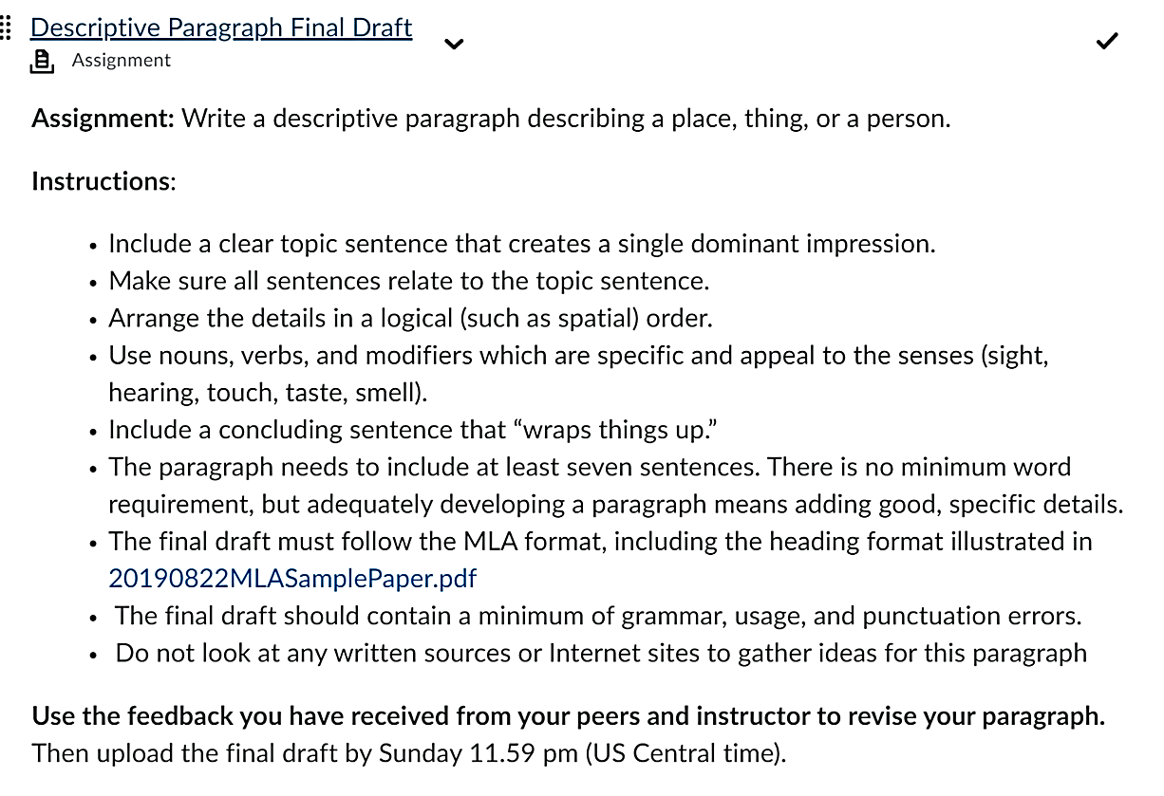
Publish Assignment Instructions

Slide 33
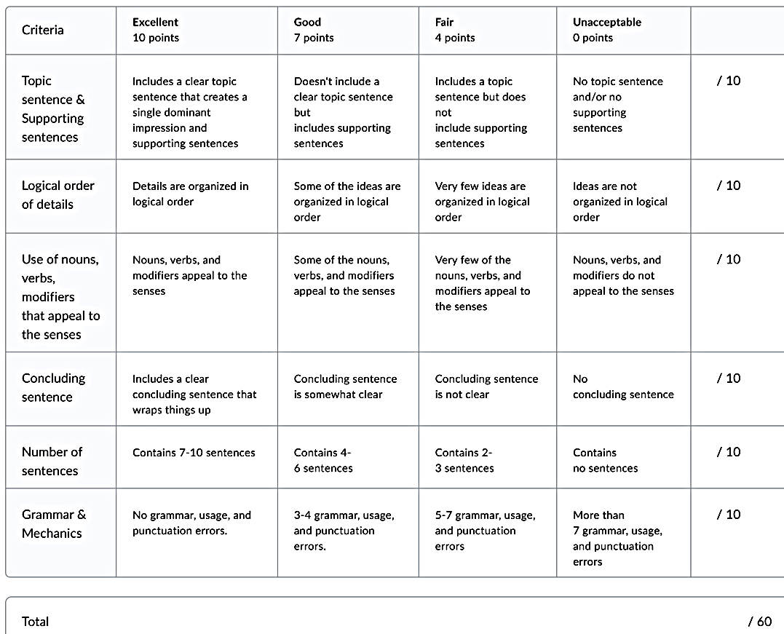
Utilize D2L Grading Rubrics

Slide 34
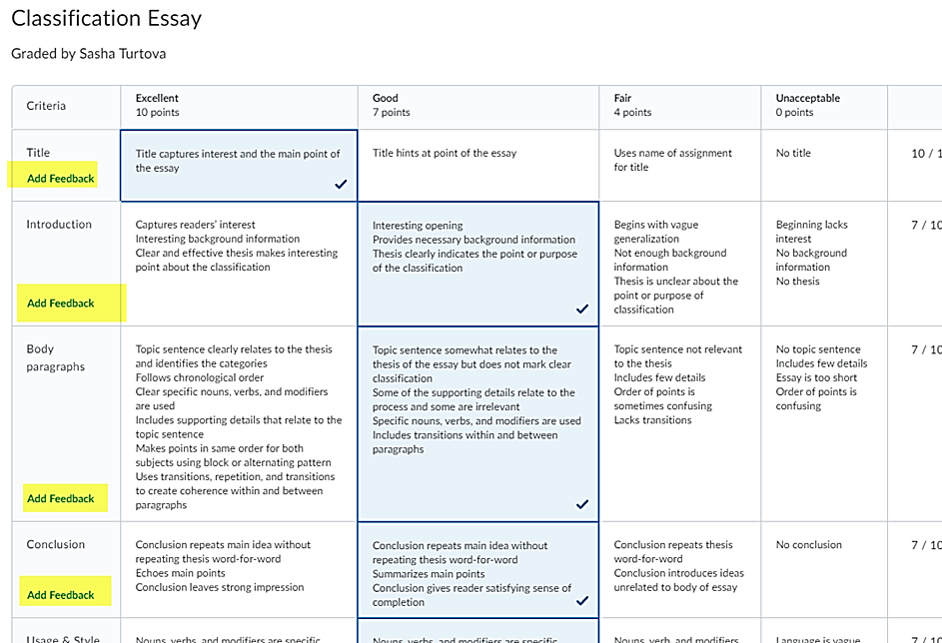
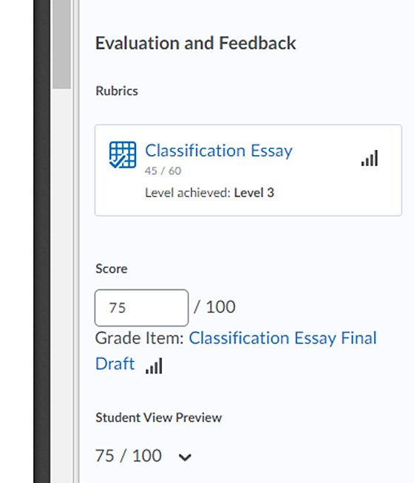
Grading with D2L Rubrics

Slide 35
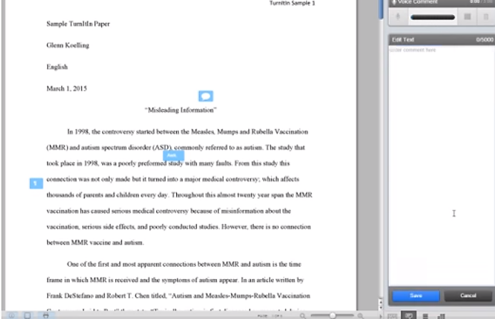
Formative Feedback and Turnitin
Turnitin provides the tools for:
  Checking for similarity and plagiarism
  timely feedback (not weeks later)
  specific and relevant feedback (tied to a specific task or product)
  Actionable feedback (student writers should walk away with a clear idea of what they can DO in response to teacher feedback)
  TurnItIn Instructor Tutorial, Northwest College, https://youtu.be/kbAUE7ddh5I

Slide 36
Allow Multiple Opportunities for Success

Slide 37
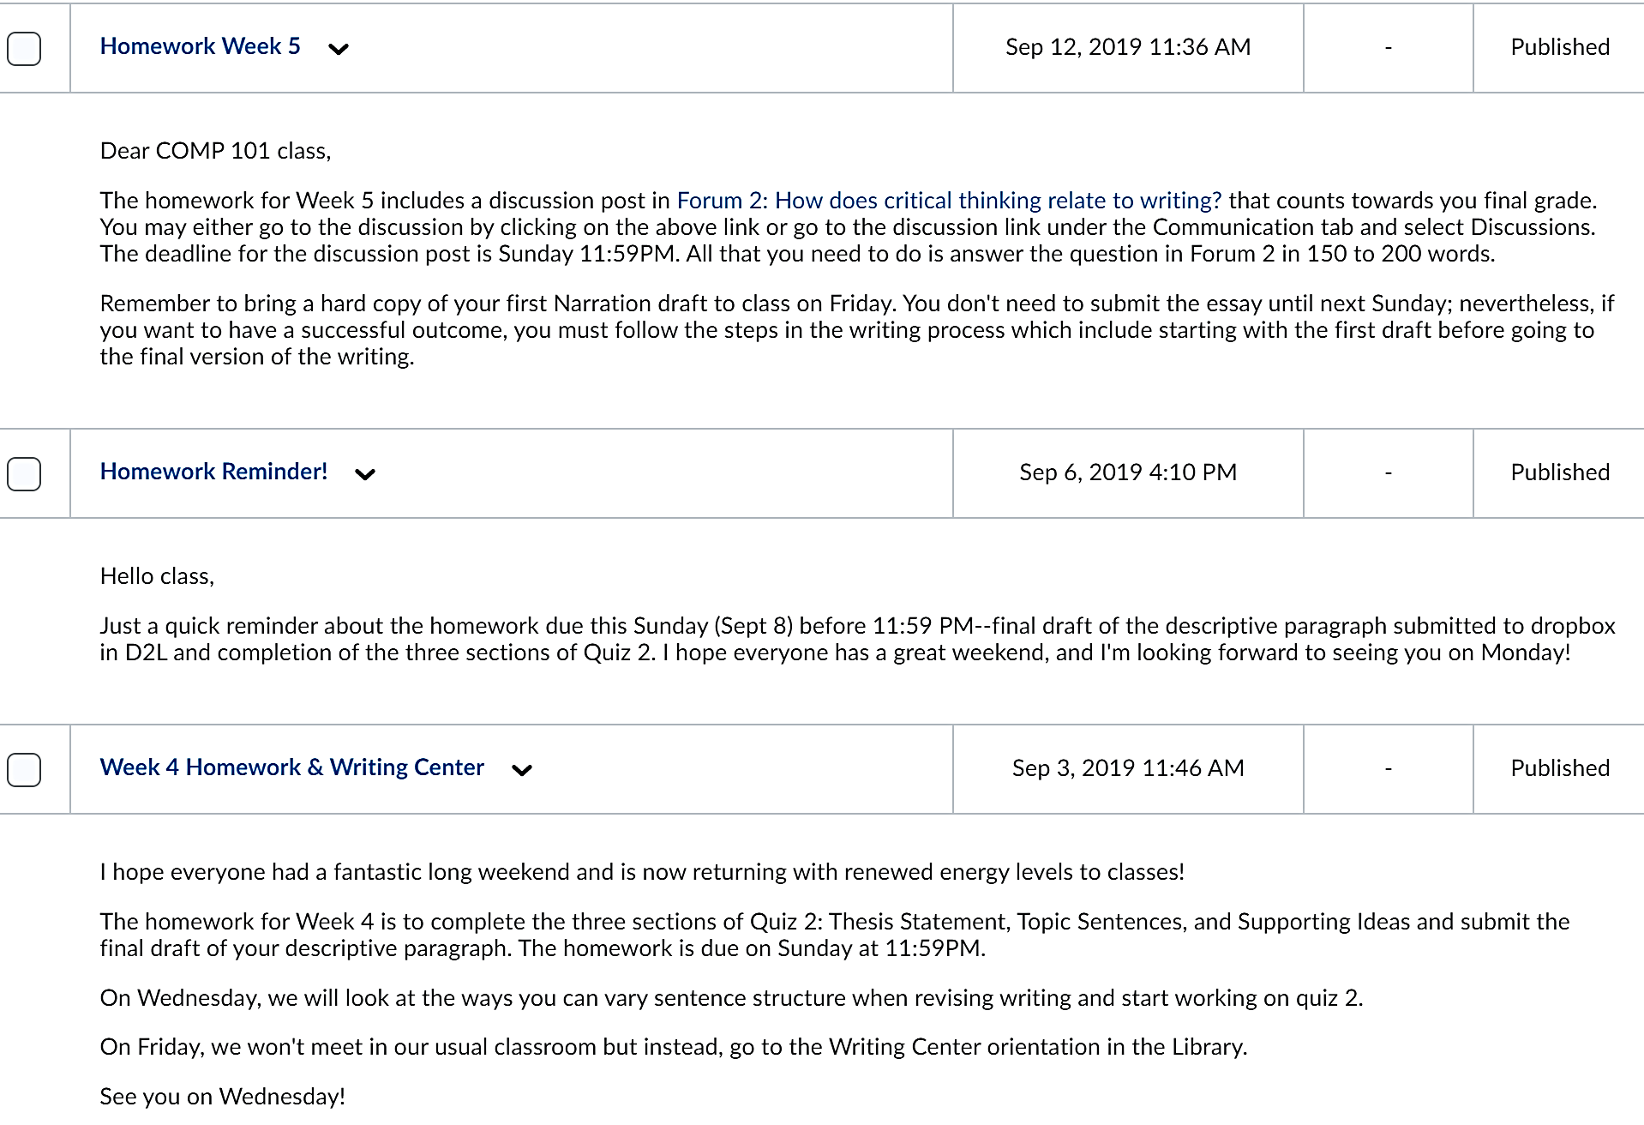
Schedule Weekly Announcements
Using the Weekly Content, you can create and schedule course announcements for each week to keep students on track.

Slide 38
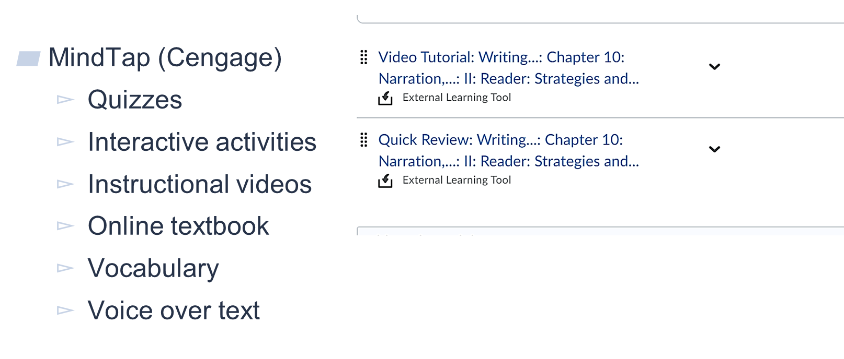
Use Digital Content

Slide 39

PowerPoint Slides & Presentations

Slide 40
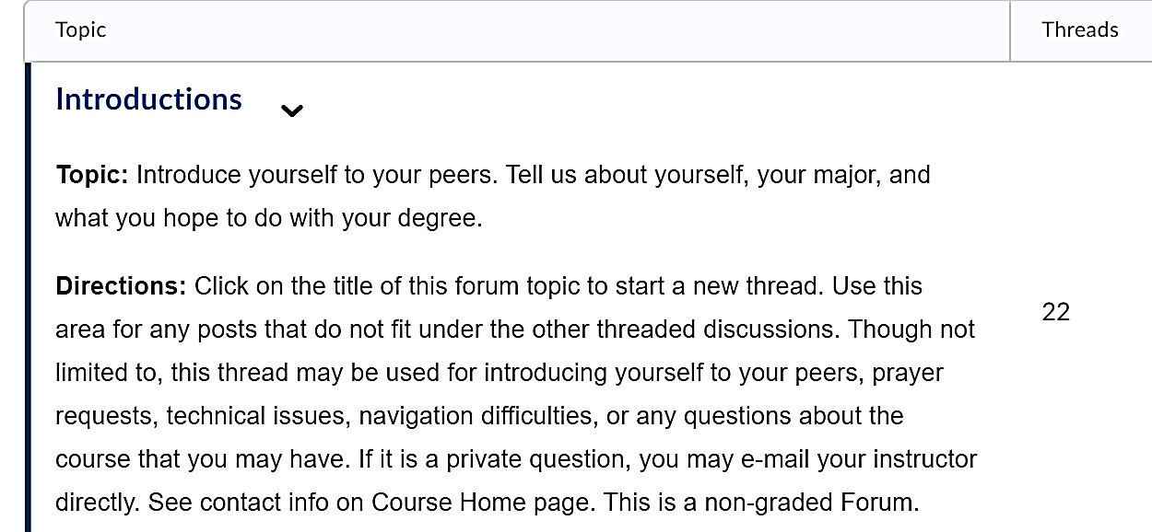
Provide Dialogue Opportunities

Slide 41
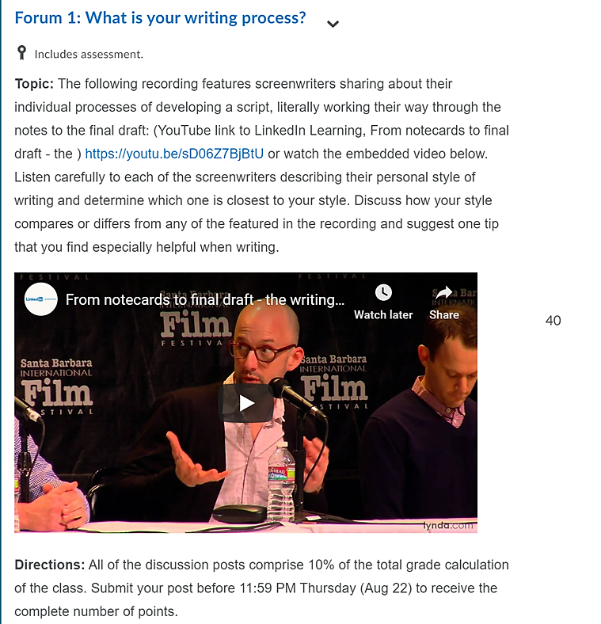
Provide Dialogue Opportunities
You can post questions, embed available online videos, and build discussion forums in your course to supplement class discussions and extend opportunities for dialogue beyond the classroom.

Slide 42
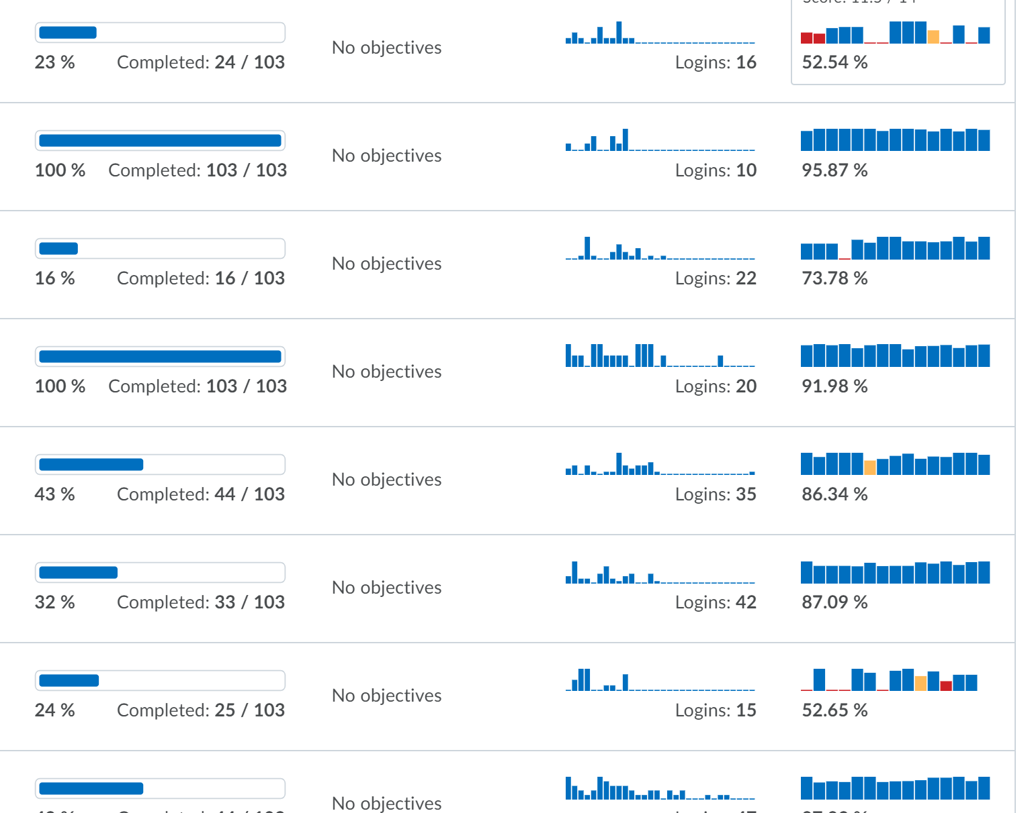
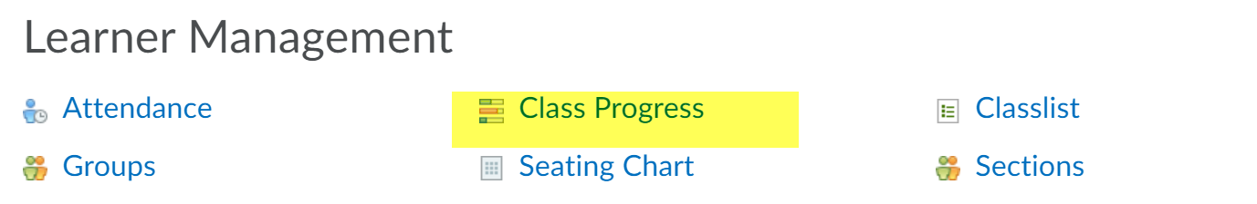
Monitor Individual Progress
Use D2L to monitor class and individual learner’s progress:

Slide 43
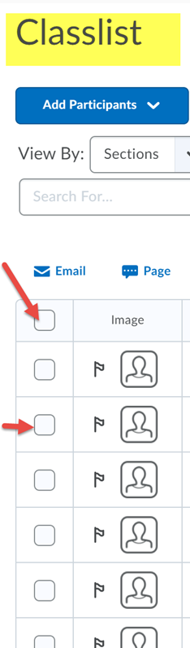
Offline Courses
You can easily communicate with your students through the built-in email in D2L. Just go to Communication, click on Class list, find the name of the student or sent a mass email to everyone in the class.
,
Communicate with Learners
Notes:
Lunar Module

Slide 44
Let’s reflect . . .
What are two ideas that you can take back to your offline course from this session?

Slide 45
Humanizing Your Online Course
1. How do we establish teaching presence in online courses?
2. How do we enhance off-line courses with online features?
3. How do we best scaffold learning in our courses?

Slide 46
Community of Inquiry Framework
Research

Slide 47

INSTRUCTIONAL
SCAFFOLDING
Instructional Support For Optimal Learning
Multi-Dimensional Learning Balance
Reach Beyond Current Knowledge Capacity
Supportive Anchor Points Provide Firm Foundation
Faculty Serve As Mentor/ Facilitator of Knowledge

Slide 48

Types of Assessment
FORMATIVE
SUMMATIVE
REFLECTIVE

Slide 49

FORMATIVE
SUMMATIVE
To Help Form and Shape Learning
To Evaluate Student Knowledge
To Improve Student Performance
To Measure Student Proficiency
To Identify & Close Gaps in Student Learning
To Identify & Close Gaps in Curriculum Design

Slide 50

REFLECTIVE ASSESSMENTS
To Expand Self- Awareness of Learning Comprehension
To Empower Students as Expert Assessors of Learning
To Recapture & Evaluate Learning Experiences
To Increase Metacognition; To Know What We know

Slide 51
ASSESSMENT DESIGN
FORMATIVE ➔ SUMMATIVE ➔ REFLECTIVE
FORMATIVE
REFLECTIVE
Intro
Project 2
Project 4
Project 1
Project 3
FORMATIVE
SUMMATIVE

Slide 52
SCAFFOLDING DASHBOARD
PROJECT 1
FORMATIVE
UNDERSTAND
PROJECT 2
FORMATIVE
APPLY & ANALYZE
PROJECT 3
SUMMATIVE
EVAULATE & CREATE
PROJECT 4
REFLECTIVE
DEBRIEF
Supportive Learning Structure
Maintains Learning Focus
Deeper Learning & Discovery
Engages & Motivates Students
Reduces Anxiety & Uncertainty
Creates Learning Momentum

Slide 53

FORMATIVE ASSESSMENTS


●
❍
ARTICLE
Write Short Popular Press Article
CASE STUDY
Design Study;
Research Subjects
COOPERATIVE
Assemble Team;
Develop Project
MIND MAP
Identify Subject Relationships
■
□
❐
❑
MENTAL MODELS
Identify Client Bias; Thinking Framework
MULTI-MEDIA
Develop Content for Media
PANEL/EXPERT
Develop Approach; Q&A for Interview
PROPOSAL
Identify Problem & Potential Solution
❒
⬧
⑪
⑫
REPORT RESEARCH
Develop Research;
Current/Future State
STUDY PREP
Questions; Issue Brief; Hypothesis
CONDUCT TOOL
Complete Business Tool with Client
PRE WORKSHOP
Create PPT; Workshop Tools

Slide 54
SUMMATIVE ASSESSMENTS


●
❍
ARTICLE
Longer Research-Based Article
RESEARCH STUDY
Research Report; Scenario Outcomes
COOPERATIVE
Present Team
-Based Project
SYSTEMS MAP
Visual Map of Complex Systems
■
□
❐
❑
MM1 TO MM2
Required Shifts For Current/Future State
MULTI-MEDIA
Present Content in A/V or Social Media
PANEL/EXPERT
Conduct Interviews; Q&A with Experts
PROPOSAL
Develop Proposal & Value Justification
❒
⬧
⑪
⑫
REPORT
Prepare Client Analysis Report
CONDUCT STUDY
Test Hypothesis & Analyze Results
TOOL REPORT
Analysis; Business Tool Findings
WORKSHOP
Conduct Group Learning Workshop

Slide 55
REFLECTIVE ASSESSMENTS


●
❍
ARTICLE
Article Submission; Social Media Post
RESEARCH REVIEW
White Paper; Issue Brief; Media Post
COOPERATIVE
Lessons Learned on Team Project
MIND MAP
Map Entire Visual Representation
■
□
❐
❑
BIAS INSIGHTS
Role of Bias in Strategy Formation
MULTI-MEDIA
Social Media Broadcast
PANEL/EXPERT
Interview Follow up Report; Next Steps
PROPOSAL
Present Proposal; Implementation
❒
⬧
⑪
⑫
REPORT BRIEF
Present Report Findings to Client
POST STUDY
Key Findings Report; Media Synopsis
TOOL PLAN
Performance Action Plan; Dash Board
POST WORKSHOP
After Action Report; Lessons Learned

Slide 56
Continuous Improvement
Evaluate
Build/Redesign
01
Teach
Faculty & designer interaction throughout the development
When the course is taught the first few times, there will be new ideas that the faculty member will have regarding improvements
04
02
Redesign
Collect Data
03
Iterative design leads to improved learning and teaching experiences
Student survey results, student time on task, best student work, D2L data, QM scorecard
Source: iDesignedu.org

Slide 57
Humanizing Your Online Course
1. How do we establish teaching presence in online courses?
2. How do we enhance off-line courses with online features?
3. How do we best scaffold learning in our courses?

Slide 58
Discussion
Dr. Jay Gary
jgary@oru.edu
Ms. Sasha Turtova
aturtova@oru.edu

Slide 59
Humanizing your
Online Course
http://bit.ly/ORUhumanize
Dr Jay Gary & Ms. Sasha Turtova
Online & Lifelong Learning, Oral Roberts University
Notes:
My name . . .
Role at ORU . . .

Slide 60

Why is Online Attractive?
Benefits
https://visual.ly/community/infographic/education/benefits-online-education

Slide 61
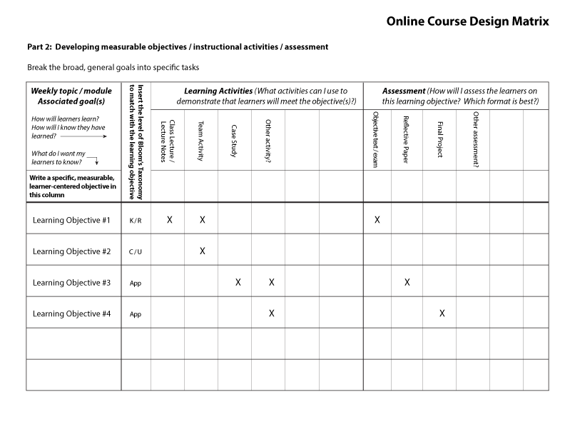
Scaffolding
Notes:
3.1 The assessments measure the achievement of the stated learning objectives or competencies.
Alignment: Course assessments (ways of confirming learner progress and mastery) are consistent with the course and module/unit-level learning objectives or competencies (2.1 and 2.2) by measuring the accomplishment of those objectives or competencies. Instructional materials (4.1), learning activities (5.1), and course tools (6.1) support the learning objectives or competencies and enable learners to be successful on the assessments.
From the types of assessments chosen, it is clear that learners can successfully complete the assessments if they have met the objectives or competencies stated in the course materials and learning activities.

Slide 62
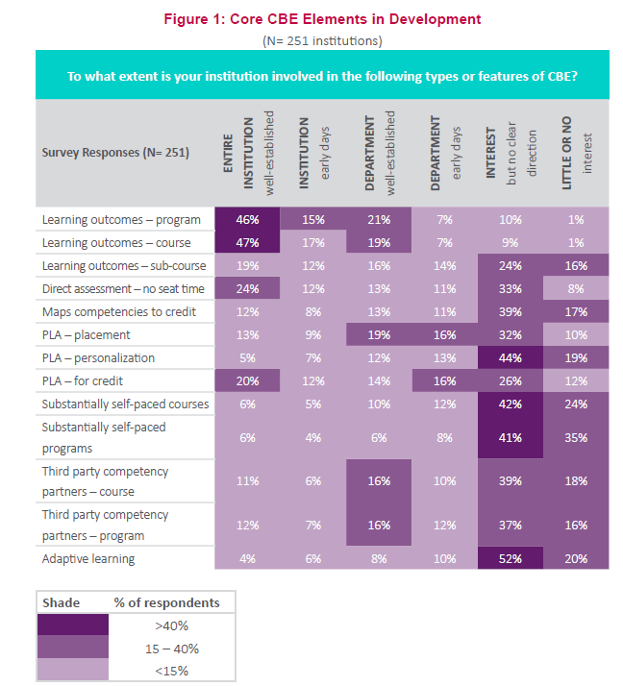
How Ready are we to Create Modules?
Source: 2018, EV CBE Gap Analysis

Slide 63
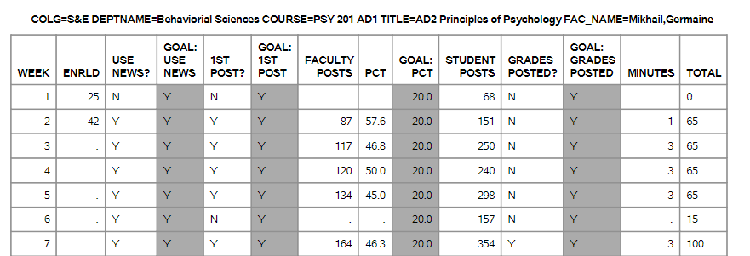
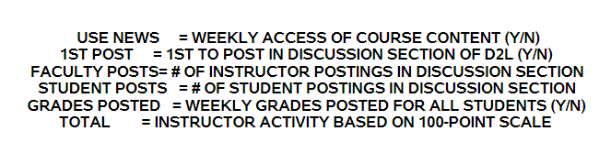
Faculty Activity Reports

Slide 64
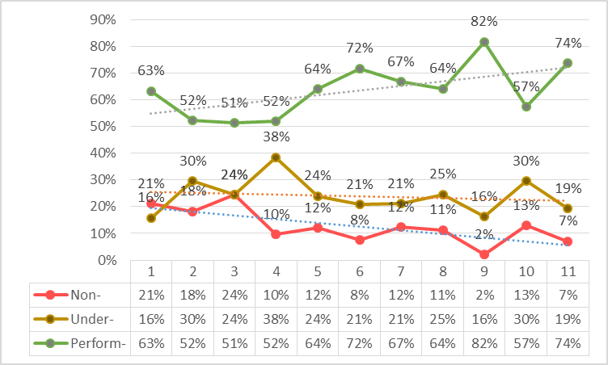
Faculty Performance
2 yrs. avg. =
63% Performing < 100 total
24% Under-Performing < 60 total
13% Non-Performing < 40%
We categorize online faculty performance as non-, under- or performing, based on <40, <60, <100
* This chart presents data for 11 terms, nearly 2-years, from Summer A 2016 (#1) to Spring A 2018 (#11).
* What is success? 70% performing, and < 8% non-performing out of 57 faculty
* Two of the last 3 terms have been the best performance over the past two years, Spg A 18 and Fall A 17

Slide 65
Instructional Design
Design
Design
  Consider Framing Questions
  Analyze the Performance Space
  Content, Competencies, Outcomes
  Specify Delivery System
Develop
  Write Learning Objectives
  Develop Learning Assessments
  Specify Learning Activities
Evaluate
  Deliver Instruction
  Conduct internal & External Evaluation
  Revise System & Instruction

Slide 66
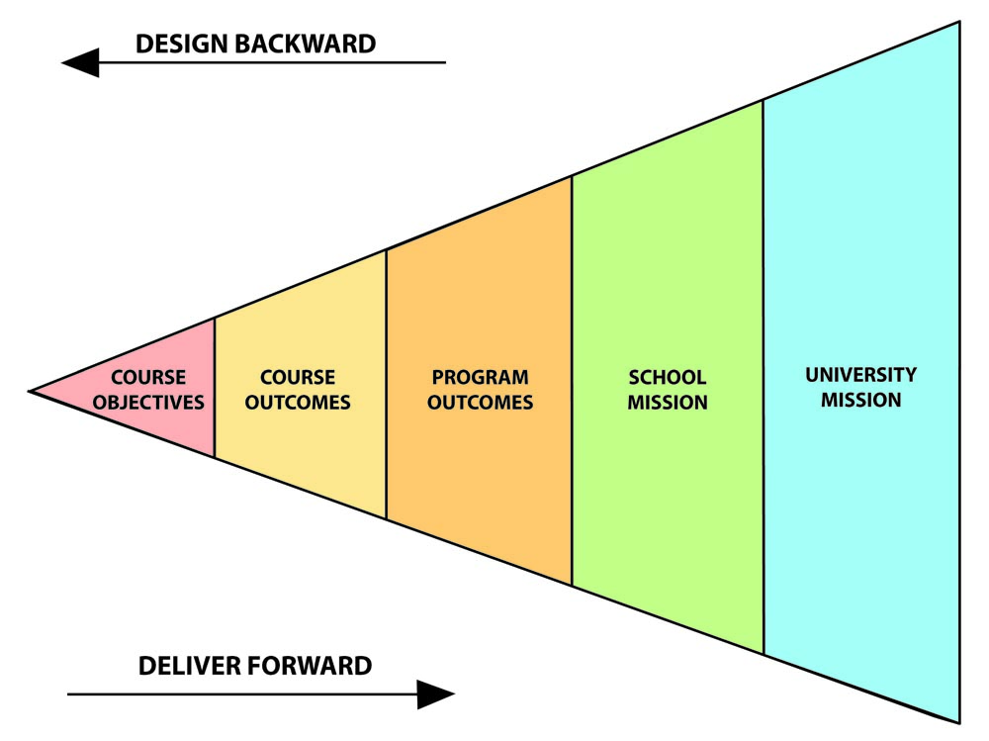
Design Backward, Deliver Forward
Design

Slide 67

Design Backward
Design
1
2
Identify
Desired
Results
3
Determine
Acceptable
Performance
Plan curriculum,
experiences &
Instruction
Objectives
KSA’s
Assessment
Activities
© 1998 Grant Wiggins and Jay McTighe

Slide 68
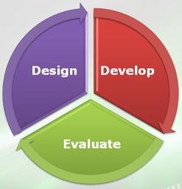
Instructional Design
Design
Performance
Space
Learning
Space

Slide 69
According to research . . .
“In order to create an intentionally inviting online environment, courses need to have a clear and consistent structure that offers intuitive navigation.”
- Inside Higher Ed. (2017)
Notes:
The course’s look can be intentionally inviting, intentionally disinviting, unintentionally inviting or unintentionally. Often times instructors have a lot of information that needs to be crammed into the online learning environment, which can create a disinviting learning environment. In order to create an intentionally inviting online environment, courses need to have a clear and consistent structure that offers intuitive navigation. – Inside Higher Ed, March 15, 2017 https://www.insidehighered.com/digital-learning/advice/2017/03/15/4-expert-strategies-designing-online-course
We realized our courses needed better design, based on best practices, a consistent layout, so students could navigate easily and find what they needed, and of course the delivery (which needed to go hand in hand with the design)

