Slide 1
How to Foster Resilience in Students
DR. HALEY FRENCH, LPC & MS. RACHEL OJEDA, LPC
ORU STUDENT COUNSELING SERVICES

Slide 2


Life as a River

Slide 3
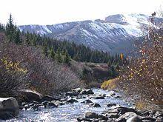
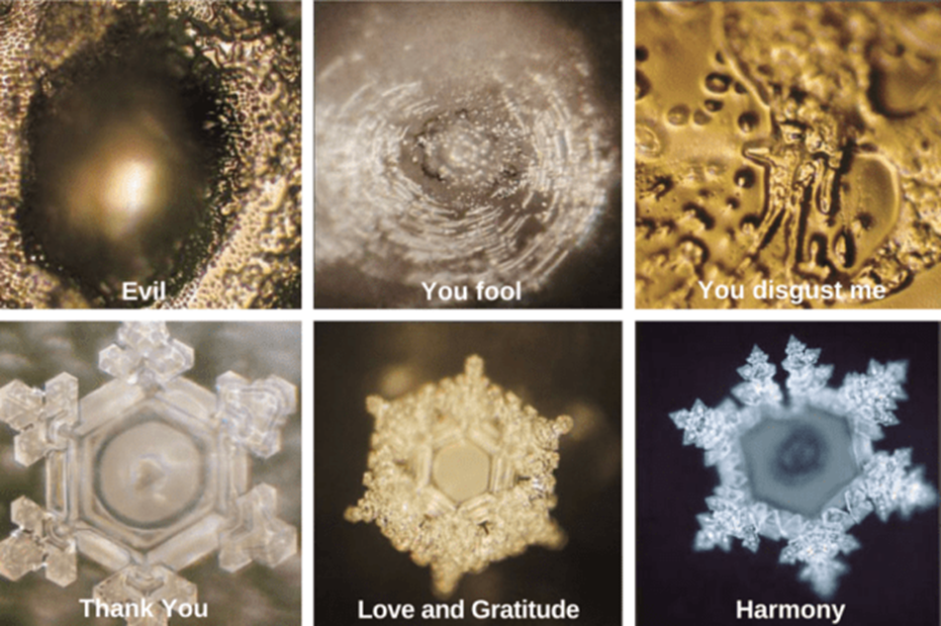
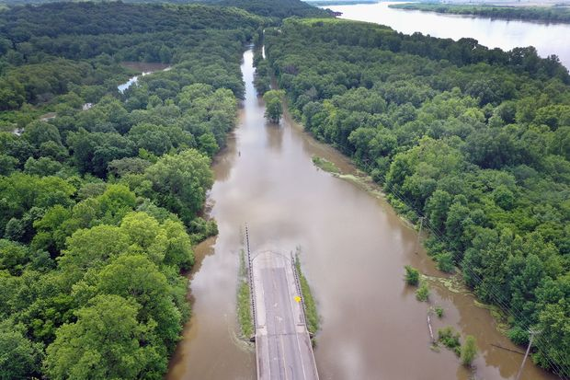
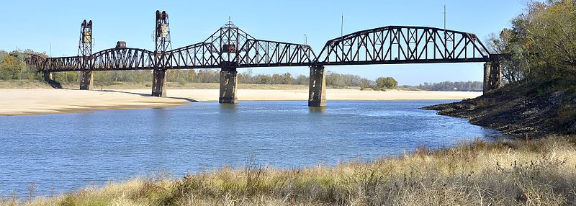
Helpers & Inhibitors to Flow

Slide 4
Defining Resilience: What is it?
“Resilience is the process of adapting well in the face of adversity, trauma, tragedy, threats or significant sources of stress— such as family and relationship problems, serious health problems or workplace and financial stressors. It means ‘bouncing back’ from difficult experiences” (American Psychological Association, 2019).
  Resilience is not extraordinary, but a “common phenomenon arising from ordinary human adaptive processes” (Masten, 2001, p. 234).
  Resilience does not mean that a person does not experience adversity. In fact, the development of resilience must involve a ‘threat’ to which the individual adapts (Masten, 2001).
  Resilience is not ‘innate’ in some people and absent from others. It can be developed and learned by anyone, and it involves thoughts, actions, and behaviors.
  (American Psychological Association, 2019, https://www.apa.org/helpcenter/road-resilience)

Slide 5
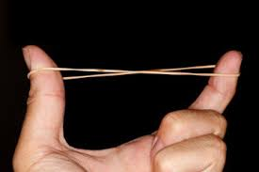
Resilience
“Stems from the Latin word resilire (to rebound)”… “referring to the property of elasticity or springing back, much as a rubber band does after it’s stretched…” (Masten, 2014, p. 9)
“In engineering science, materials are said to be resilient when they resist cracking or breaking under stress or return to original form after distortion by stress or load…” (Gunederson, Folke, & Janssen, as quoted in Masten, 2014, p. 9).
“…referring to the process of successful transformation to a stable new functional state…” (Masten, 2014, p. 9).

Slide 6
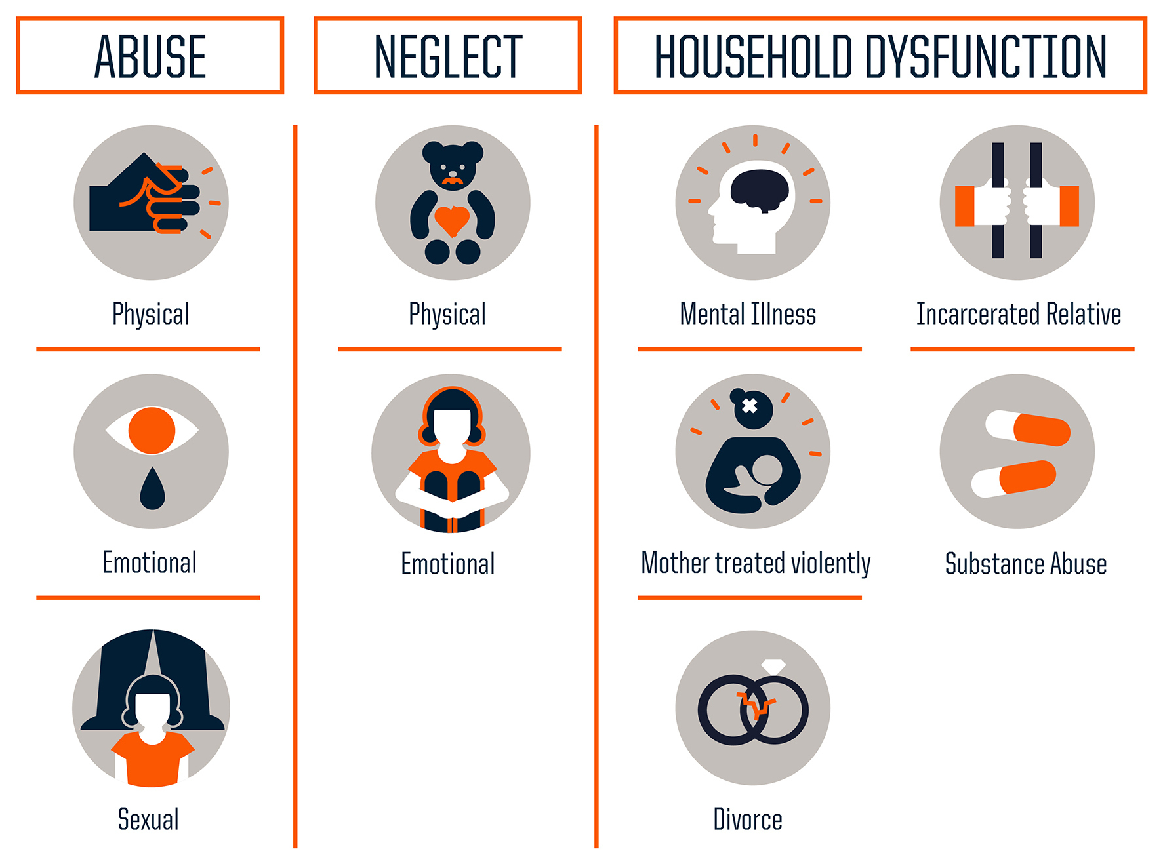
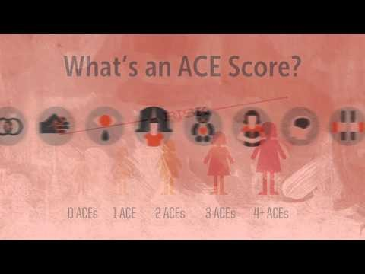
ACEs
(Adverse Childhood Experiences)

Slide 7
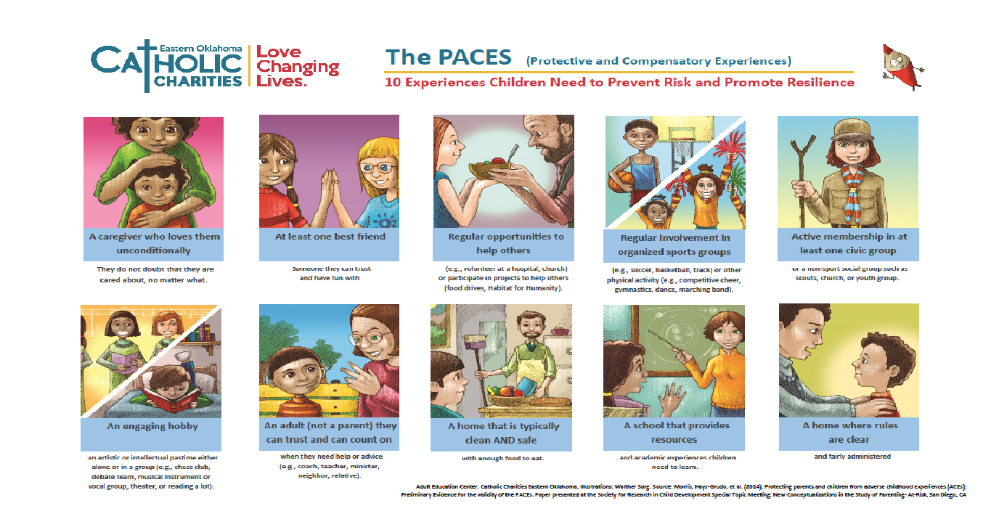
PACEs (Protective and Compensatory Experiences)

Slide 8
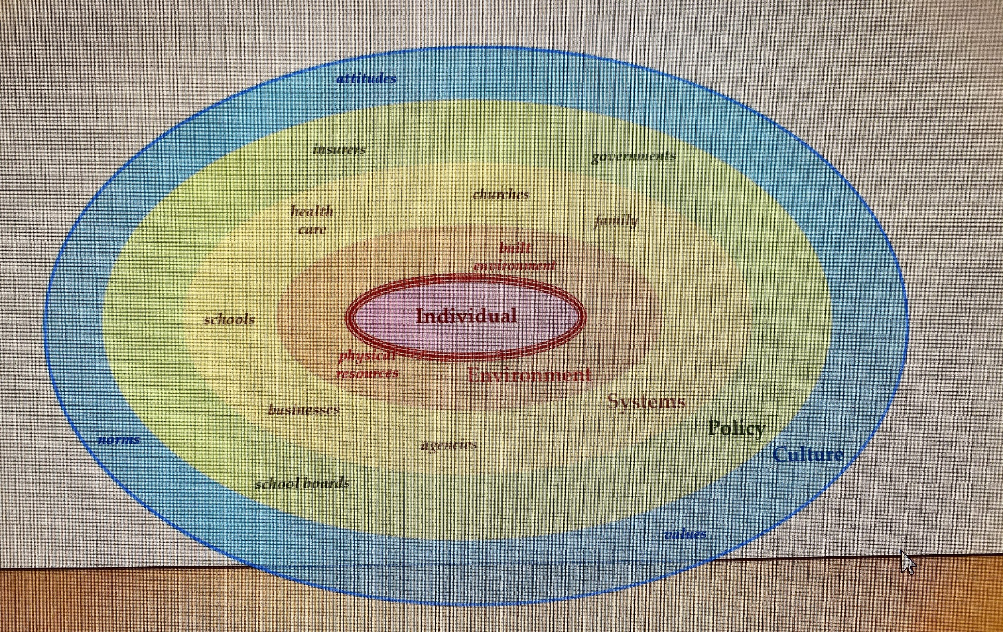
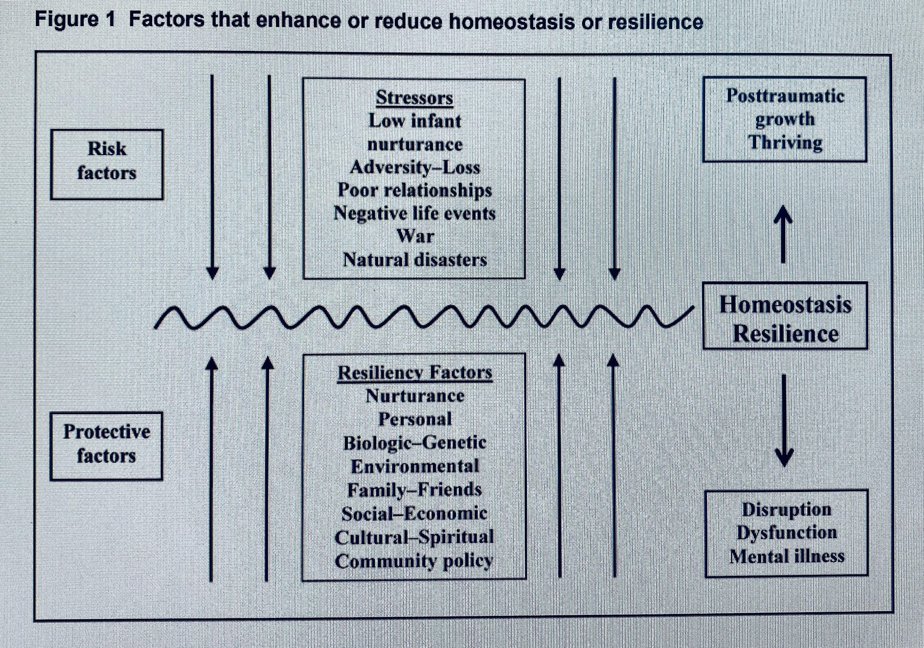
Nested development & Nested Support Systems
Resilience is not cultivated by one thing or person in one context. It is cultivated through a network or layered ‘nest’ of systems. YOU are a part of the support system that can act as a protective measure against the effects of adversity in ORU students’ lives.
(Hays-Grudo & Slocum, 2018)
Herrman et al. (2011)

Slide 9
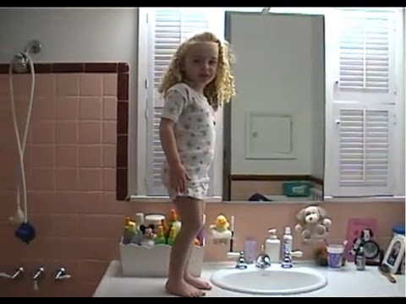
Contributing Factors to Resilience
A healthy human brain in good working order
Close relationships with competent, caring adults
Committed families
Effective schools & community
Opportunity to succeed
Belief in self nurtured by positive interaction with the world
(Masten, 2014)

Slide 10

Students carry a lifetime of experience into the classroom
We can assist students in learning how to off-load the ‘SAS’ (stress, anger, and sadness) that they carry by learning how to cope positively

Slide 11
Stages of Development & Resilience
Identity vs. Role Confusion (Erikson, 1950)
Intimacy vs. Isolation (Erikson, 1950)
“Competence begets competence” (Masten, 2014, p. 73).
The transition to adulthood is a time in which a “convergence of opportunities and maturation of function” occurs that is “conducive to positive redirection of the life course” (Masten, 2014, p. 73).
“The transition to adulthood years appeared to be a window of opportunity for young people who had gotten off-track to take a more positive road, often heralded by a change of heart or surge in motivation to succeed…” (Masten, 2014, p. 77).
“During emerging adulthood, new planning capacity, motivation, and orientation to the future emerge in many young people, in conjunction with late-maturing aspects of brain development and function. These capacities coincide with opportunities that many societies provide during this age period to scaffold positive growth in the transition into adulthood…” (Masten, 2014, p. 78).

Slide 12
Anti-fragility
“But college is quite possibly the best environment on earth in which to come face-to face with people and ideas that are potentially offensive or even downright hostile. It is the ultimate mental gymnasium, full of advanced equipment, skilled trainers, and therapists standing by, just in case…” (Lukianoff & Haidt, 2018, pp. 8-9).
“Human beings need physical and mental challenges and stressors, or we will deteriorate”(Lukianoff & Haidt, 2018, p. 22).
“Many of the important systems in our economic and political system are like our immune systems: they require stressors and challenges to learn, adapt, and grow. Systems that are anti-fragile become weak, and inefficient when nothing challenges them or pushes them to respond vigorously” (Lukianoff & Haidt, 2018, p. 23).
“…but we also glory in our sufferings, because we know suffering produces perseverance, perseverance character, and character hope” Romans 5:3-4 (NIV).

Slide 13
Cultivating Resilience in the University Context
“Colleges and universities at their best balance this dynamic tension of providing enough stress to challenge and motivate our students and our staffs without overwhelming them” (Eells, n.d.).
“Teaching resilience as part of the process of learning can become part of the environment” (Eells, n.d.).

Slide 14
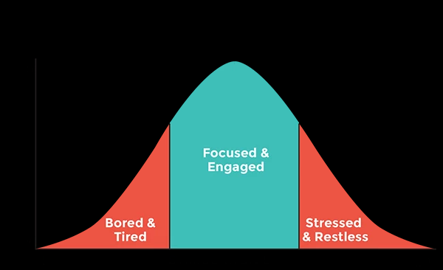
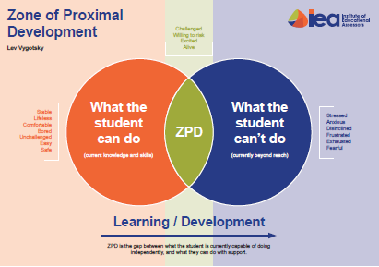
ZPD & Yerkes-Dodson Law
“Education should not be intended to make people comfortable; it is meant to make them think” (Hannah Holborn Gray, as quoted in Lukianoff & Haidt, 2018, p. 51).

Slide 15
Dr. Eells of Cornell University –
SAVES model
S - Social Connection
A – Attitude
V – Values
E – Emotions
S – Silliness

Slide 16
Social Connection
Recognizing a need & meeting it
  Remember things about students
  If class size allows, greet them by name
  Staying a consistent version of yourself
  Checking in on students (Ephesians 1:17-19)
Sociolinguistic Theory (Vygotsky) & Social Learning Theory (Bandura)
Encouraging students to ask questions, “Smart people ask questions…”
Surround yourself with role models
Find a mentor

Slide 17
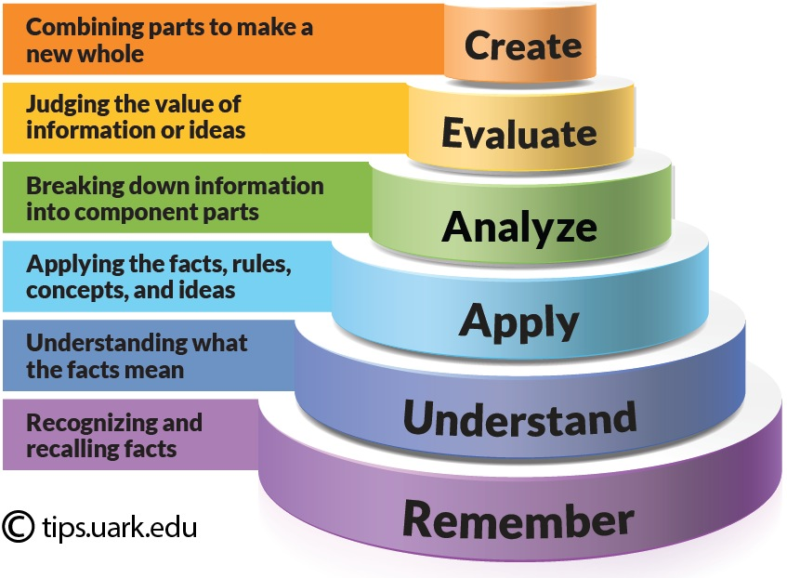
Attitude
Permanence
  Step back and realize that this will change
Pervasiveness
  Learning how to ‘contain’ negative events and shift our focus to the positive
Personalization
  Opening up to the broader context and history of a situation, and recognizing that it’s greater than me
  (Eells, n.d.)

Slide 18
Values
Helping students recognize the value of school, beyond the degree
  Building character and social skills that are valuable to the work force
  Employers are looking for more than just a GPA
Understanding purpose by balancing uniqueness with humility
Finding pursuits that are meaningful
  When surveyed the number one thing that Generation Z is looking for in work is a sense of meaning
Finding meaning even in pursuits that seem mundane

Slide 19
Emotions
Labeling & expressing emotion (going beyond emojis and memes)
Emotions have a big impact on learning
  Fear/Threat
  Joy/Pleasure
  Sadness/Disappointment
  Anticipation/Curiosity
Perceived threat – high recovery time 30-90 minutes to return to a positive state of learning
Notice emotional states within the classroom & knowing that you have the power to shift emotional states (as do your students) (Jensen, 2005, pp. 72-77).
“I've learned that people will forget what you said, people will forget what you did, but people will never forget how you made them feel” (Maya Angelou)

Slide 20
Silliness
“Authenticity”
What sets you apart from Google is who you are…
Not taking ourselves too seriously and recognizing opportunities to be human
We are teaching students all the time through our responses, behaviors, attitudes, preparedness – what messages do you send your students?

Slide 21
Reflecting on Luke 5:5-11(NIV): A picture of resilience in Scripture
5 One day as Jesus was standing by the Lake of Gennesaret, the people were crowding around him and listening to the word of God. ² He saw at the water’s edge two boats, left there by the fishermen, who were washing their nets. ³ He got into one of the boats, the one belonging to Simon, and asked him to put out a little from shore. Then he sat down and taught the people from the boat.
⁴ When he had finished speaking, he said to Simon, “Put out into deep water, and let down the nets for a catch.”
⁵ Simon answered, “Master, we’ve worked hard all night and haven’t caught anything. But because you say so, I will let down the nets.”
⁶ When they had done so, they caught such a large number of fish that their nets began to break. ⁷ So they signaled their partners in the other boat to come and help them, and they came and filled both boats so full that they began to sink.
⁸ When Simon Peter saw this, he fell at Jesus’ knees and said, “Go away from me, Lord; I am a sinful man!” ⁹ For he and all his companions were astonished at the catch of fish they had taken, ¹⁰ and so were James and John, the sons of Zebedee, Simon’s partners.
Then Jesus said to Simon, “Don’t be afraid; from now on you will fish for people.” ¹¹ So they pulled their boats up on shore, left everything and followed him.

Slide 22
References
American Psychological Association (2019). The road to resilience. https://www.apa.org/helpcenter/road-resilience
Eells, G. T. (n.d.). Cultivating resilience. PowerPoint. https://www.fs.cornell.edu/docs/node_doc/725_Culitvating%20Resilience%20June%20Facilities%20talk%20(00000002).pdf
Erikson, E. H. (1950). Childhood and society. New York, NY: W.W. Norton & Co.
Jensen, E. (2005). Teaching with the brain in mind. Alexandria, VA: ASCD.
Lukianoff, G. & Haidt, J. (2018). The coddling of the American mind: How good intentions and bad ideas are setting up a generation for failure. New York, NY: Penguin Books.
Masten, A. (2001). Ordinary magic: resilience processes in development. American Psychologist, 56(3), pp. 227-238.
Masten, A. (2014). Ordinary magic: Resilience in development. New York, NY: Guilford Press.

