Slide 1

Professional Development Jan. 7, 2020
Creative Ways to Evaluate Learning at ORU
Prof. Denise Miller
Dr. Marcela Chaván
Prof. Rhonda Gallagher
Dr. Philip Nelson

Slide 2

After Johnny wrote, “I have went…” his teacher had him write “I have gone” on the board 100 times. Johnny completed his learning experience while the teacher was temporarily out of the room. He left her a note: “I have went home”.
How do we know if our students are really learning and altering their behavior?

Slide 3

Practice strategies to assess student learning to
Improve learning and student engagement
Help faculty improve teaching on the basis of the feedback they receive.

Slide 4

Learning and Engagement Benefit of evaluation
Motivation
  Students prioritize the competencies over which they expect to be evaluated.
  Professors prioritize specific competencies or choose what’s easy to grade

Slide 5
List a learning priority for one of your courses.
_____________________________________________________

Slide 6

Another Benefit of evaluation
FeedBack
  Students modify or feel affirmed
  In their thinking and study habits.
  Professors modify or feel
  affirmed in their instruction strategies.

Slide 7
Do you notice student behaviors that make you wonder how well the students are learning your course competencies?
Can you list one of your learning priorities that may not be “sinking in”?
______________________________________________________________________________

Slide 8

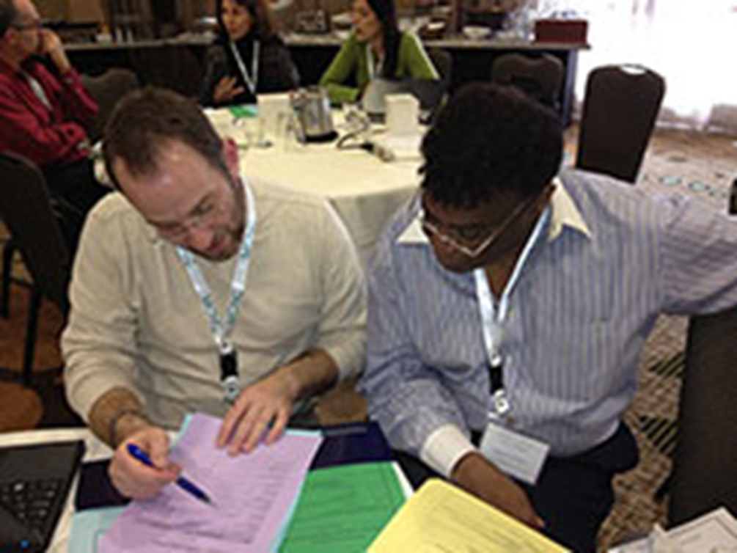

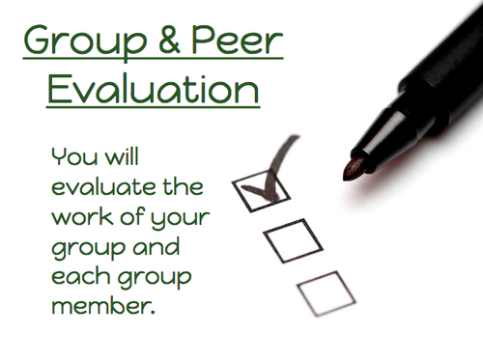
Perhaps a new evaluation method can result in “deeper” learning.

Slide 9
        Prof. Denise Miller
And Reflect!

Slide 10

Collaboration in Evaluative Settings
by Dr. Chavan

Slide 11

Quick Techie Review Quizzes
by Dr. Nelson

Slide 12
Peer Grading
by Prof. Gallagher
https://docs.google.com/spreadsheets/d/1NaxVaphYuLaEm0RoZLnD8t237T5XG-boyAII-4dhIq8/edit#gid=0

Slide 13
Remember 4 strategies for evaluation.

Slide 14

Pair and Share
What strategy might you implement this semester?
What are your reservations?
How do others respond to the reservations?
How will this strategy work for online learners?

Slide 15

List an evaluation technique that you expect to try this semester on polleverywhere.
____________________________________________________________
Thanks for practicing evaluation strategies as we prepare Whole Leaders for the Whole World.

Slide 16
Resources
M. Farrell and S. Maheu, April 5, 2019. Why Open-book Tests Deserve a Place in Your Courses, The Teaching Professor

