Slide 1

Futuristic Technology for the Leading Edge Professor
Dr. Bill Crawford and Michael Mathews

Slide 2

Abstract
Learn what many leading universities are using to create smart spaces for the classroom of the future. This session will focus on case studies from other universities and colleges who are taking classroom and teaching technologies to the next level of engagement. This session will leverage most of the technologies already available at ORU.

Slide 3
Agenda
Introductions
Dr. Bill Crawford – Teaching and innovation that works
Mike Mathews, what futuristic ideas are other using
What futuristic ideas are truly about the student
What other colleges and universities are successfully using
Looking at the integrated university
Open discussion
Questions and answers

Slide 4
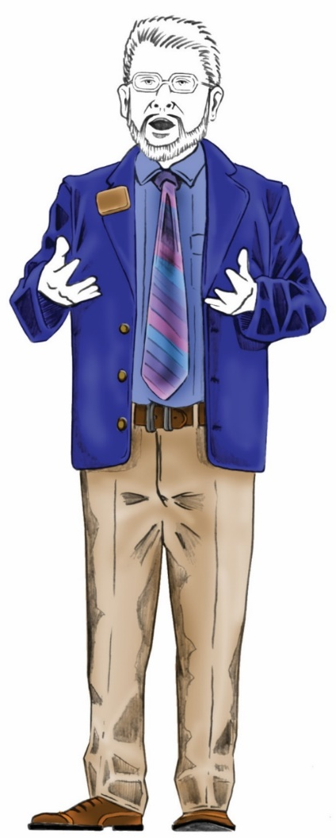
Introductions
Bill Crawford
  PhD in Organizational Psychology
  Masters in Management
  Background in Ministry, Food Service, Retail, Radio, B2B Media, Consulting, and more
  Adjunct Instructor – 25 Years
  Full-Time Professor – 4 Years
  ORU:
    Teach Management & Marketing
    Chair, Graduate Business

Slide 5
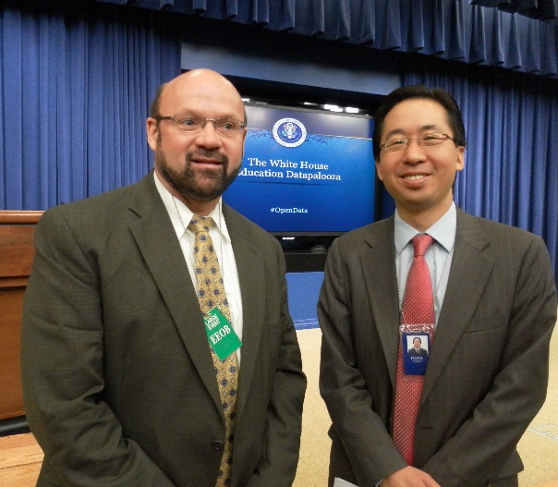
Introductions
Michael (Mike) Mathews
  VP of Innovation and Technology
  Degrees in Technology, Theology, Applied Science
  Background in Ministry, Teaching, Hi-Tech, Organizational management, Speaking and Writing
  Engineer and Teacher for Cray Research – 12 Years
  Chief Information Officer – 10 years
  Innovation – 8 Years
  Love/passion – to help orgs and people with a teachable spirit

Slide 6

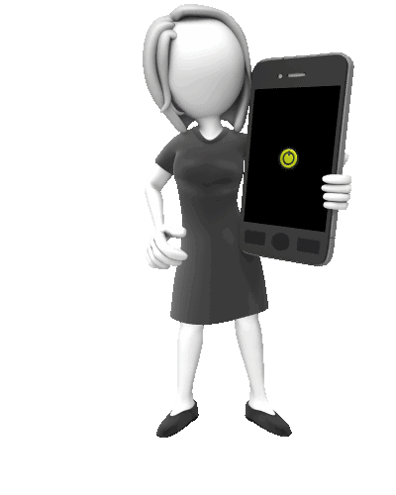

Audience thought – Is what envision and what we do really about the student

Slide 7
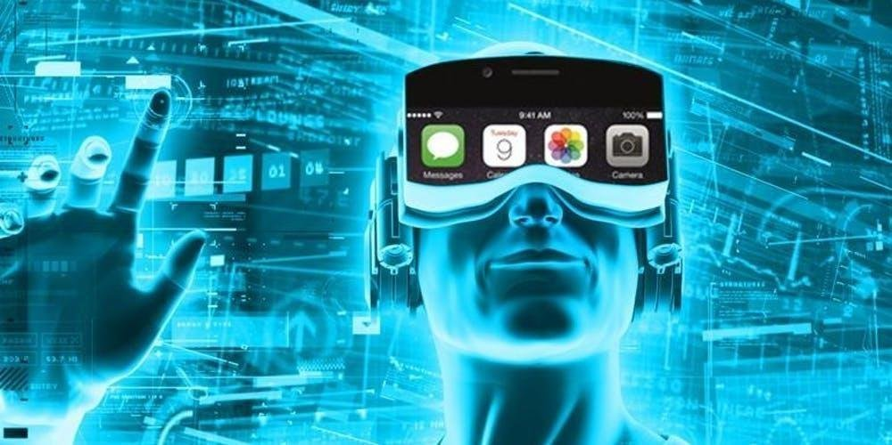
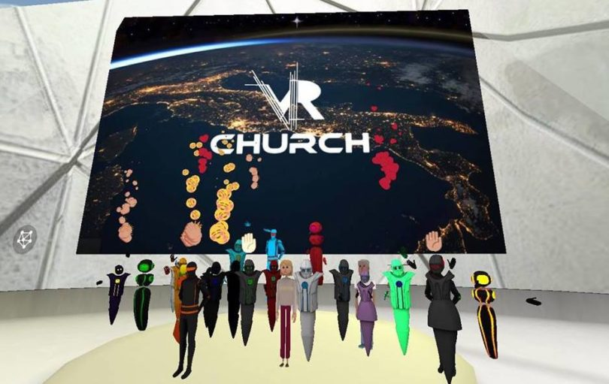
Teaching in a Digital World

Slide 8

Whole Person – All Knowledge Revelation 4:11
"You are worthy, our Lord and God, to receive glory and honor and power, for you created all things, and by your will they were created and have their being."

Slide 9


Teaching Wannabees in a Digital World

Slide 11

Technology in the Classroom
A few things that work for me
Bill Crawford, PhD

Slide 12
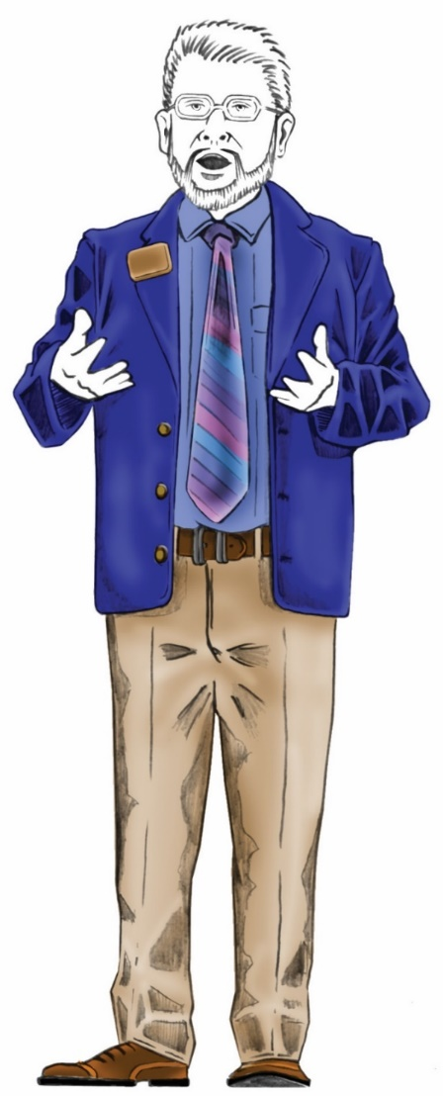
A Little About Me…
Bill Crawford
  PhD in Organizational Psychology
  Masters in Management
  Background in Ministry, Food Service, Retail, Radio, B2B Media, Consulting, and more
  Adjunct Instructor – 25 Years
  Full-Time Professor – 4 Years
  ORU:
    Teach Management & Marketing
    Chair, Graduate Business
Notes:
Teach in several SNU undergraduate programs

Slide 13

Some Tools That I Use
Kahoots
Zoom
Screen Mirroring

Slide 14

Kahoots
Play on phones, tablets, or computers
Discussion Questions, Multiple Choice, True-False
  Discussion – theory and application
  M/C and T/F – reviewing concepts
Detailed Spreadsheet!

Slide 15

Let’s Play!
Notes:
https://play.kahoot.it/v2/?quizId=be6c3954-3d8f-457d-acb0-d06e54dad302

Slide 16

Play up the Competition!

Slide 17
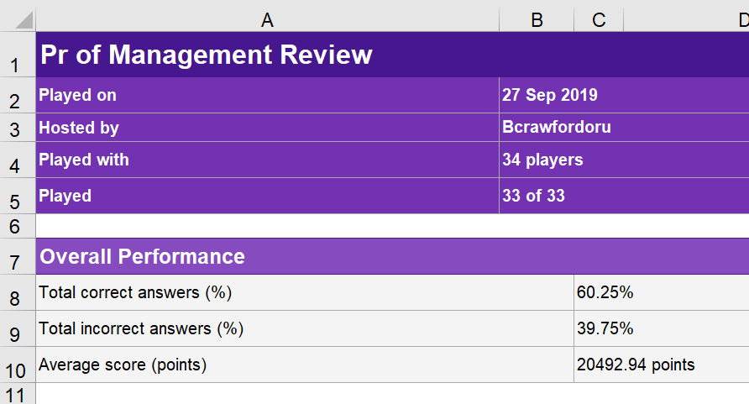
Afterwards…

Slide 18
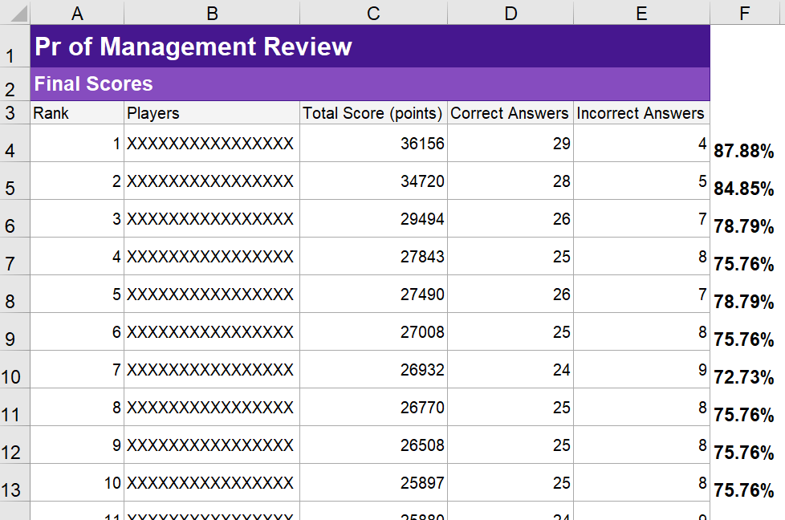
Student & Question Detail

Slide 19

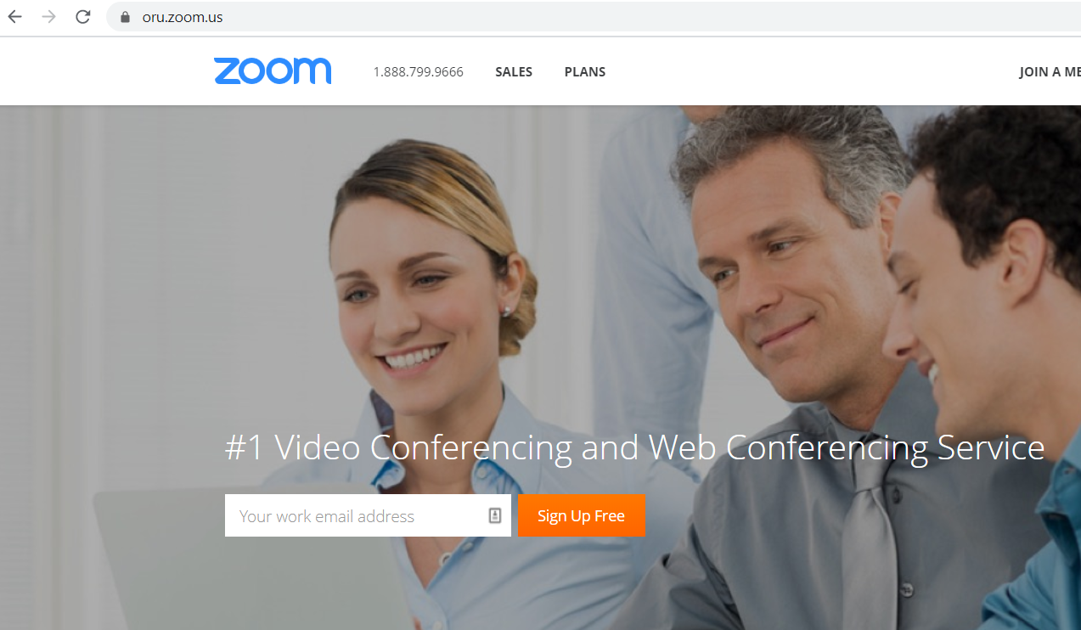
Zoom

Slide 20
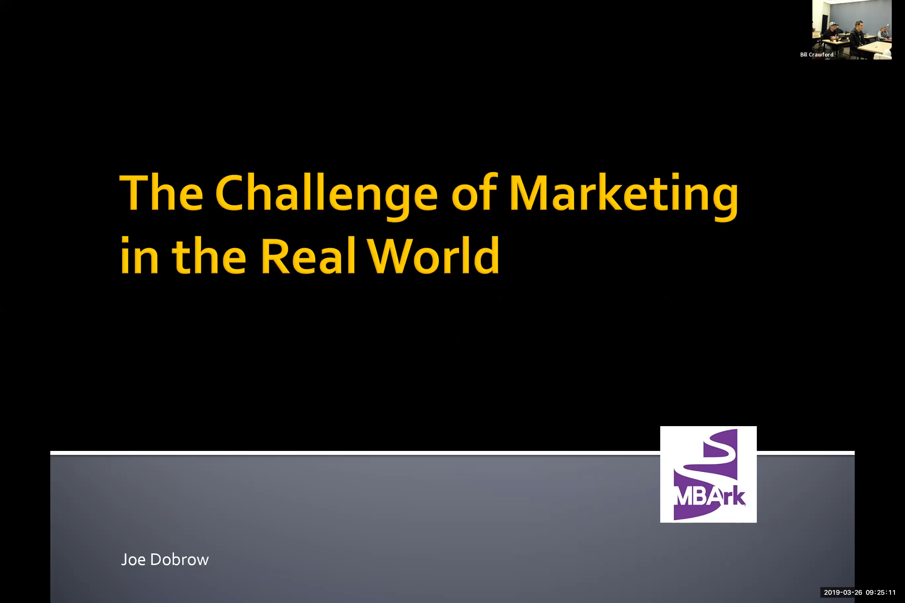
Benefits of Zoom
Guest Speakers Coming Into the Classroom

Slide 21
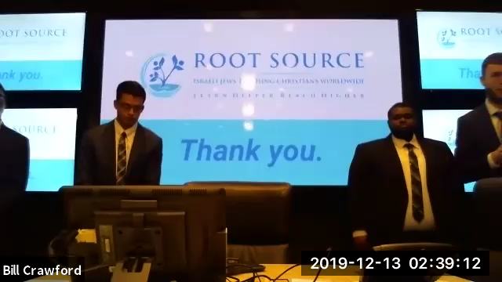
Benefits of Zoom
Student Presentations Going Out

Slide 22
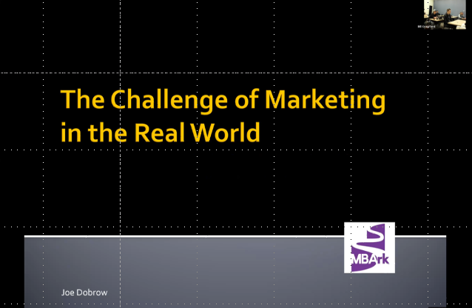
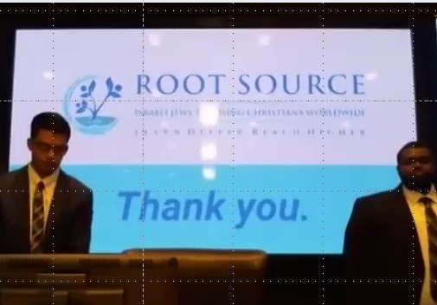
Benefits of Zoom
Guest Speakers Coming Into the Classroom
Student Presentations Going Out
Ability to Record and Play Later

Slide 23
Screen Mirroring Technology
Allows students (and faculty!) to mirror their screen from where they are sitting!

Slide 24
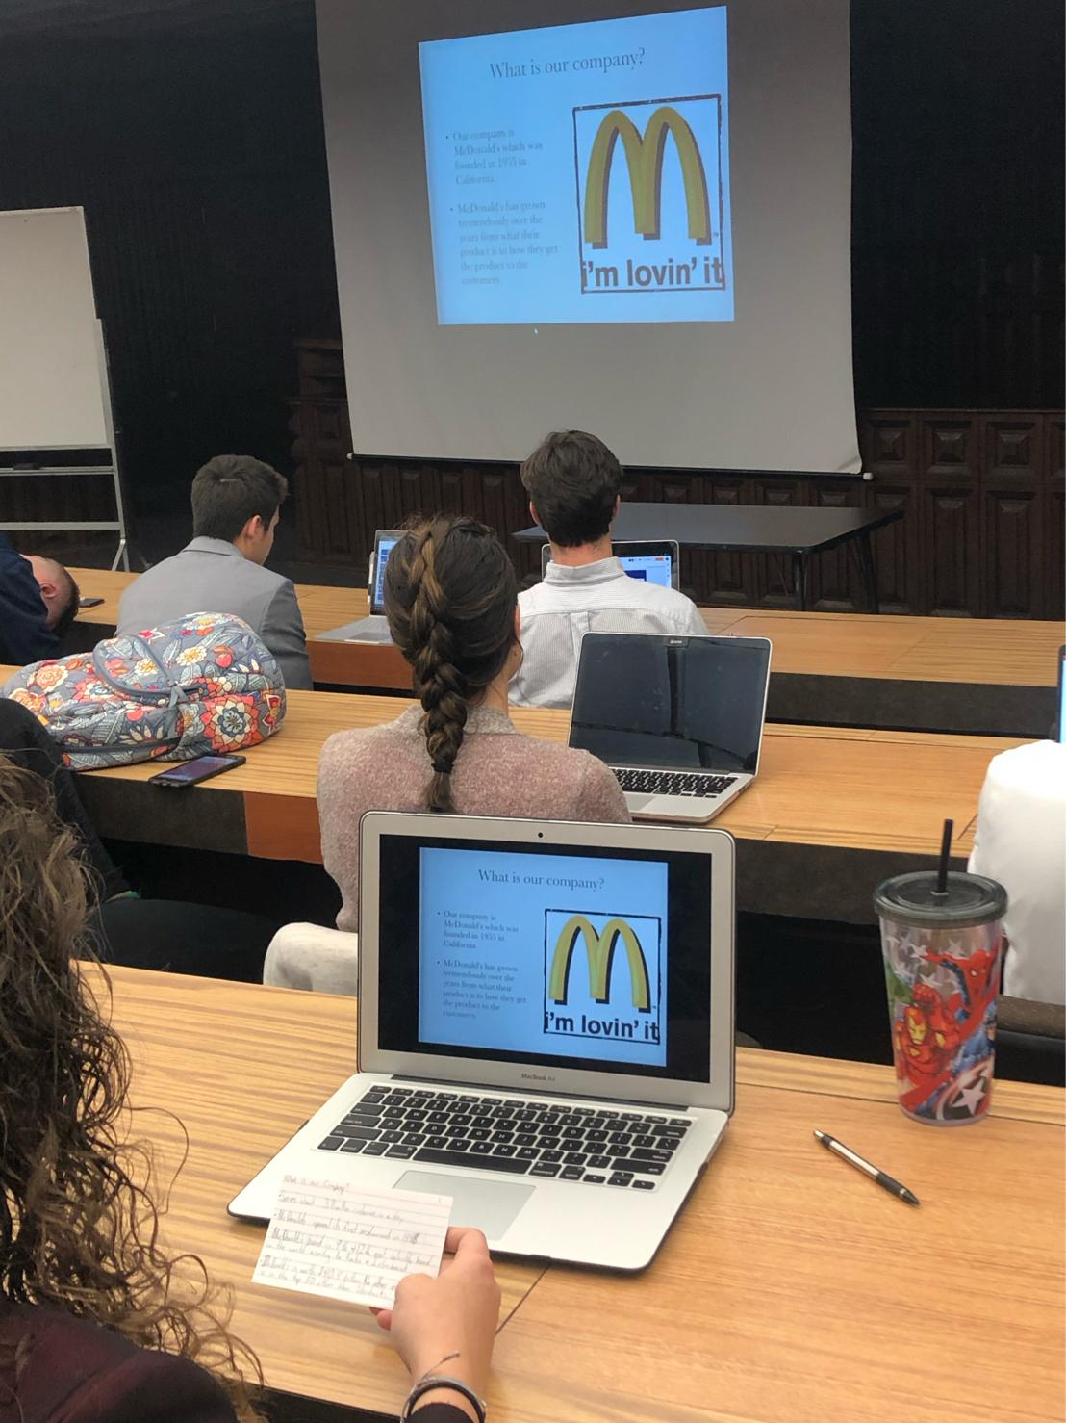
Undergrad or Principles Courses
Saves Time = More Presentations!
First steps into addressing a classroom

Slide 25
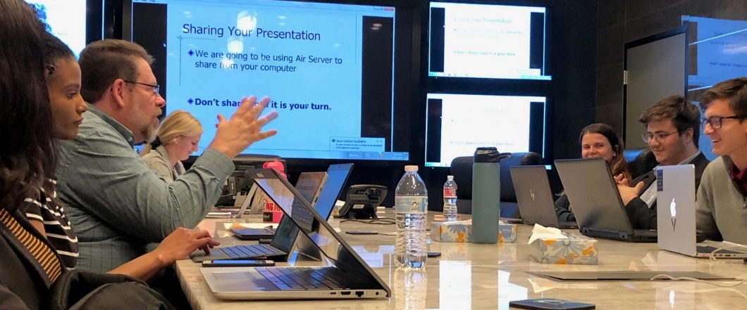
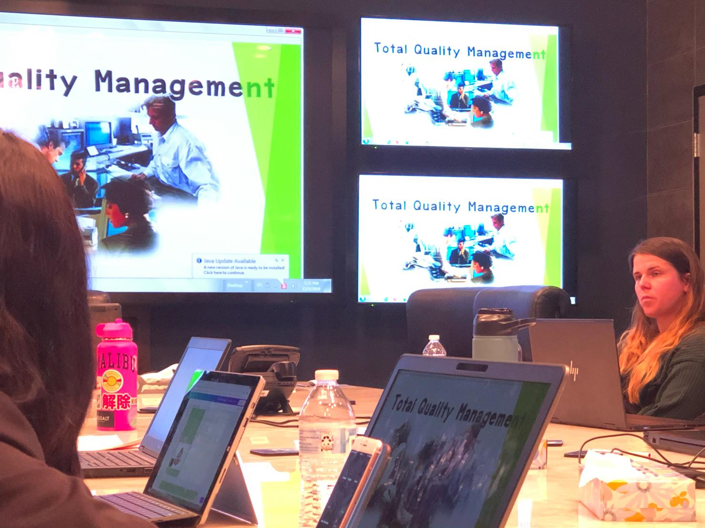
Grad or Upper Division Classes
Discussions instead of Presentations

Slide 26

Some Takeaways

Slide 27



Slide 28
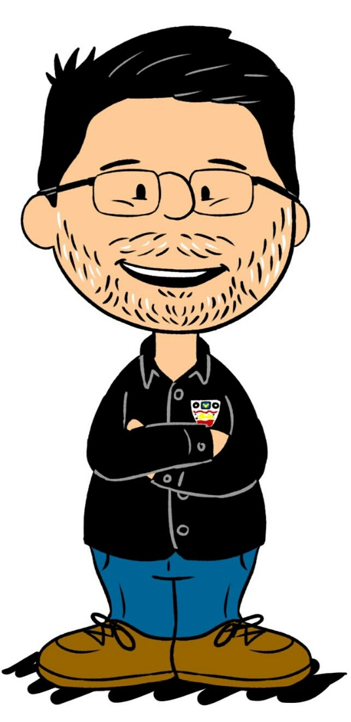
Let’s Visit Later!
Over Lunch
billcrawford@oru.edu
Ext 6884

Slide 30

Zoomtopia Award
University of Otago

Slide 31
Our Own Zoom Award
Dr. Jeff Voth
Dr. Jeff Voth had an interview with CS Lewis's stepson, Douglas Gresham. Douglas is a resident of the country of Malta. Malta is the island country where the apostle Paul was shipwrecked and is now 98% Christian. It is also the first Blockchain (classified) country in the world. Video Link.
Mr. Gresham easily and comfortably reached into Oral Roberts University on Tuesday from his residence in the country of Malta. Below is the recording of that interview. Please note the great quality of the video and natural manner in which this interview was done. We are also pleased to issue him a certificate of participation for his interview that will be placed on his own secure and personalized Blockchain. Douglas Gresham, who has been befriended by Dr. Voth has a multi-year contract with Netflix to produce the Chronicle of Narnia Series.

Slide 32



Immersive and Spatial Learning
Immersive learning is the process of
learning with the usage of a simulated,
artificial, AVR environment. The
environment enables the learners to
completely get immersed in the learning
and in a way that feels like experiencing
an actual learning environment.

Slide 33
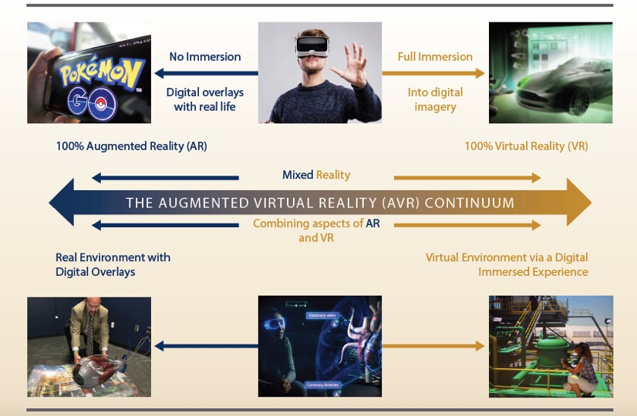

Slide 34
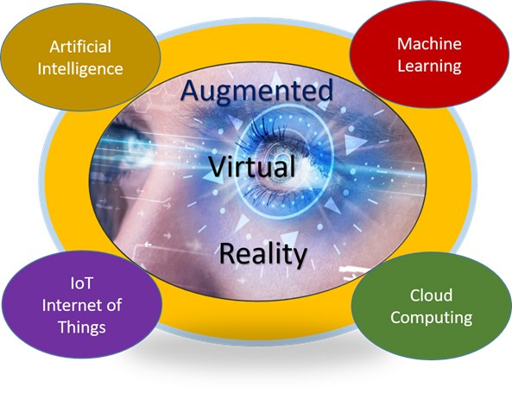

Slide 35
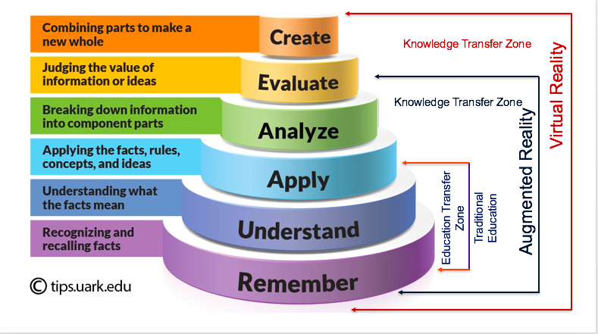
AVR First Technology to Achieve Blooms Taxonomy
Link to Article

Slide 36
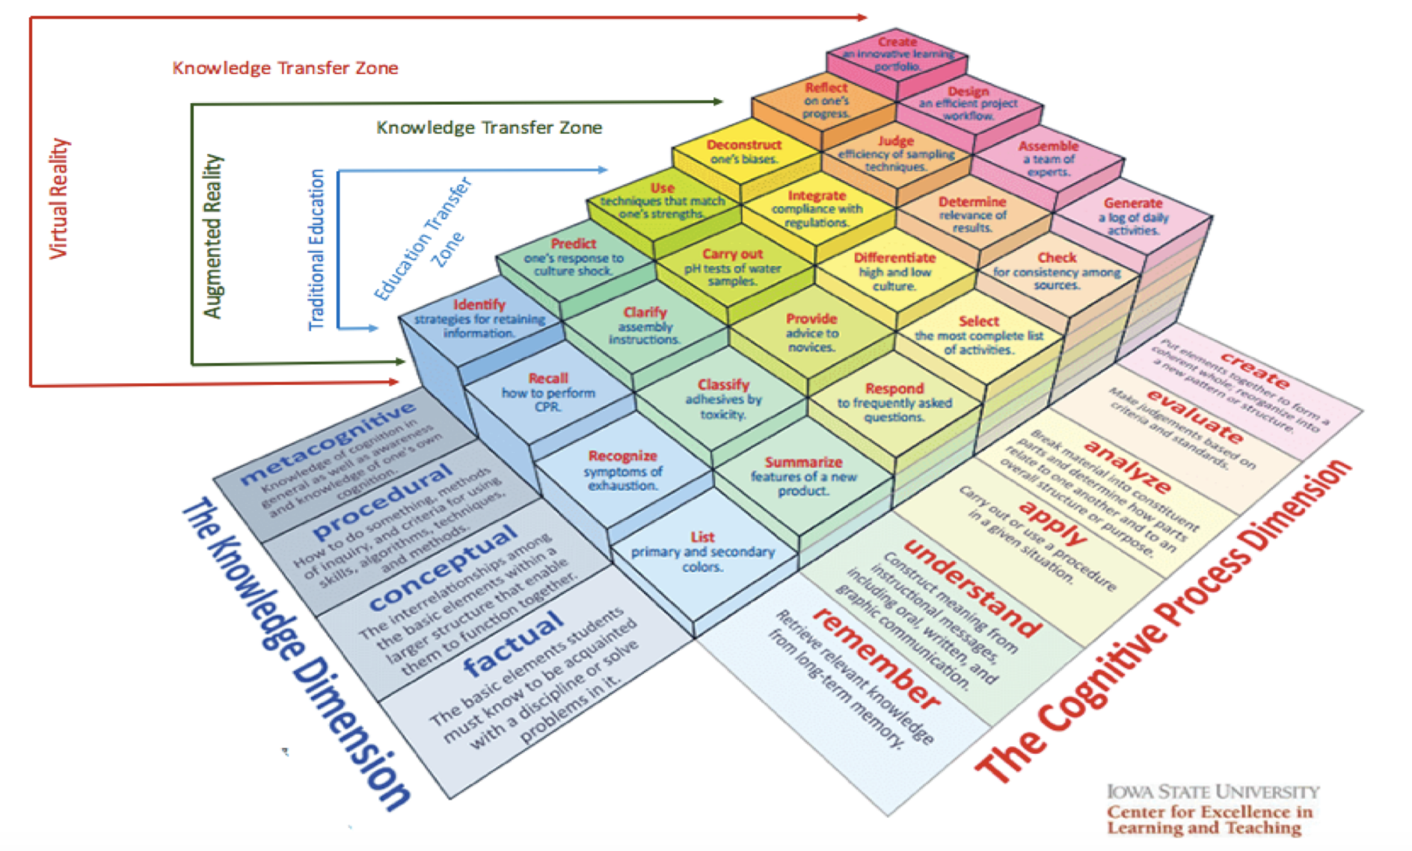

Slide 37
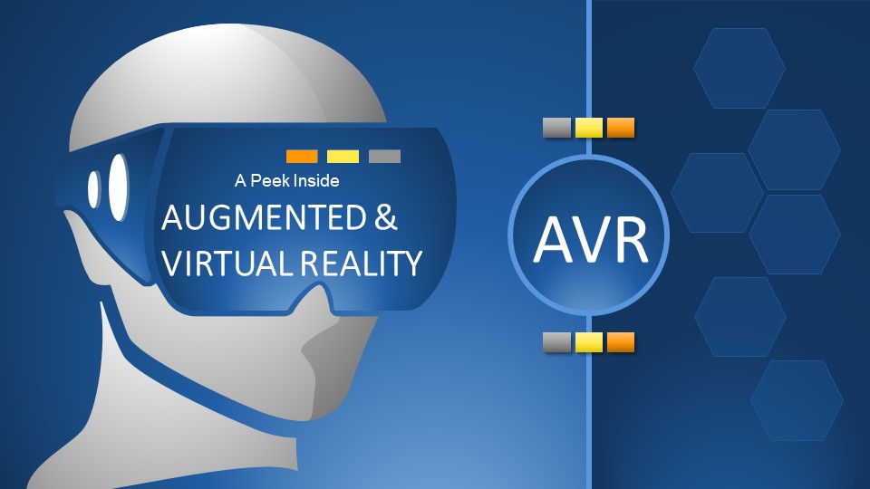
A Peek Inside

Slide 38
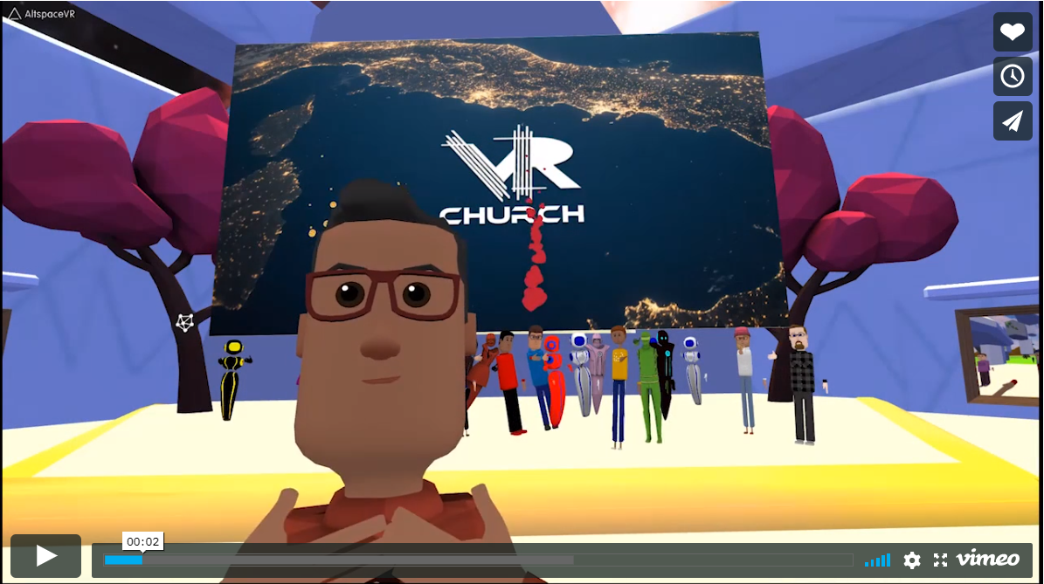

Slide 39
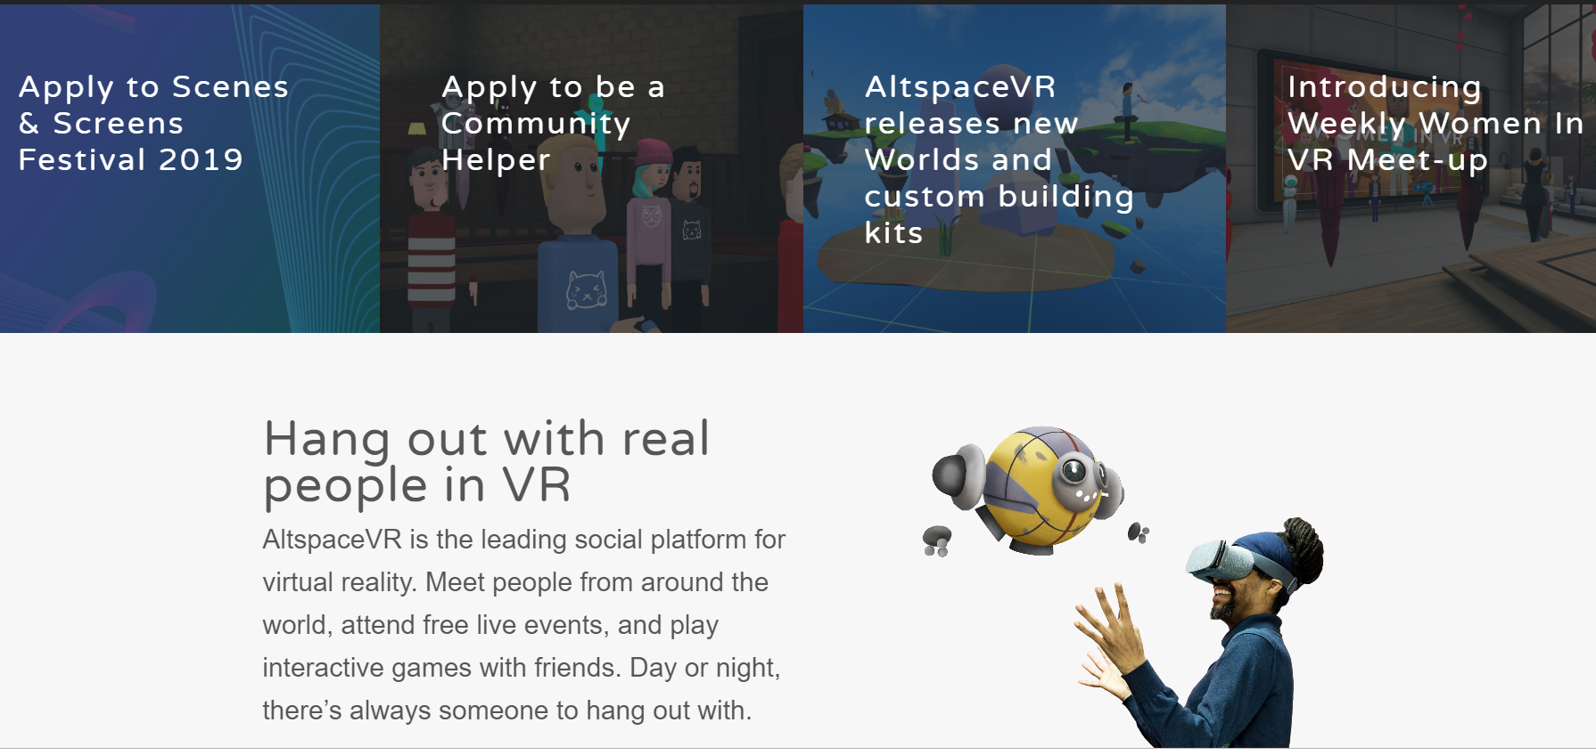
AltSpace VR

Slide 40
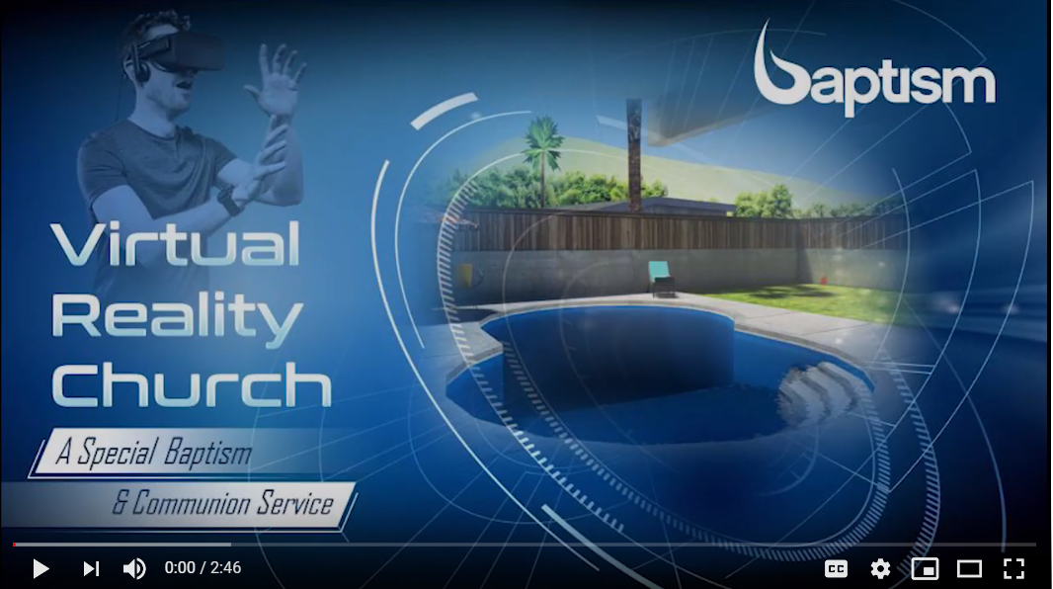

Slide 41
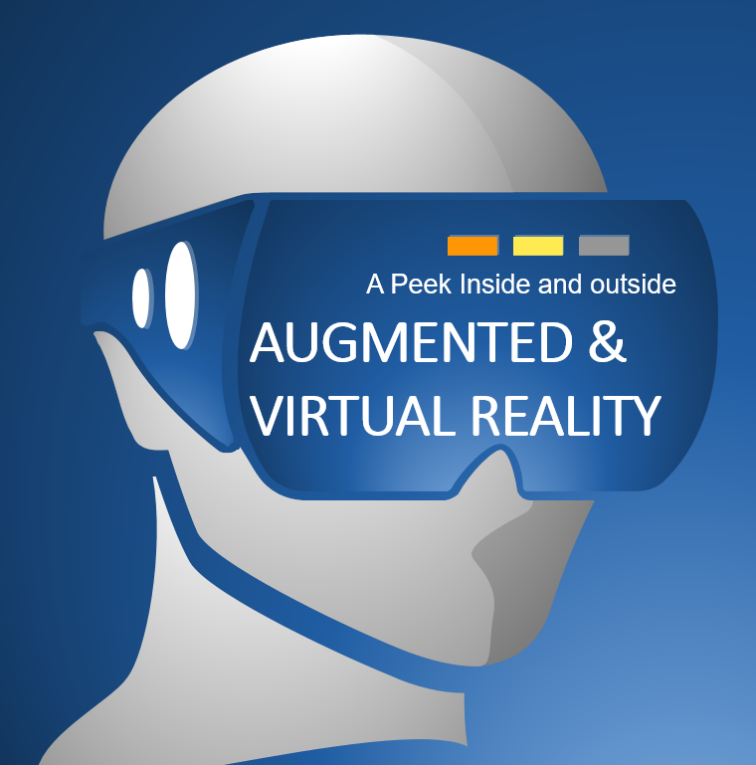


Instantly Reaching around the World
Intelligence
From inside the frequency of the human
heart and mind
To the frequency to/from the rest
of the world

Slide 42

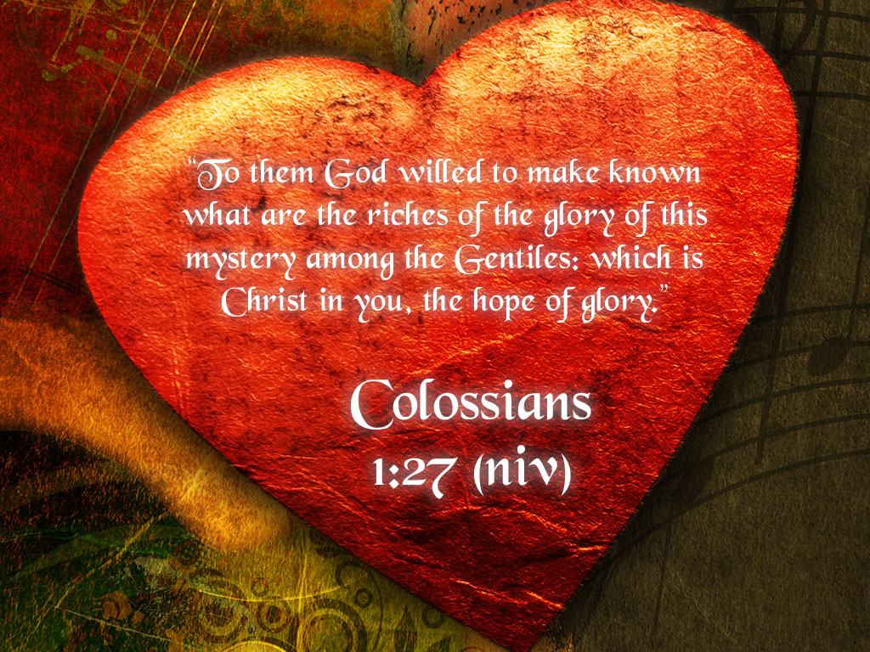
Guard Your Heart out of it are the
Issues of life
God’s Intelligence

Slide 43

Proverbs 4:23

Slide 44

Proverbs 4:23

Slide 45
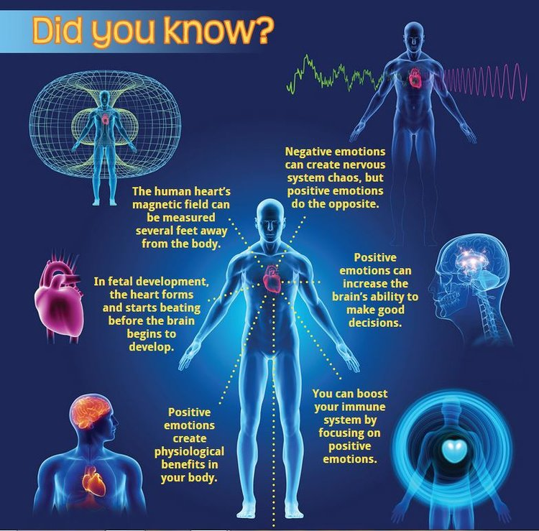
Humanizing
Technology
The Heart Math Institute

Slide 46

The Heart gives off a Frequency and all frequency produces a ‘rhythm, beat which is Music’

Slide 47

The Frequency and Music within us

Slide 48
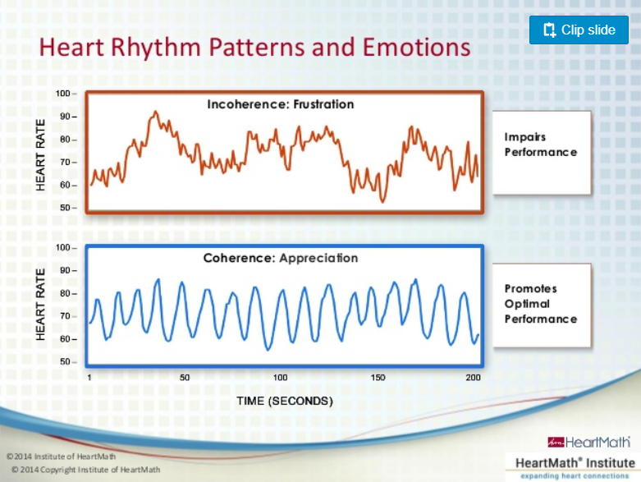

Slide 49
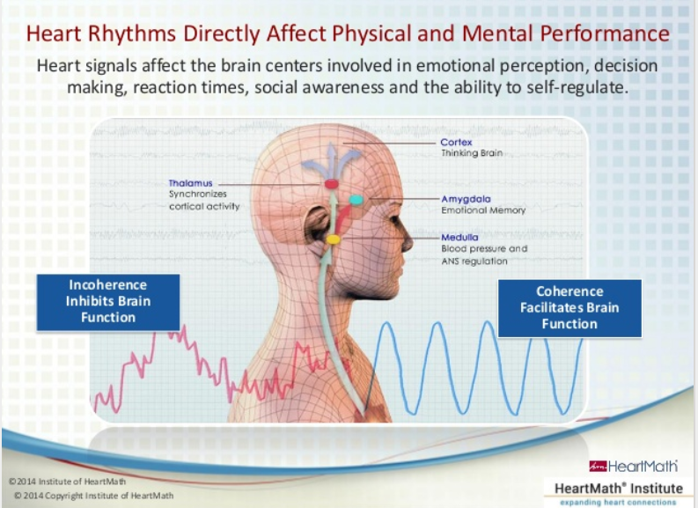

Slide 50
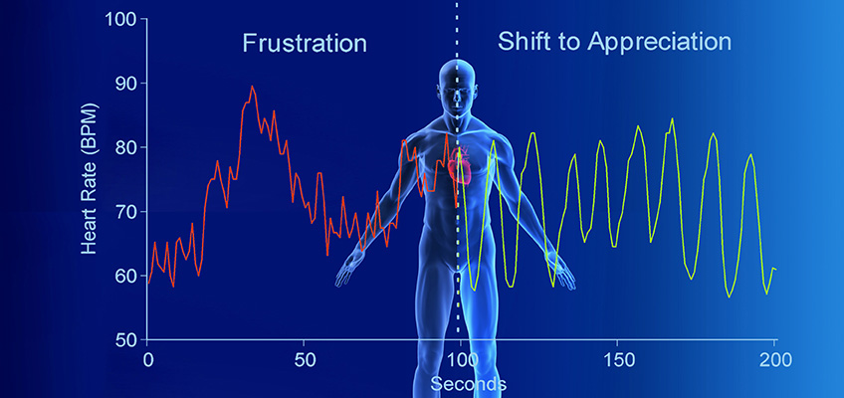
The music of the heart
‘Give thanks with a grateful heart’

Slide 51
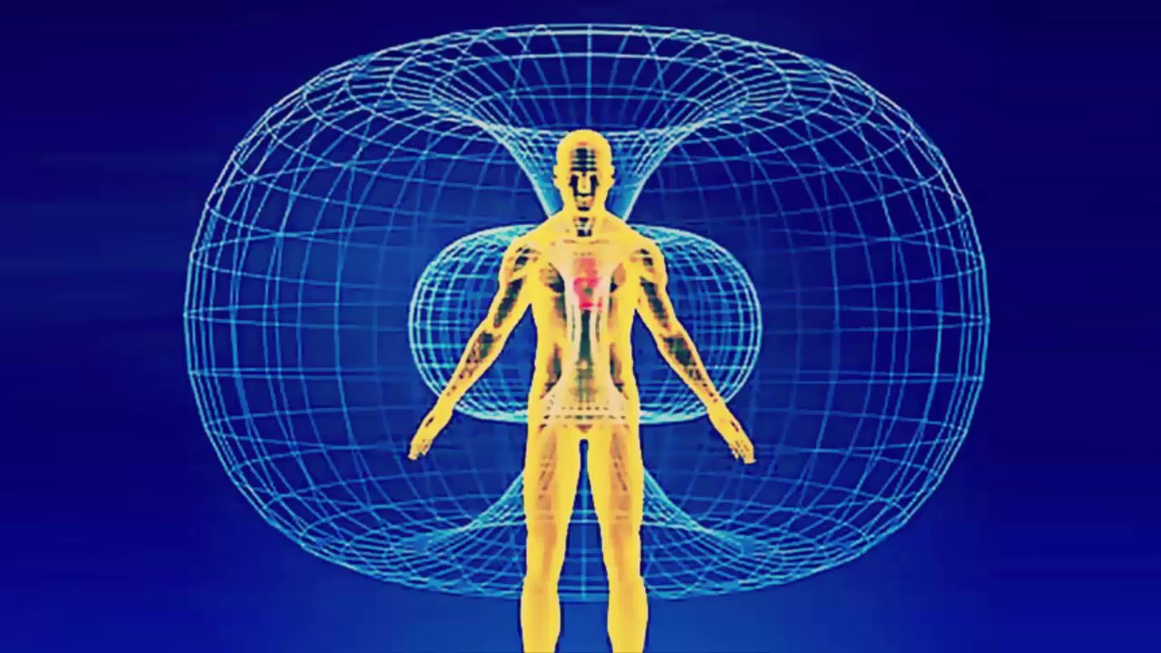
Frequency of the Heart

Slide 52
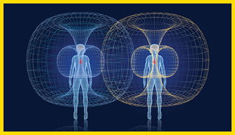
Synchronicity

Slide 53
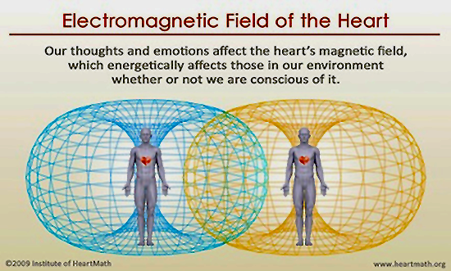
“For where two or three gather in my name, there am I with them.” Matthew 18:20

Slide 54
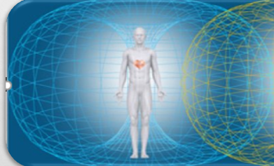
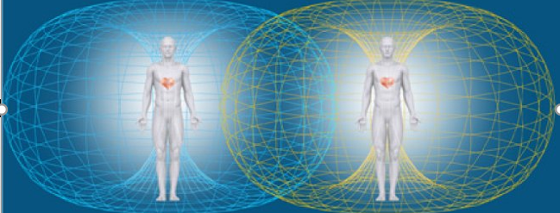
“And though a man might prevail against one who is alone, two will withstand him—a threefold cord is not quickly broken.” Ecclesiastes 4:12

Slide 55
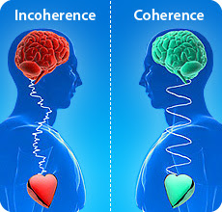
Designing with
‘Synchronicity’
In
Mind

Slide 57
VR Classroom in a digital world

Slide 58
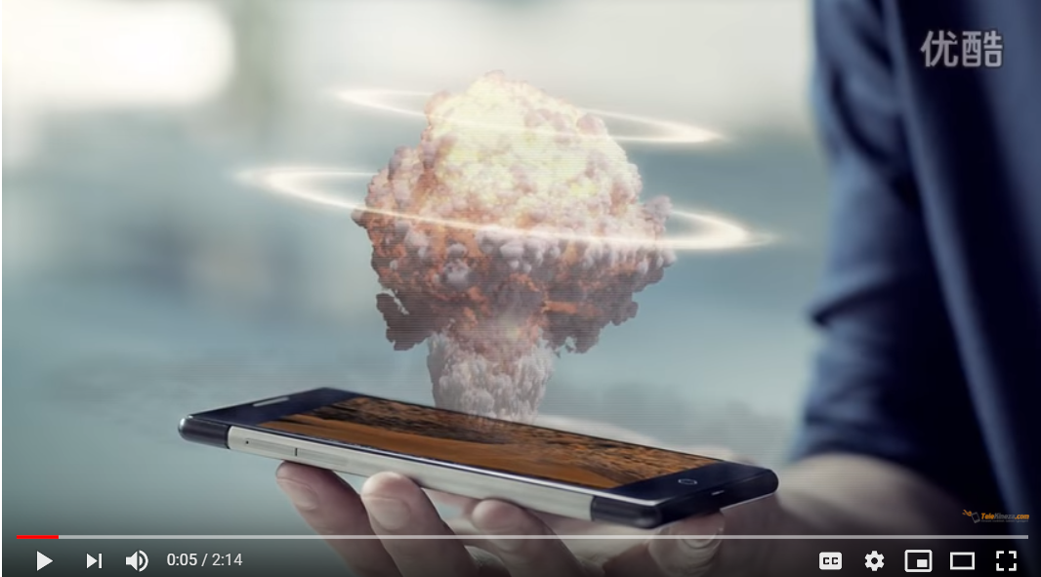
Eye Technology with Smart Tech

Slide 59
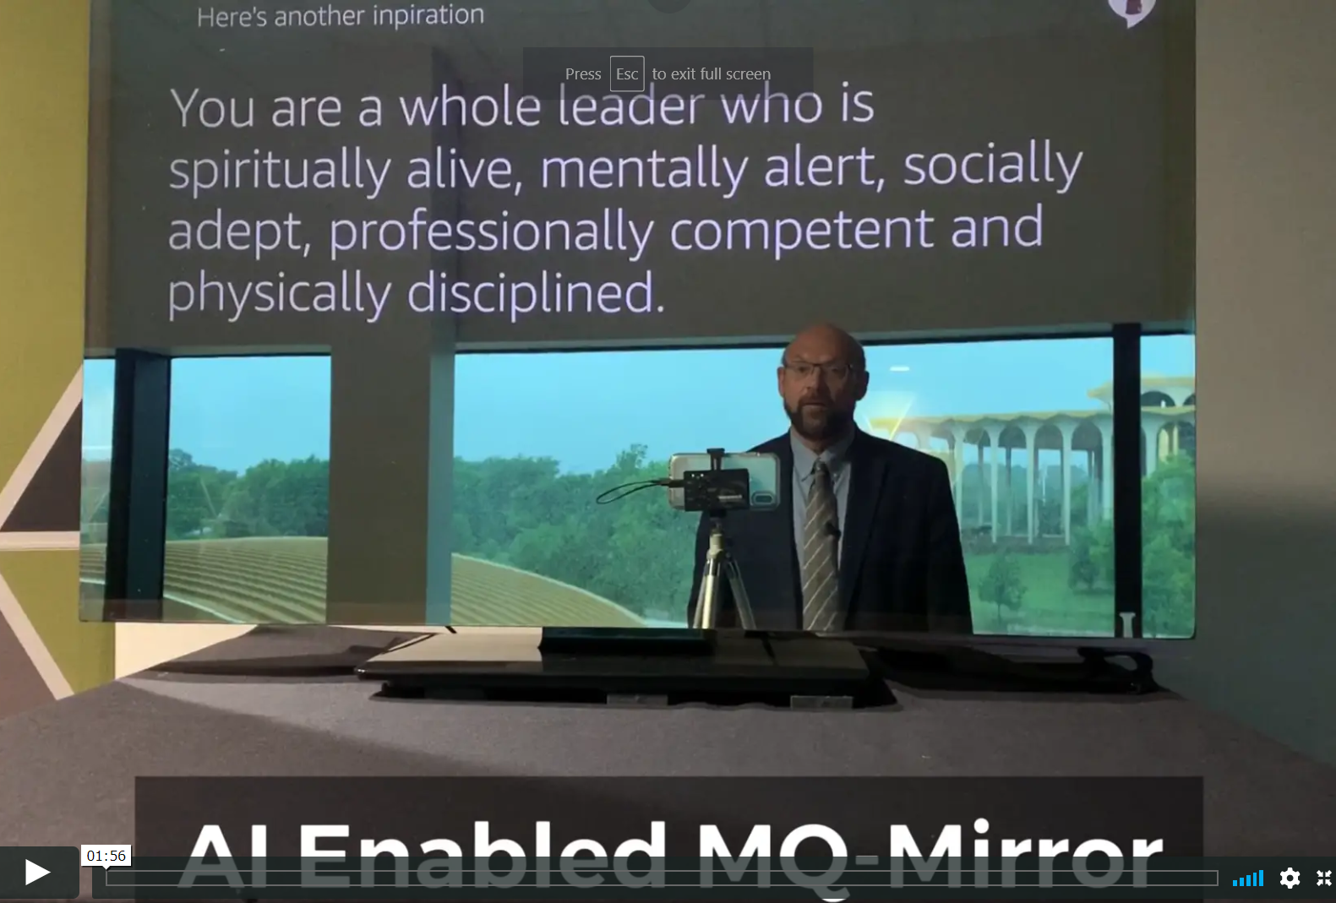
All the worlds intelligence on a Mirror

Slide 60

Questions and Answers

