Slide 1

Tricks of the Trade: D2L
Dr. Chance Bosch, College of Education

Slide 2
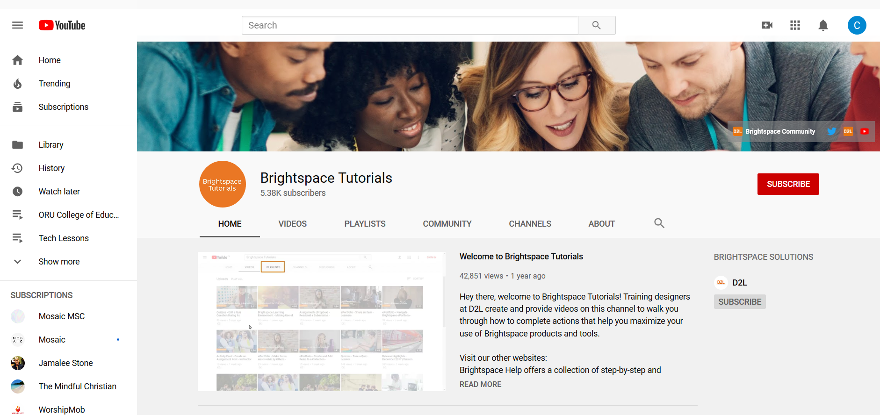
GOOGLE: D2L blah blah

Slide 3

Overview
Philosophy
Organization
Grades
Attendance
https://www.trialsitenews.com/tel-aviv-university-developed-technology-represents-novel-brain-activity-monitor/

Slide 4
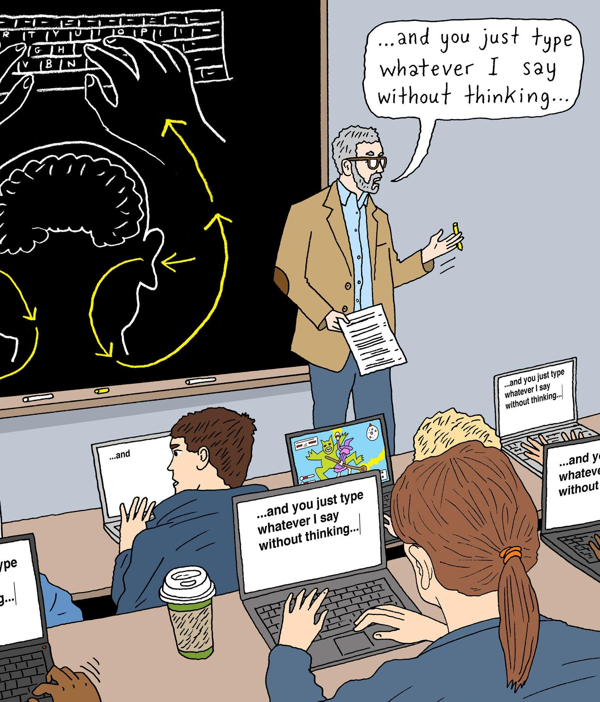
Philosophy
Technology-enhanced Learning
Research on note-taking
Personal Bias
Structural Freedom
  Student or Professor
Peter Arkle: https://www.nytimes.com/2017/11/22/business/laptops-not-during-lecture-or-meeting.html

Slide 5

Organize
Organize
  Curricular Guide
  Syllabus (Policies)
  Scope & Sequence
  Lesson Plans
  Resources (Lecture Notes)
  Assessments
  Examples
  Rubrics
  Grades

Slide 6

Grades
Grades
  Create Grading Scheme
  Use Setup Wizard
  Create an Assignment
  Link it to a Grade

Slide 7

Attendance
Attendance
  Attendance Scheme
  Register (Schedule)
  Take Attendance

Slide 8
Help?
D2L, Department, Peers
Dr. Chance Bosch
College of Education
cbosch@oru.edu

