Slide 1

Using D2L/Bongo, Teams, Zoom & Lifesize for Virtual Classrooms
Michael Mathews I Victor Ekwere Jnr. I Jesupelumi Wickliffe

Slide 2
ZOOM is great, but potentially overused
Zoom has grown from 25-million customers to 350 Million Customers.
In Spring 2020 during the first swing of Covid-19, Zoom was reaching its limits.
This fall will see the greatest usage of Zoom.
ORU needs to be prepared to not put all our virtual resources in one basket called Zoom.
The good news is there are choices and options.

Slide 3
Alexa Skills, AI, Smart API’s, IoT, Node-red, Scripting, Bridging code-sets
D2L Tools, Chat, MS Teams, VR, 360 or Voice-Activated Cameras
Zoom, Lifesize, FB-Live, Life-Size, D2L Virtual, Alexa, Roku
PC’s, Cameras, Projectors, Screens, Recording
Conference room, classroom, desks/chairs
The Five layers of constructing a virtual learning classroom
Layer 1 – Physical Space
Layer 2 – Digital Space
Layer 3 – Virtual Platform Layer
Layer 4 – Learner Engagement Layer
Layer 5 – Integration and Smart Sensory Layer

Slide 4


Setting up a Virtual Classroom directly in D2L
(Bongo)
by Victor Ekwere Jnr

Slide 5
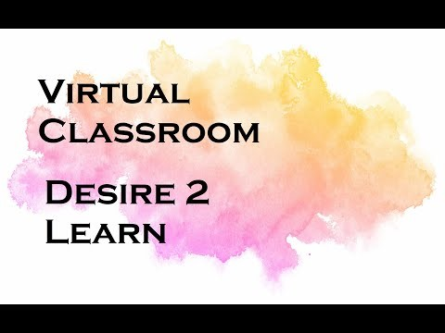
Video Reference – Instructor Viewpoint

Slide 6
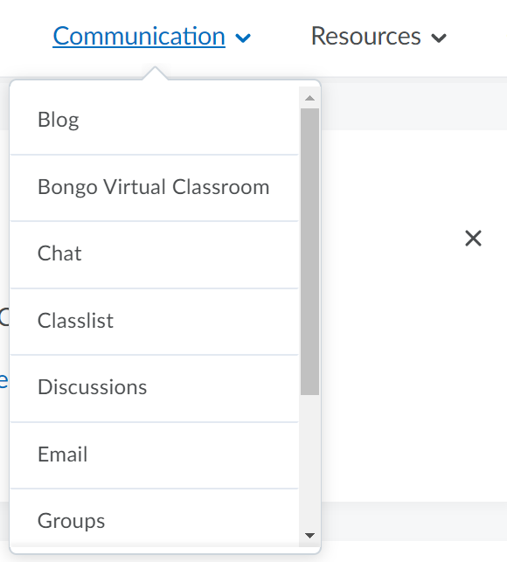
Where is D2L Virtual/Bongo Initiated
1
Click on the “Communication” Tab
2
Select “Bongo Virtual Classroom”

Slide 7
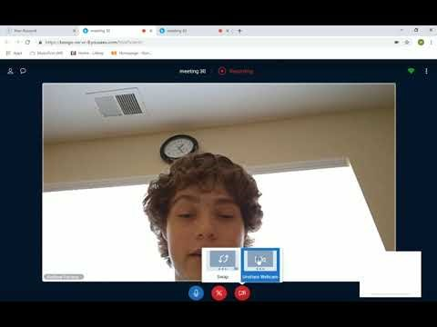
Video Reference – Instructor & Student Viewpoint

Slide 8
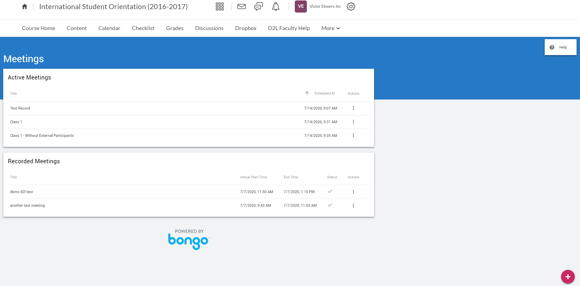
How to Schedule a Meeting
Test Class
Professor
Click here to Schedule Meeting

Slide 9
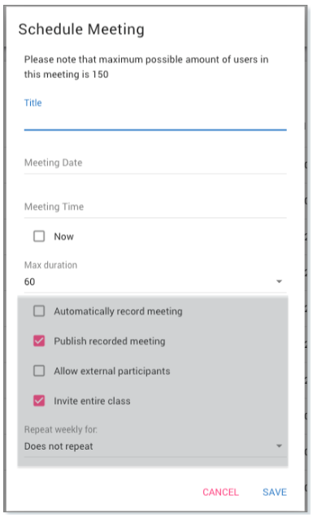
Schedule a Meeting
Meeting TITLE
Meeting DATE
Meeting TIME
Select to Invite a GUEST
INVITE Entire Class

Slide 10
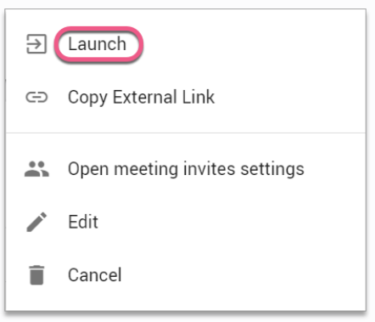
How to Start a Meeting
Go to your Bongo Meetings Home page
Click Here
This will popup. Click Launch to be redirected to the next screen.

Slide 11
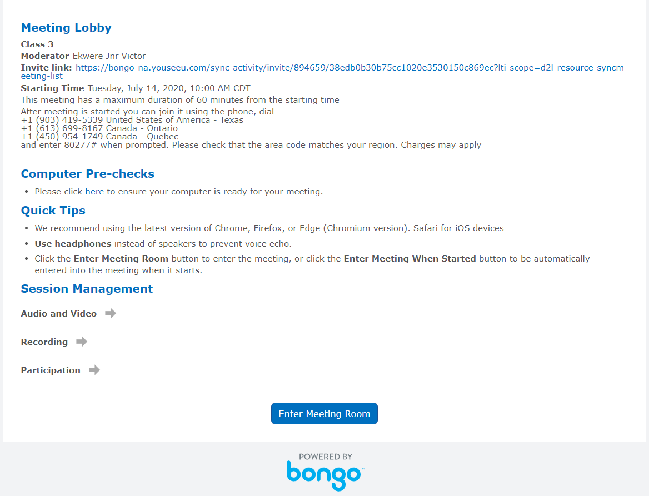
How to Start a Meeting
Quick Tip 1
Always Go through the Computer Pre-checks before entering the meeting.
Click here to Begin Meeting

Slide 12
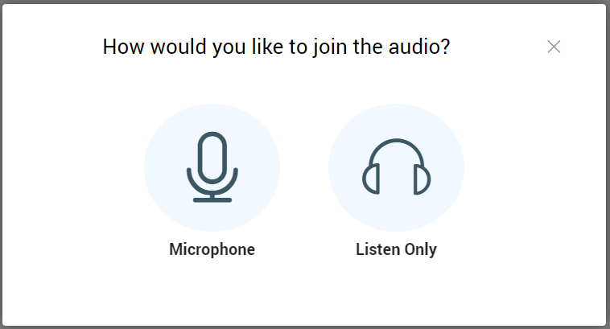
How to Start a Meeting – Audio Setting
Quick Tip 2
Always Select Join with “Microphone”

Slide 13
Inviting External Participants – Option 1
Copy and send this link to external participants

Slide 14
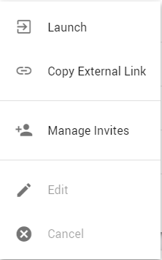
Inviting External Participants – Option 2
Select “Copy External Link” just before you start the meeting on the Bongo Meeting home page

Slide 15
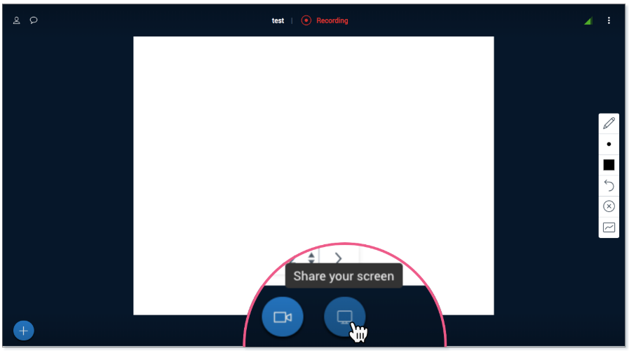
How to Share your Screen
Click the
“Share your Screen” icon

Slide 16
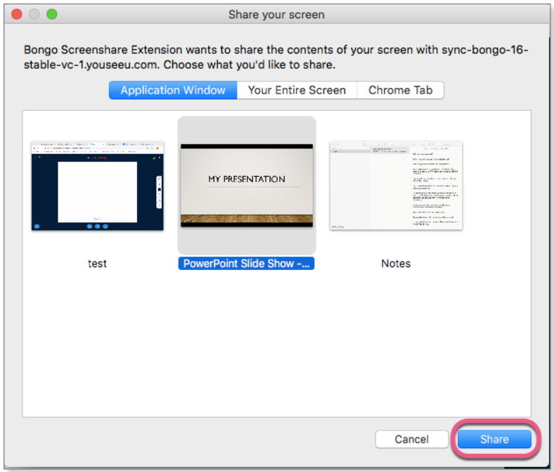
How to Share your Screen
You can share Your Entire Screen (recommended) or Application Window. Select your preferred option and Share.

Slide 17
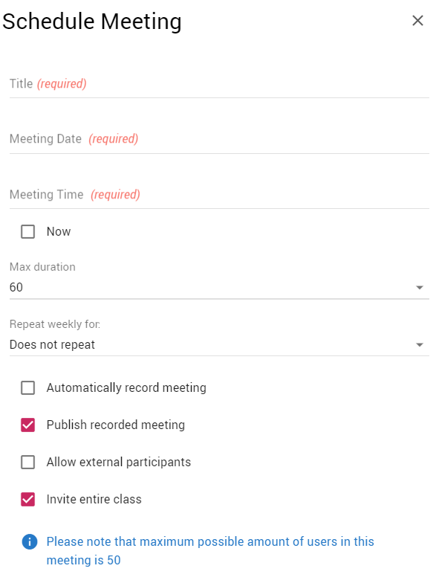
How to Record a Meeting Automatically
You can setup your meeting to “Automatically Record”

Slide 18
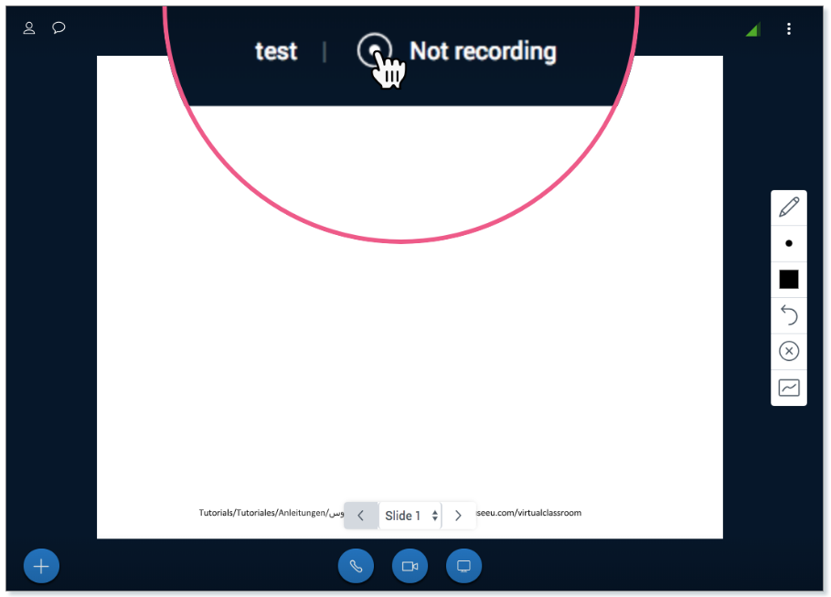
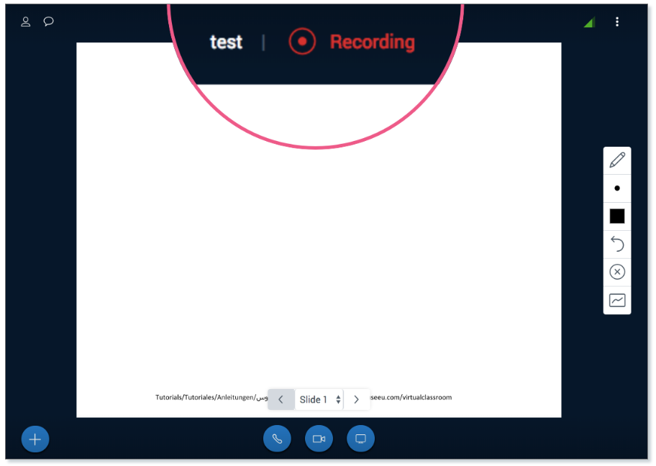
How to Record a Meeting
If you forgot to select “Automatically Record” before scheduling your meeting, click the Record Button at the top of the screen as seen below

Slide 19
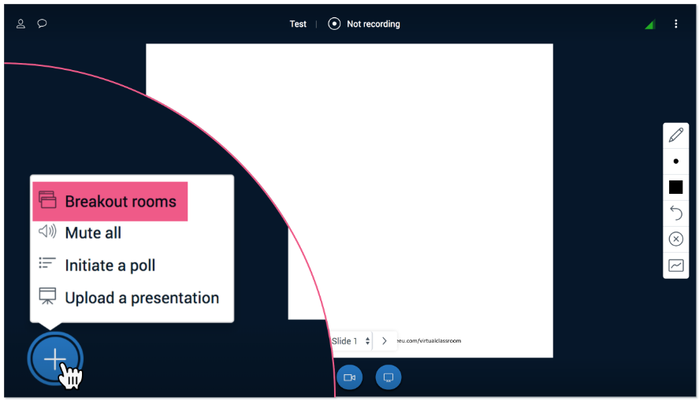
Creating Breakout Rooms
Click the (+) sign at the bottom left corner of the screen.

Slide 20
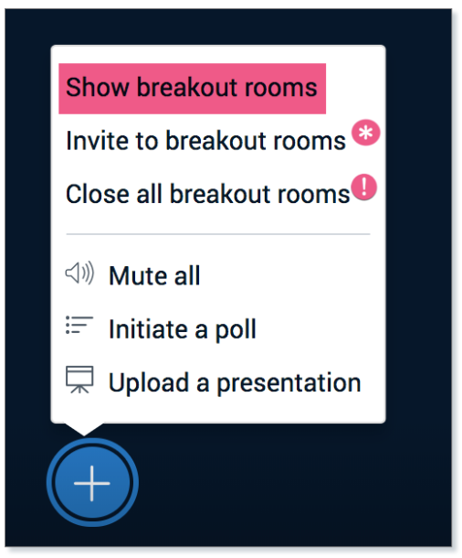
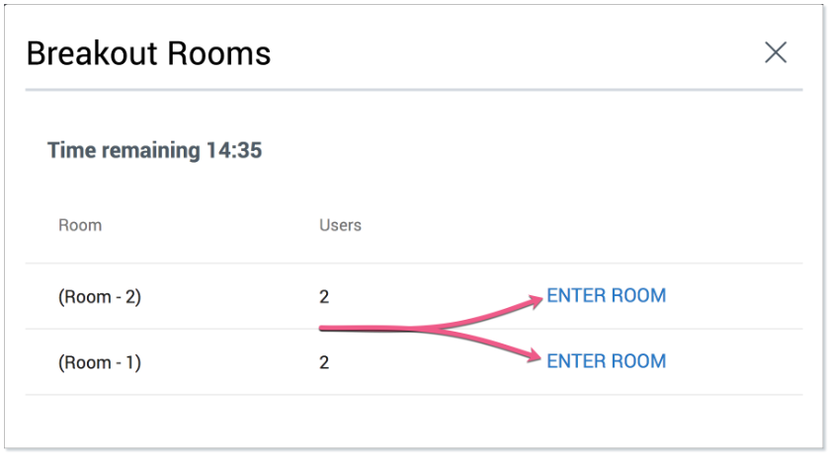
Monitor Breakout Rooms

Slide 21
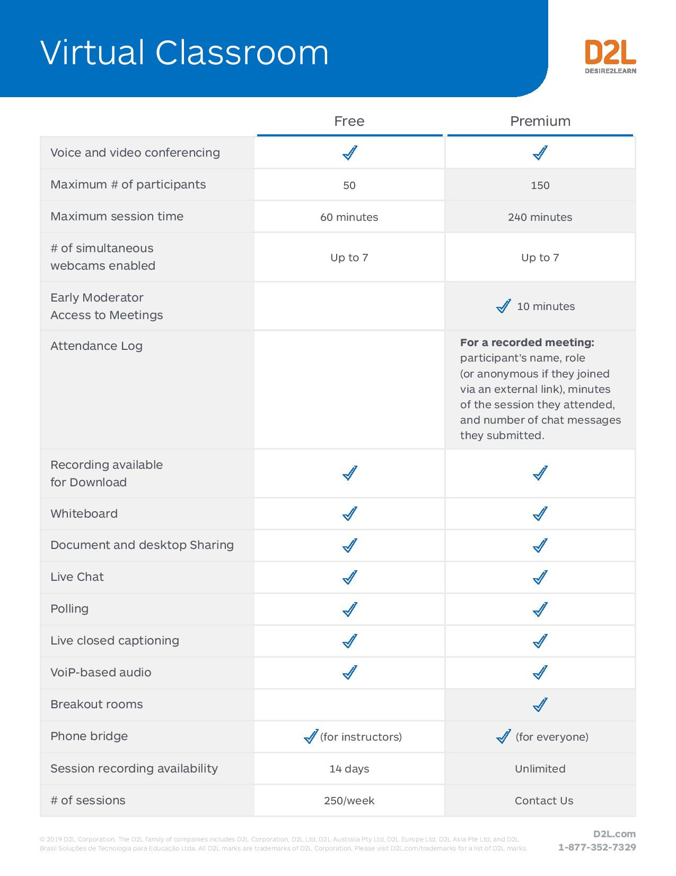
In a Nutshell…

Slide 22
Quick Help Guide
https://bongolearn.zendesk.com/hc/en-us/articles/360016009854-Troubleshooting-Within-Virtual-Classroom

Slide 23

By Jesupelumi Wickliffe

Slide 24
Agenda.
How to schedule a meeting and invite participants
How to start a meeting
How to join a meeting
How to share your screen
How to record and share recording

Slide 25
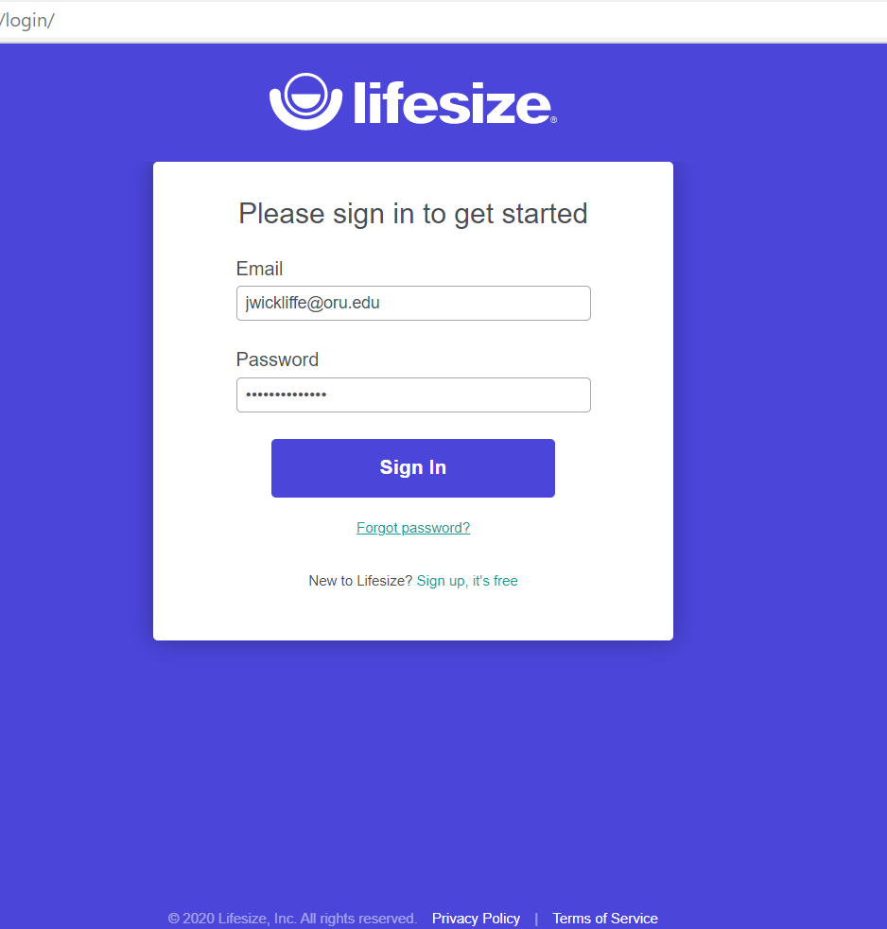
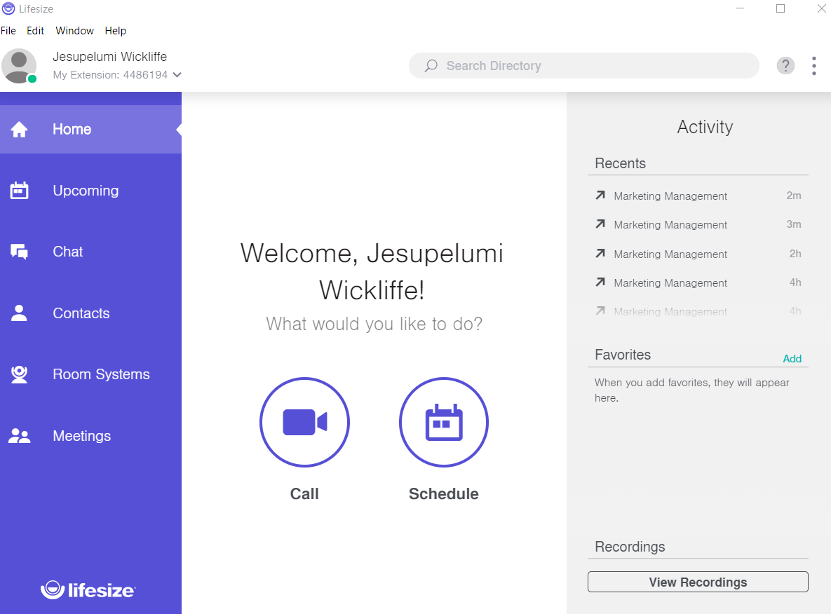
To login, visit: https://login.lifesizecloud.com/

Slide 26
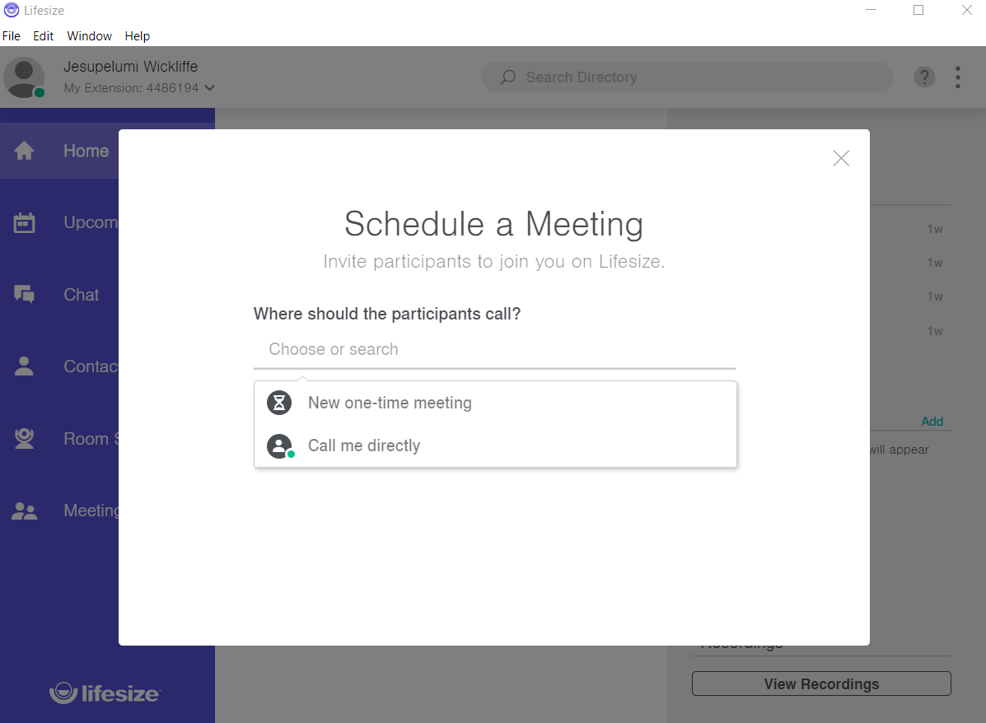
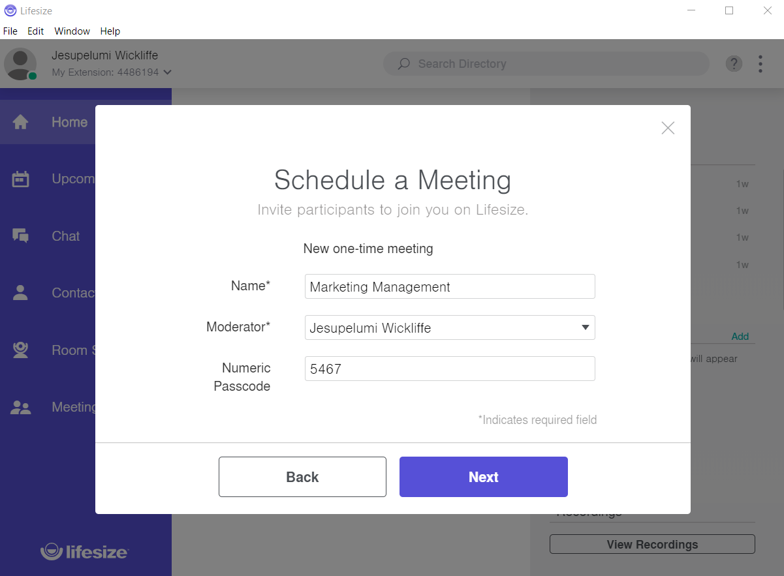
How to schedule/create a meeting and invite participants
Visit: www.lifesize.com and login

Slide 27
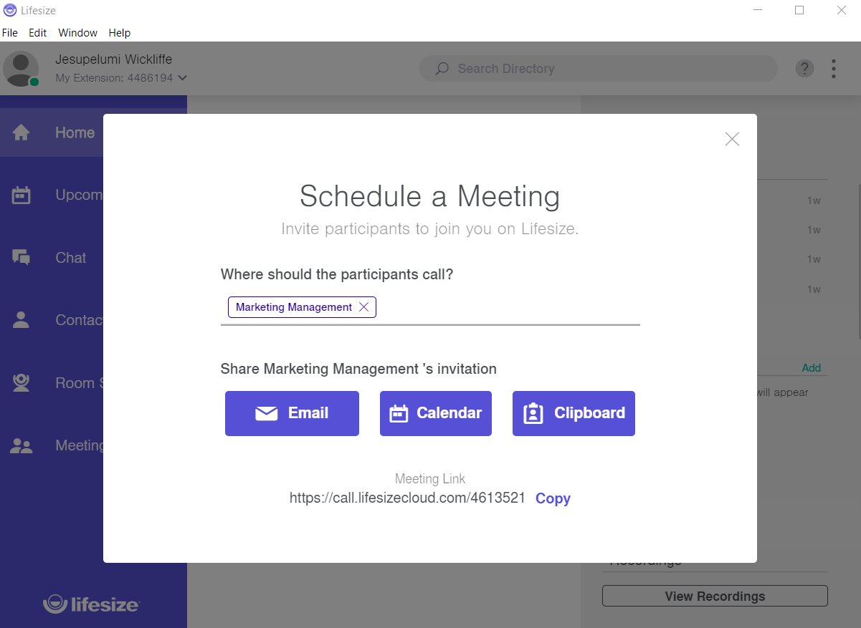
How to invite participants
Choose your preferred method of inviting meeting participants

Slide 28
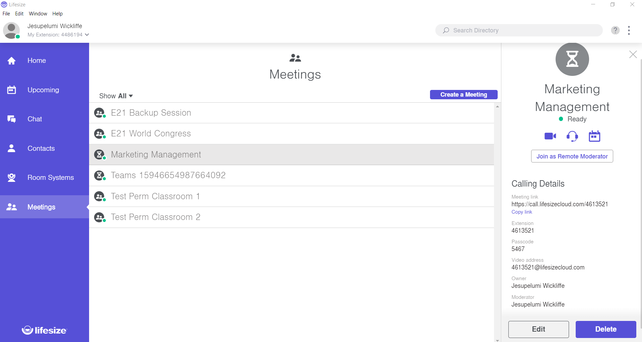
How to start the meeting
Step 1: Navigate to meeting tab and select desired meeting.
Step 2: Click here to start meeting

Slide 29
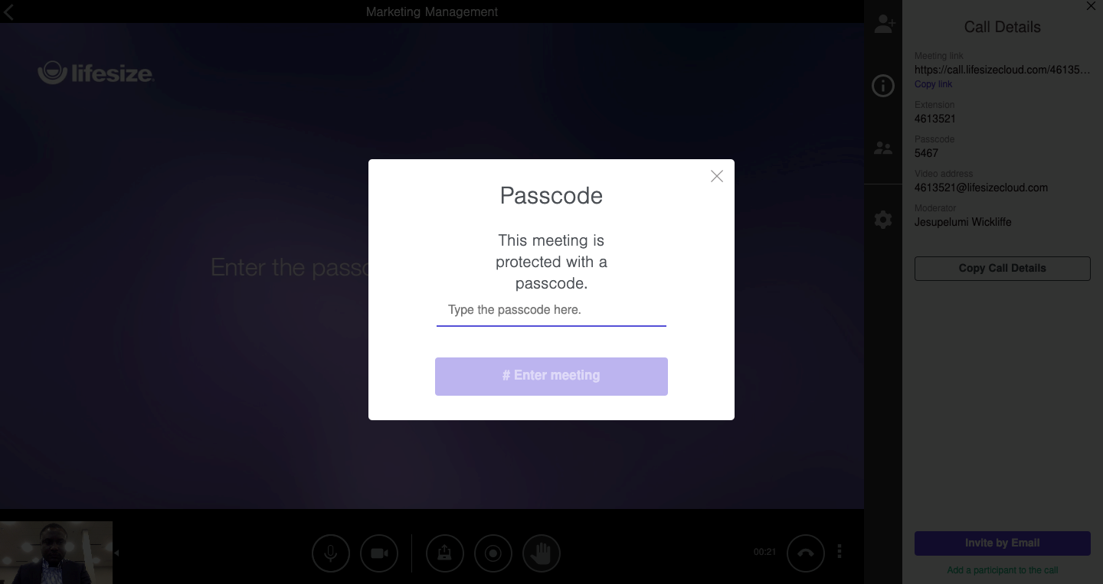
How to start the meeting
Step 3: Enter meeting passcode

Slide 30
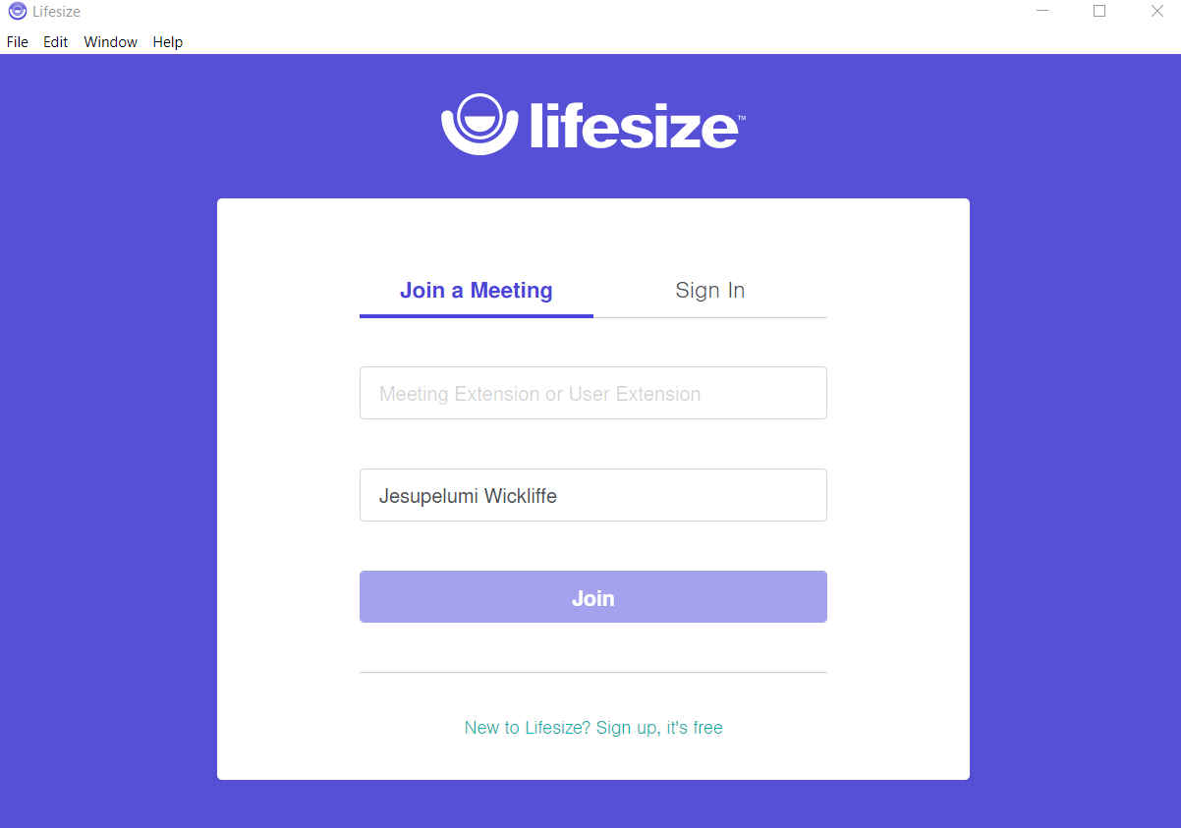
How to join a meeting
Type meeting extension
Type your name
Click “Join”

Slide 31
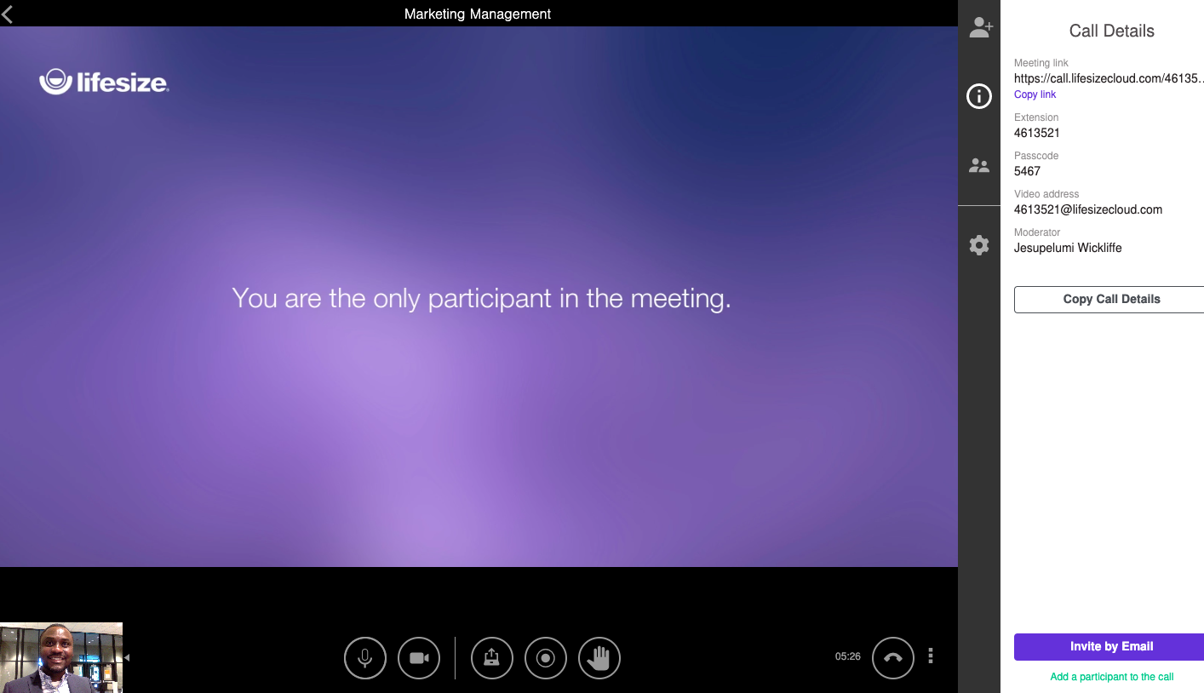
How to share your screen
Step 1:
Click the “share your screen” icon

Slide 32
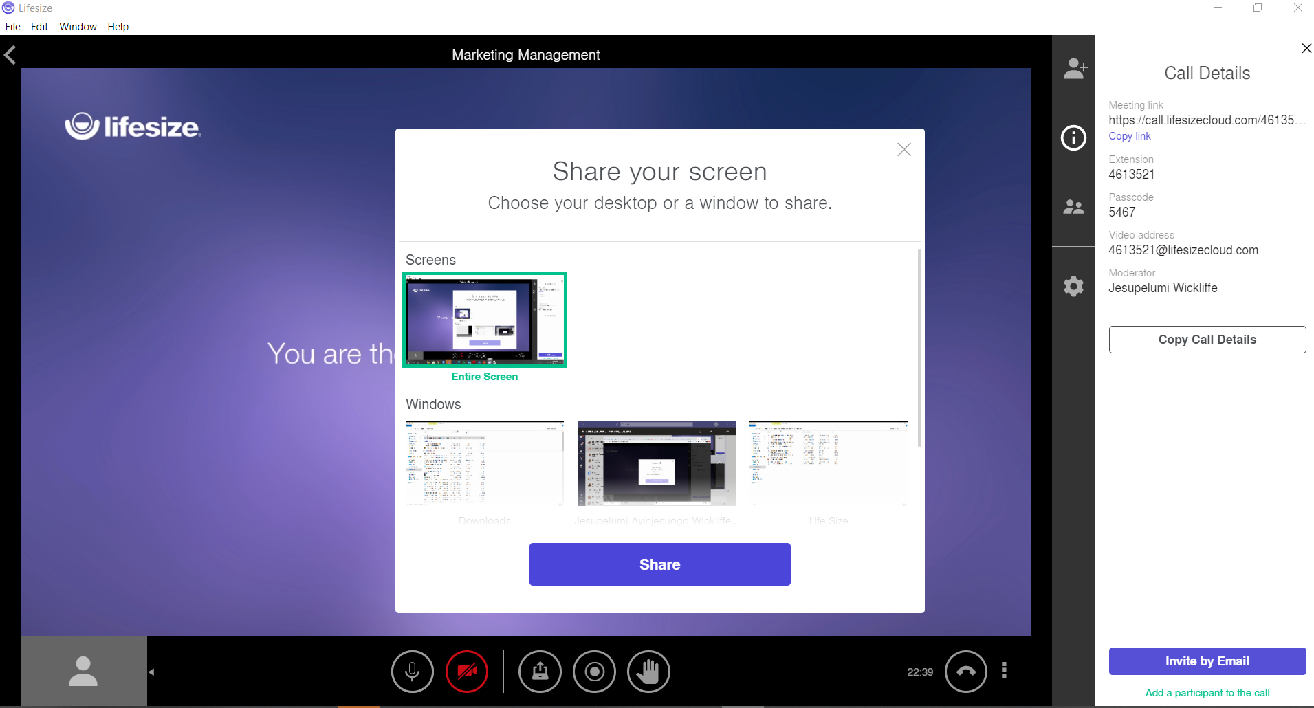
How to share your screen
Step 2:
You Can share your Entire Screen (recommended) or Application Window.
Step 3:
Click “Share”.

Slide 33
How to record a meeting
Click on the “record” icon.

Slide 34
Share meeting Recording
Click on the “View Recordings” icon.

Slide 35

Microsoft Teams for Education

Slide 36

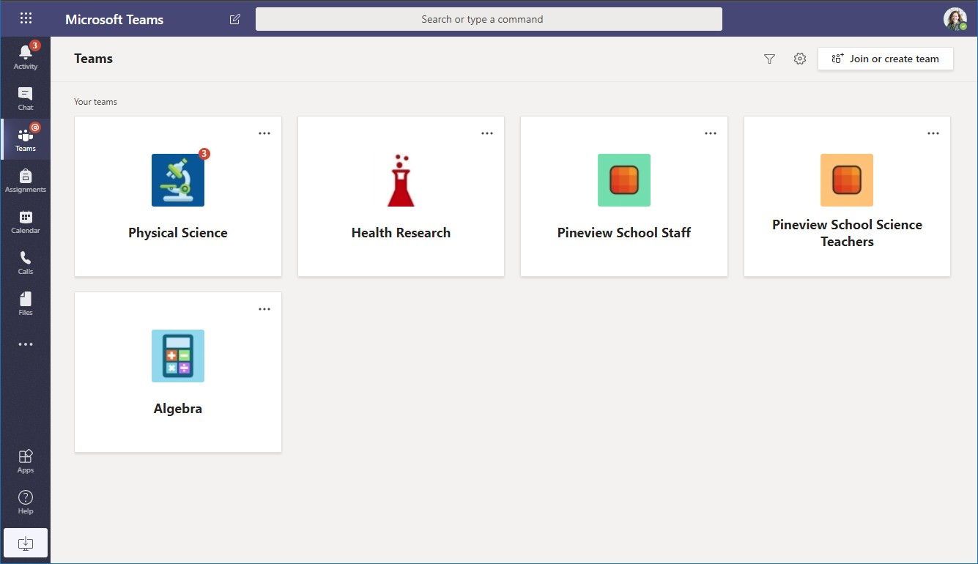
Microsoft Teams for Education
Microsoft
Learn more about Teams
Quick Start Guide
New to Microsoft Teams for Education? Use this guide to learn the basics.
Start a new chat
Launch a private one-on-one or small group conversation.
Use the command box
Search for specific items or people, take quick actions, and launch apps.
Manage profile settings
Change app settings, change your pic, or download the mobile app.
Navigate Microsoft Teams
Use these buttons to switch between Activity
Feed, Chat, your Teams, Assignments, Calendar, and Files.
Join or create a team
Find the team you’re looking for, join with a code, or make one of your own.
Manage your team
Add or remove members, create a new channel, or get a link to the team.
View and organize teams
Click to see your teams. Drag team tiles around to reorder them.
View your team
Click to open your class or staff team.
Find personal apps
Click to find and manage your personal apps.
What is a team?
You can create or join a team to collaborate with a certain group of people. Have
conversations, share files and use shared tools with the group – all in one place. That group could consist of a class of students and educators, a group of staff and
educators collaborating on a topic, or even a group for a student club or other extracurriculars.
Add apps
Launch Apps to browse or search apps you can add to Teams.

Slide 37

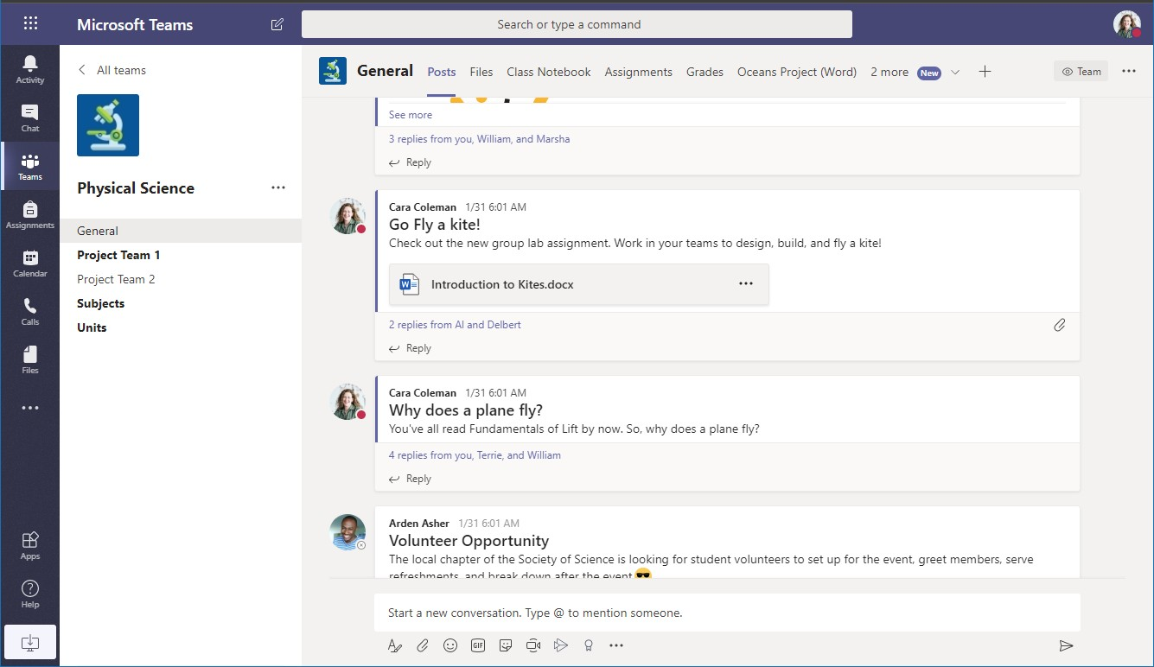
Microsoft Teams for Education
Microsoft
Learn more about Teams
Class teams
Class teams provide special capabilities tailored for teaching and learning
Add channels and manage your team You can change team settings, add members to the class team and add channels .
Open Class Notebook
Class Notebook is a digital binder you can
use in your class to take notes and collaborate.
Open Assignments and Grades
Assignments allows educators to create and distribute assignments. Students can complete and turn
in their assignments without leaving the app. Educators can use the Grades tab to provide feedback on assignments and track student progress. Students can see their progress, too.
Add tabs
Explore and pin applications, tools, documents and more to enrich your class.
We’re constantly adding more education specific tabs. Check back often.
Every team has channels Click one to see the files and conversations about that
topic, class unit, or week in the course. You can even have private channels for group projects!
Share files
Let class members view a file or work on it together.
Every team comes with a General
channel. Open channel settings to add new channels, manage notifications and other settings.
Start a discussion with the class
Type and format you message or announcements here. Add a file, emoji, GIF,
or sticker to liven it up!
Format your message
Add a subject, format text, convert the
message to an announcement, post across multiple teams or control who can reply and more.
Add more messaging options
Click here to add new messaging capabilities like polls, Praise, and more to enrich classroom discussion.

Slide 38


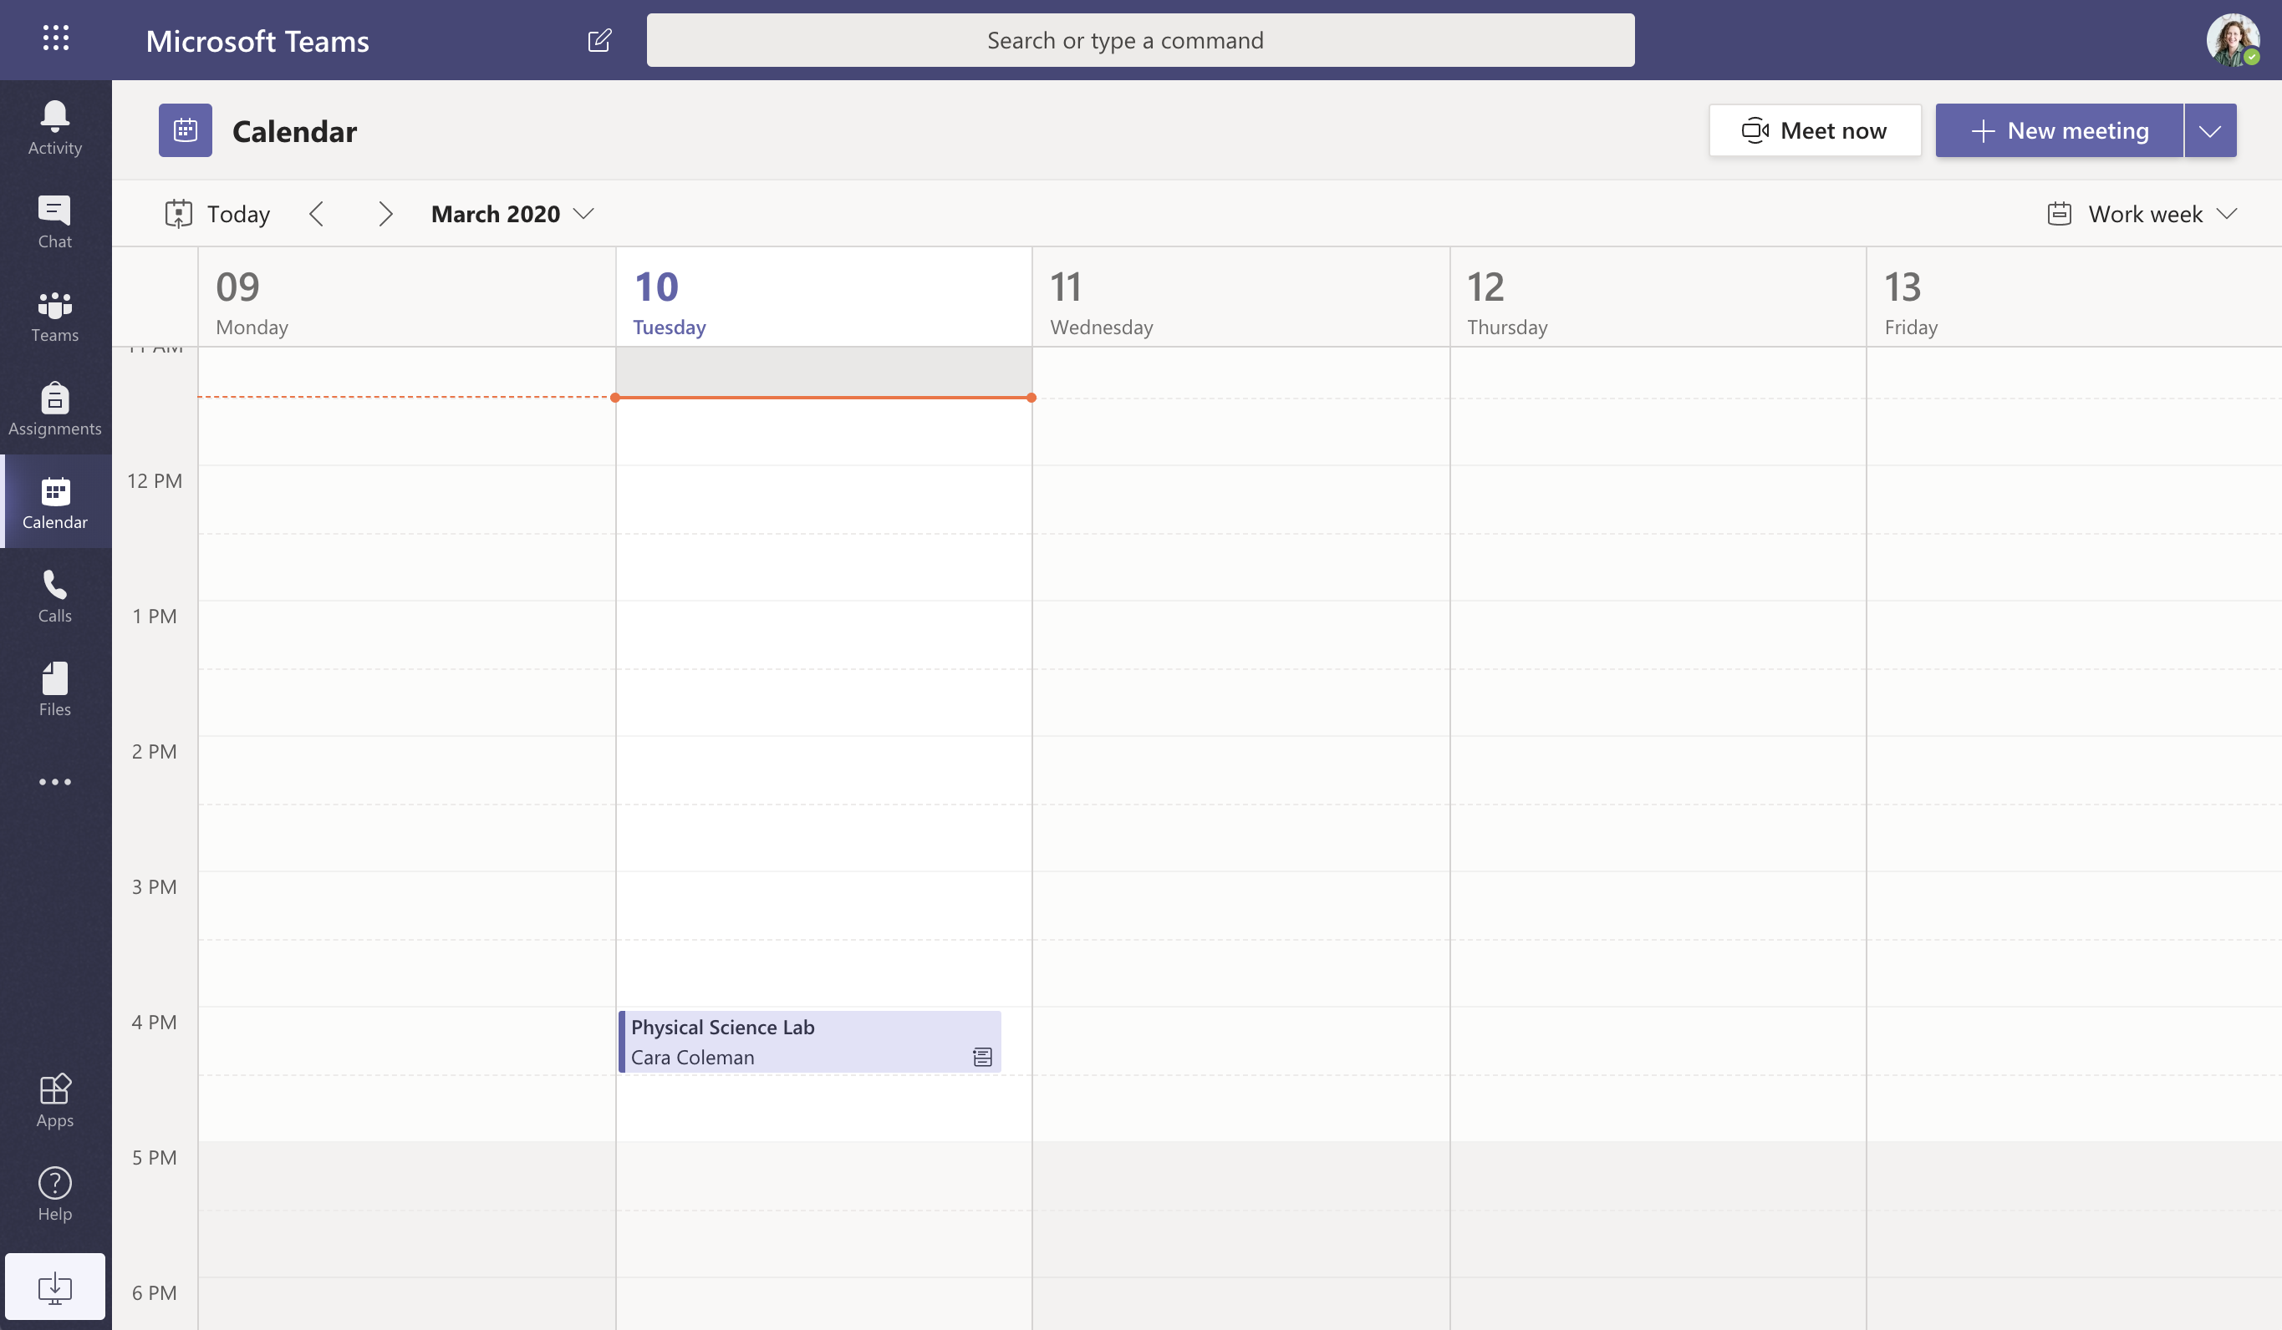
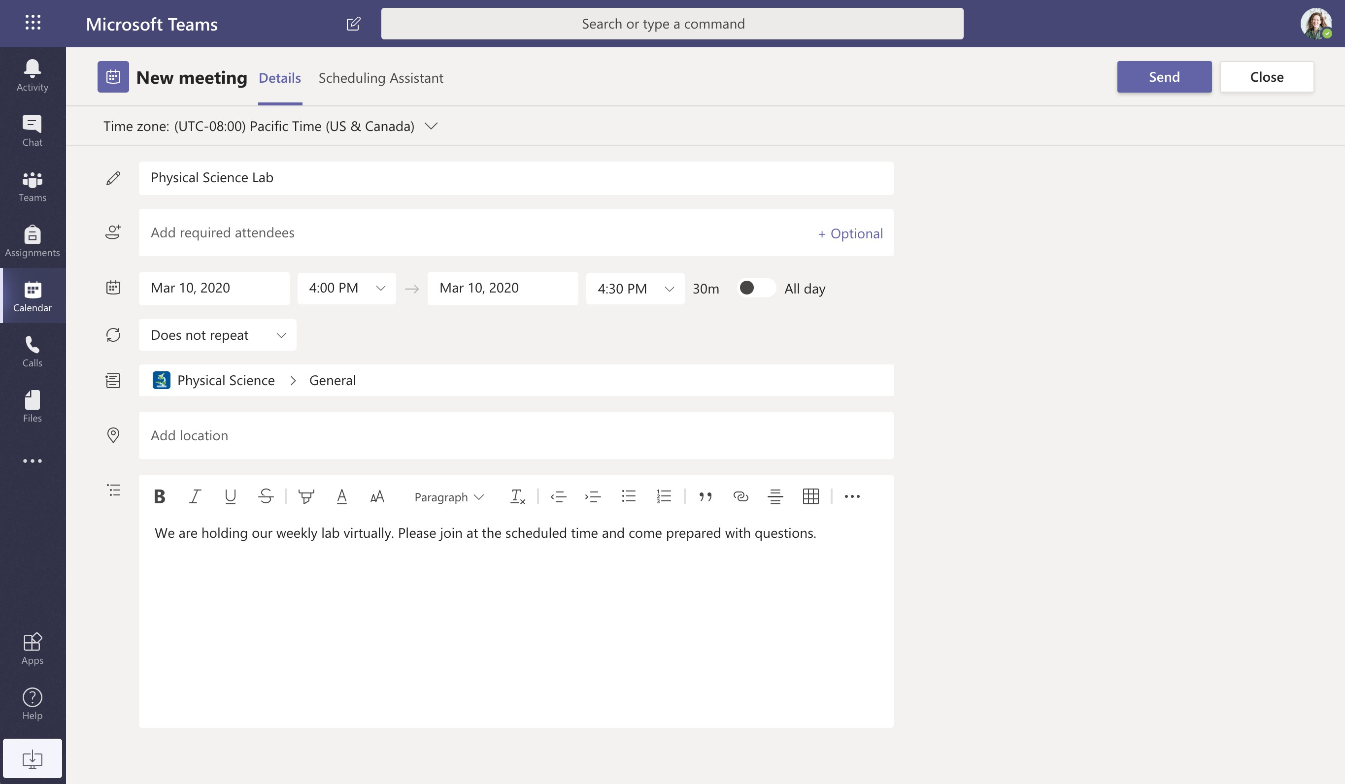
Microsoft Teams for Education
Microsoft
Learn more about Teams
Schedule a meeting with your team or class
Hold classes, staff collaboration meetings, or trainings over online meetings
Start a meeting right away
Add participants directly to a meeting that starts right away.
Add new meeting
Schedule a new meeting for live discussion with up to 250 people or schedule a live
event for a broadcasted event with a wider audience.
Invite individuals to a meeting
Invite one or more individuals to your meeting. Meeting recordings and resources
shared during the meeting will be organized within the meeting history item in your Chat view.
Invite a channel to a meeting
Invite your whole class or working group to a meeting by selecting a channel to host the meeting. Meeting
recordings and resources shared during meetings will be organized within the selected channel.

Slide 39

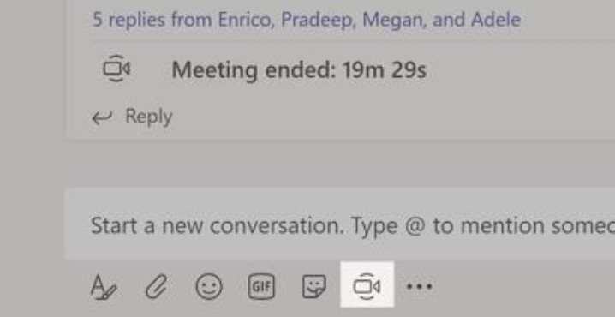
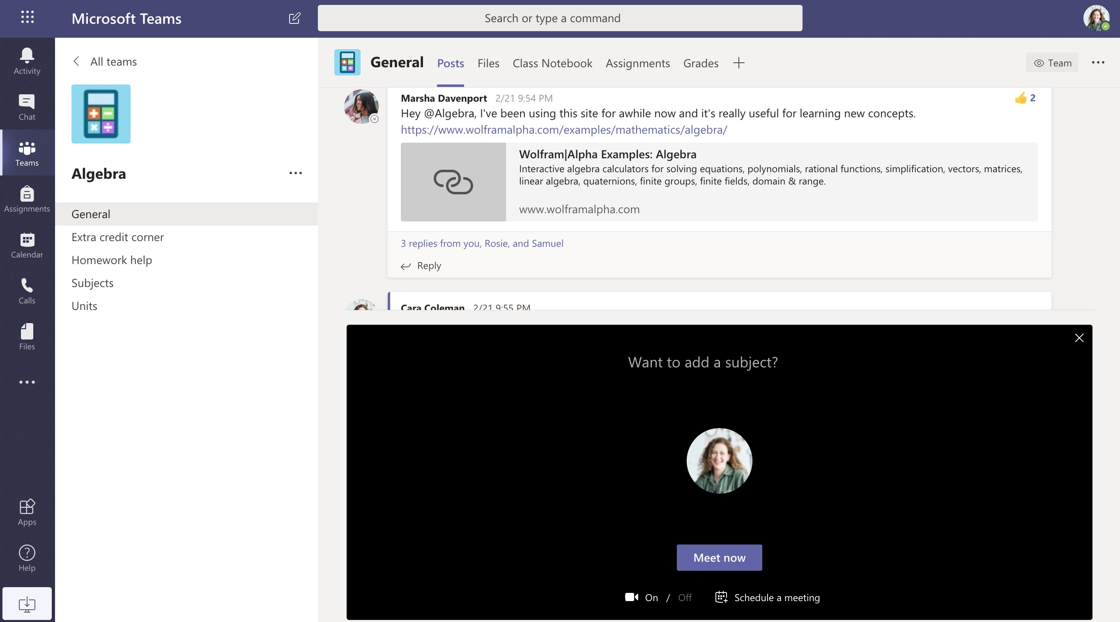
Microsoft Teams for Education
Microsoft
Learn more about Teams
Schedule a meeting with your team or class
Hold classes, staff collaboration meetings, or trainings over online meetings
Click Meet now under the message box to start a live meeting in a channel. If you click Reply to a message, then the meeting will be attached to that conversation. If you wish to start an independent meeting that is not tied to a channel, then follow the instructions on the previous page by selecting Calendar > New Meeting.
You can invite people to the meeting or ask them to join it directly from the channel.
Select Meet now to start the meeting right away or Schedule a meeting to schedule the meeting for the future. Members of the channel will see an invitation for the meeting in their calendar if you decide to schedule it for later.

Slide 40
Microsoft Teams for Education
Microsoft
Learn more about Teams
Roles in an online meeting
Every participant in a meeting is assigned a role as a presenter or attendee. A participant's role controls what they can do while in a meeting.
Capabilities | Organizer/Presenter | Attendee
Speak and share video | ✓ | ✓
Participate in meeting chat | ✓ | ✓
Privately view a PowerPoint file shared by someone else | ✓ | ✓
Share content | ✓
Mute other participants | ✓
Remove participants | ✓
Admit people from the lobby | ✓
Change the roles of other participants | ✓
Start or stop recording | ✓

Slide 41
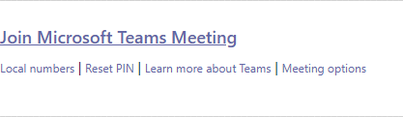
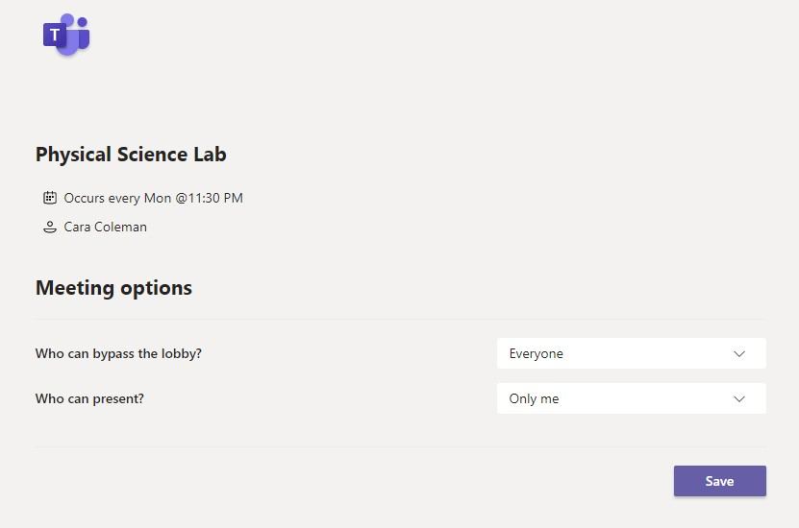
Microsoft Teams for Education
Microsoft
Learn more about Teams
Set meeting roles through your Meeting options
Meeting options allow you to control if meeting participants join your meetings as attendees or presenters.
Control who can enter the meeting directly.
Use the virtual meeting lobby so that participants wait to be admitted to the meeting instead of joining immediately.
Go to your Calendar and navigate to the meeting you'd like to update. Click or tap Meeting options near the meeting join link to open your Meeting options.
Control who joins the meeting as a presenter or attendee.
Select Only Me to designate all other participants as attendees. This is the safest set-up for meetings held in a classroom setting.
If you expect to have more than one presenter in your meeting, select Specific people and pick the other participants who should join as presenters. Select Everyone if you want all participants to join the meeting as a presenter.
Meeting options may be limited by your IT administrator’s policy settings.

Slide 42


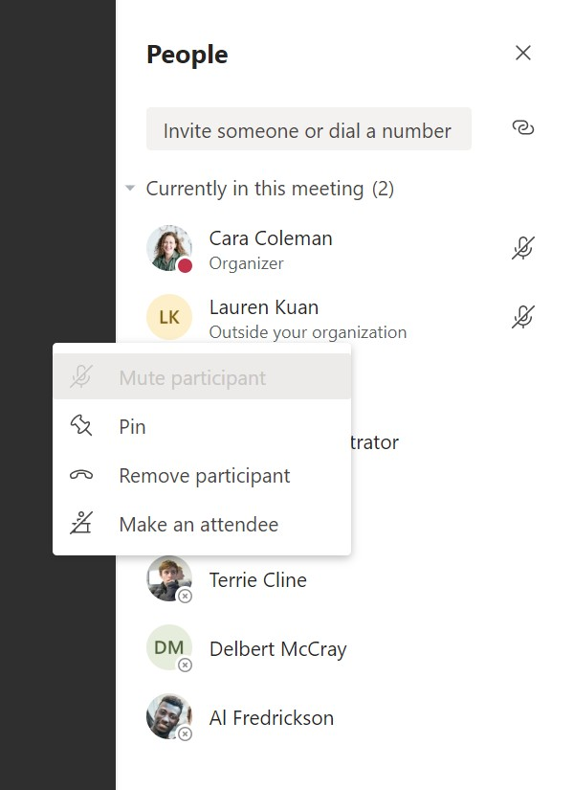
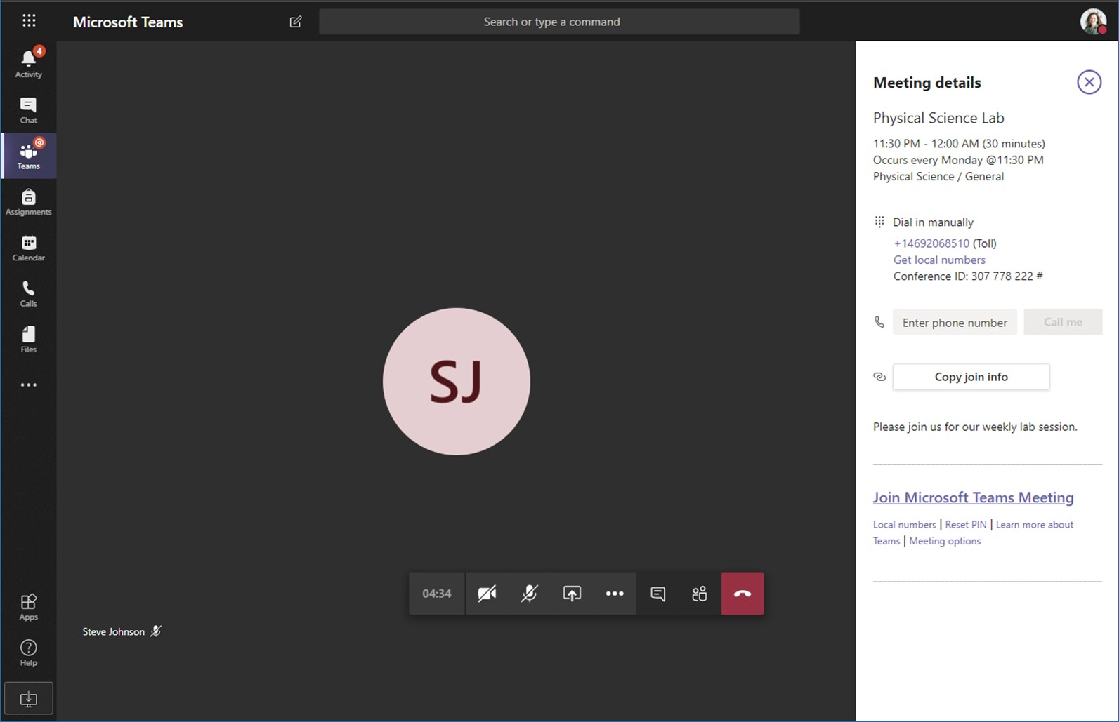
Microsoft Teams for Education
Microsoft
Learn more about Teams
Change roles during a meeting
Every participant in a meeting is assigned a role as a presenter or attendee. A participant's role controls what they can do while in a meeting.
To change a participant’s meeting role, click or tap Show participants in your call controls. Right-click on the participant whose role you want to change. Select Make an attendee or Make a presenter.
To quickly access your Meeting options and change the meeting role settings for both current participants and anyone joining your meeting in the future, click or tap More actions in your call controls, then Show meeting details. You can find the link to your Meeting options near the join link for the meeting.

Slide 43
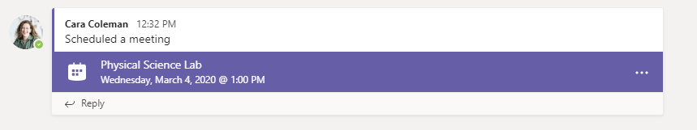
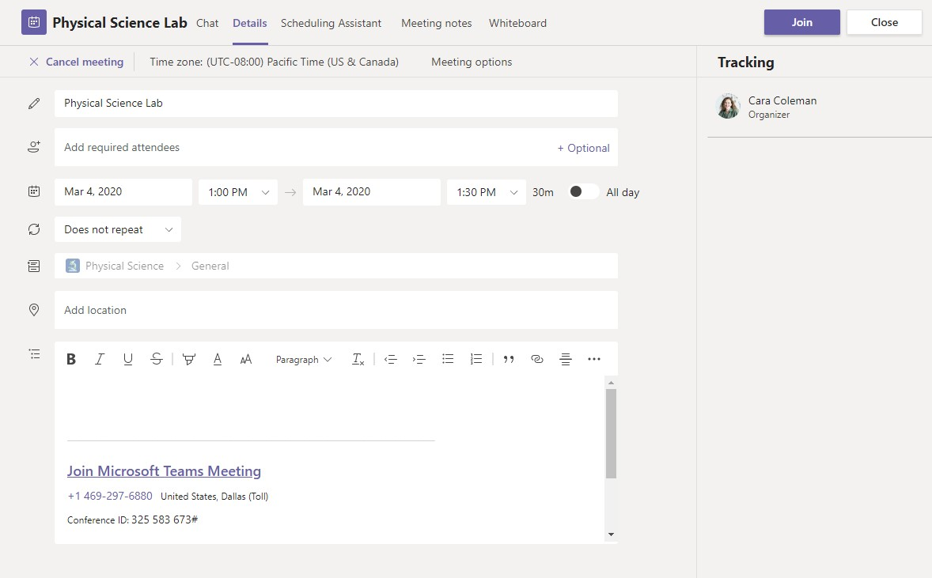
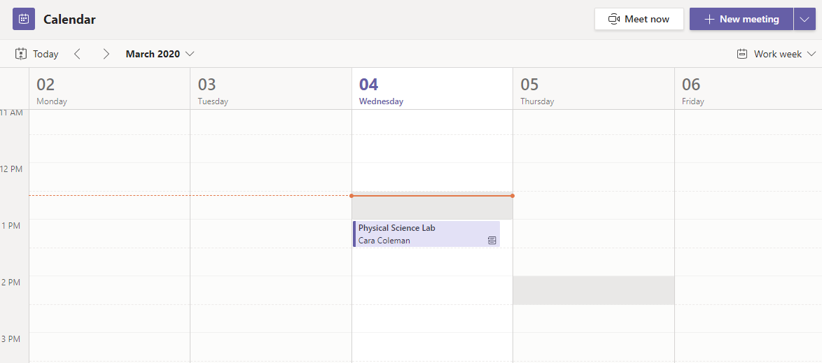
Microsoft Teams for Education
Microsoft
Learn more about Teams
Join a meeting
Hold classes, staff collaboration meetings, or trainings over online meetings
Find the meeting invitation in the channel of your team or on your Teams calendar.
Open the meeting and click Join to join the meeting.

Slide 44
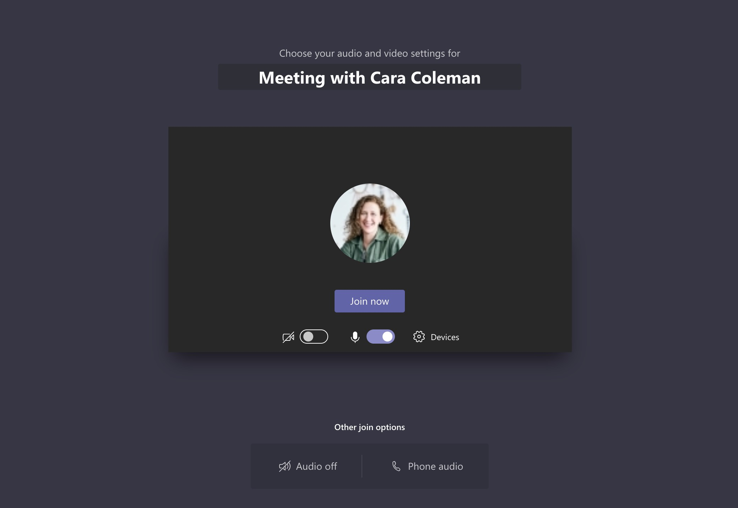
Microsoft Teams for Education
Microsoft
Learn more about Teams
Join a meeting
Hold classes, staff collaboration meetings, or trainings over online meetings
Find the meeting invitation in the channel of your team or on your Teams calendar. Click to open the meeting item and select Join.
Double-check your audio and video input, turn on the camera, and unmute your microphone to be heard. Select Join now to enter the meeting.

Slide 45

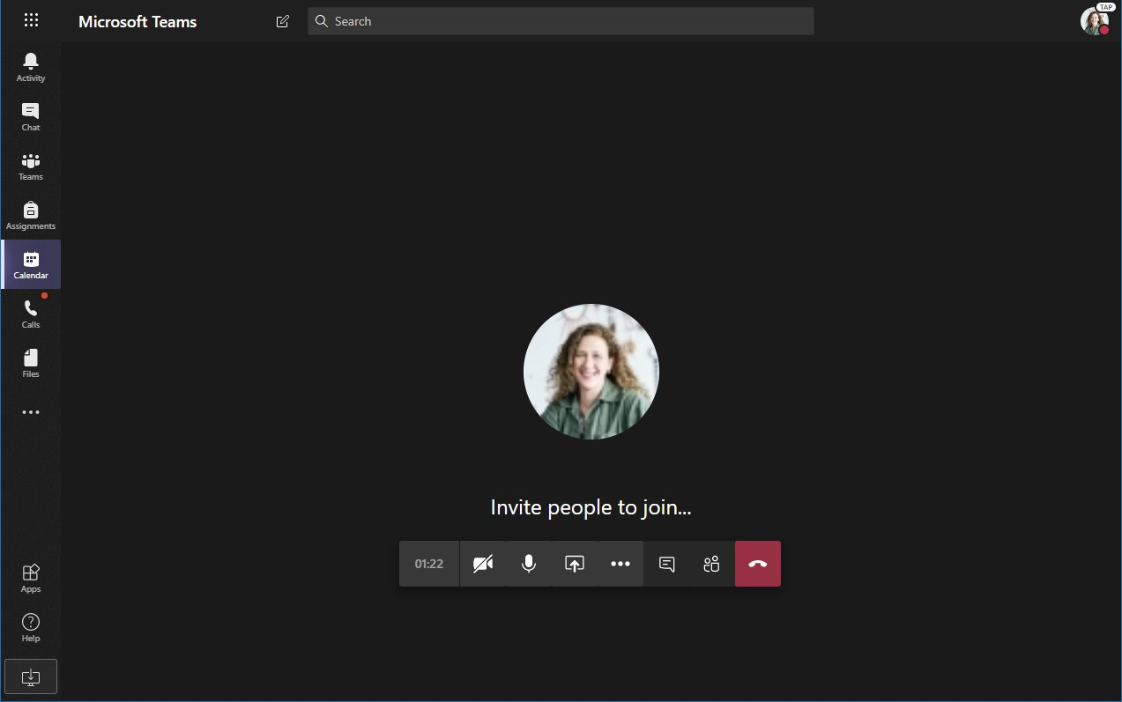
Microsoft Teams for Education
Microsoft
Learn more about Teams
Participate in a meeting
Share video, voice, or your screen during the online call.
Send chat messages
Send chat messages, share links, add a file, and more. Resources you share will be available after the meeting.
Turn your video feed on and off.
Leave the meeting
The meeting will continue even after you have left.
Mute and unmute yourself.
Add participants to the meeting.
Share your screen and sounds from your computer.
Access additional call controls
Start a recording of the meeting, change your device settings, and more.

Slide 46
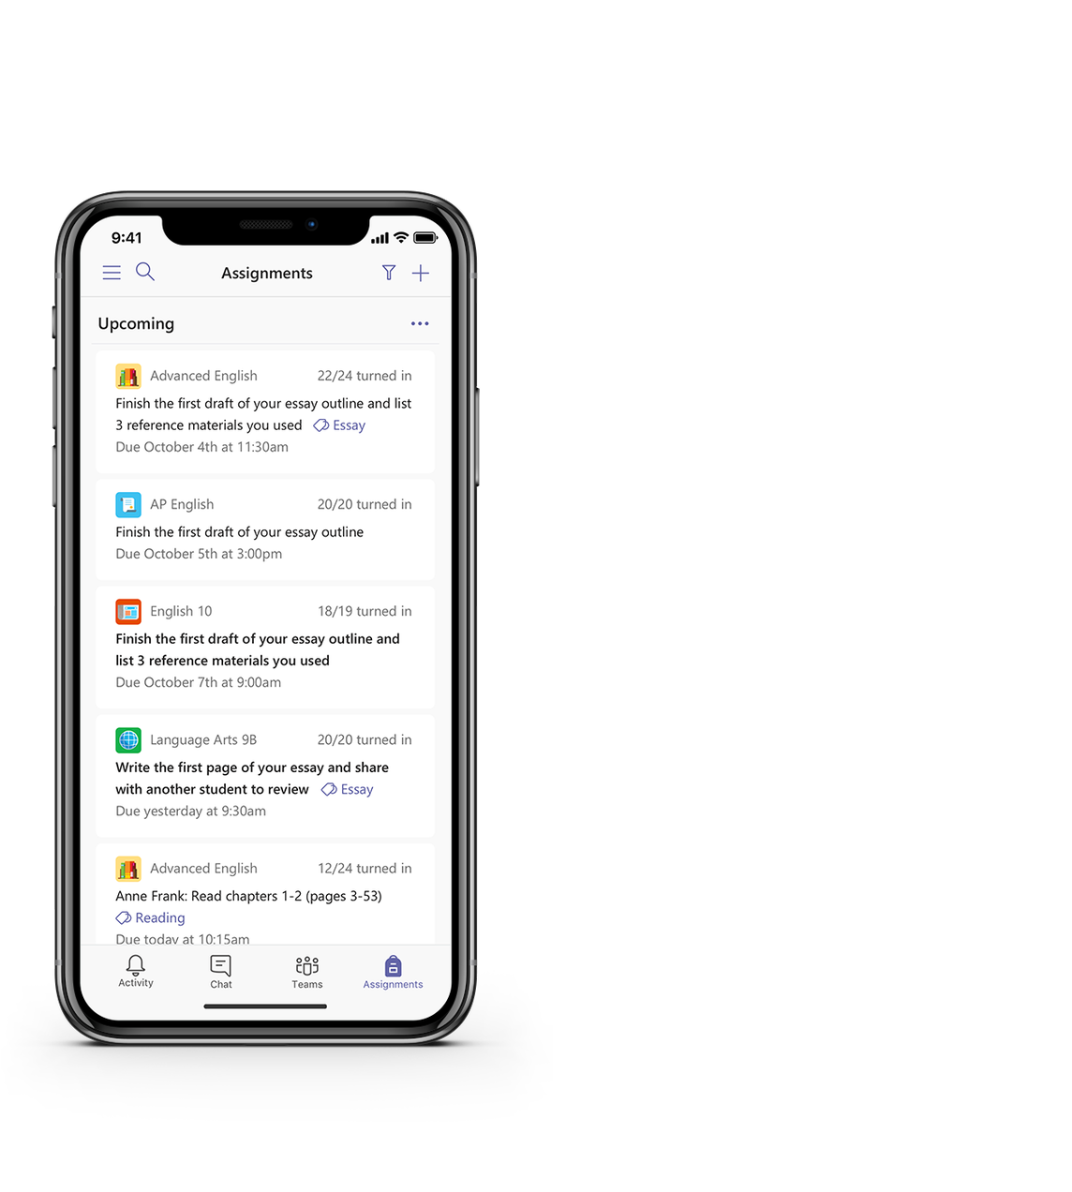

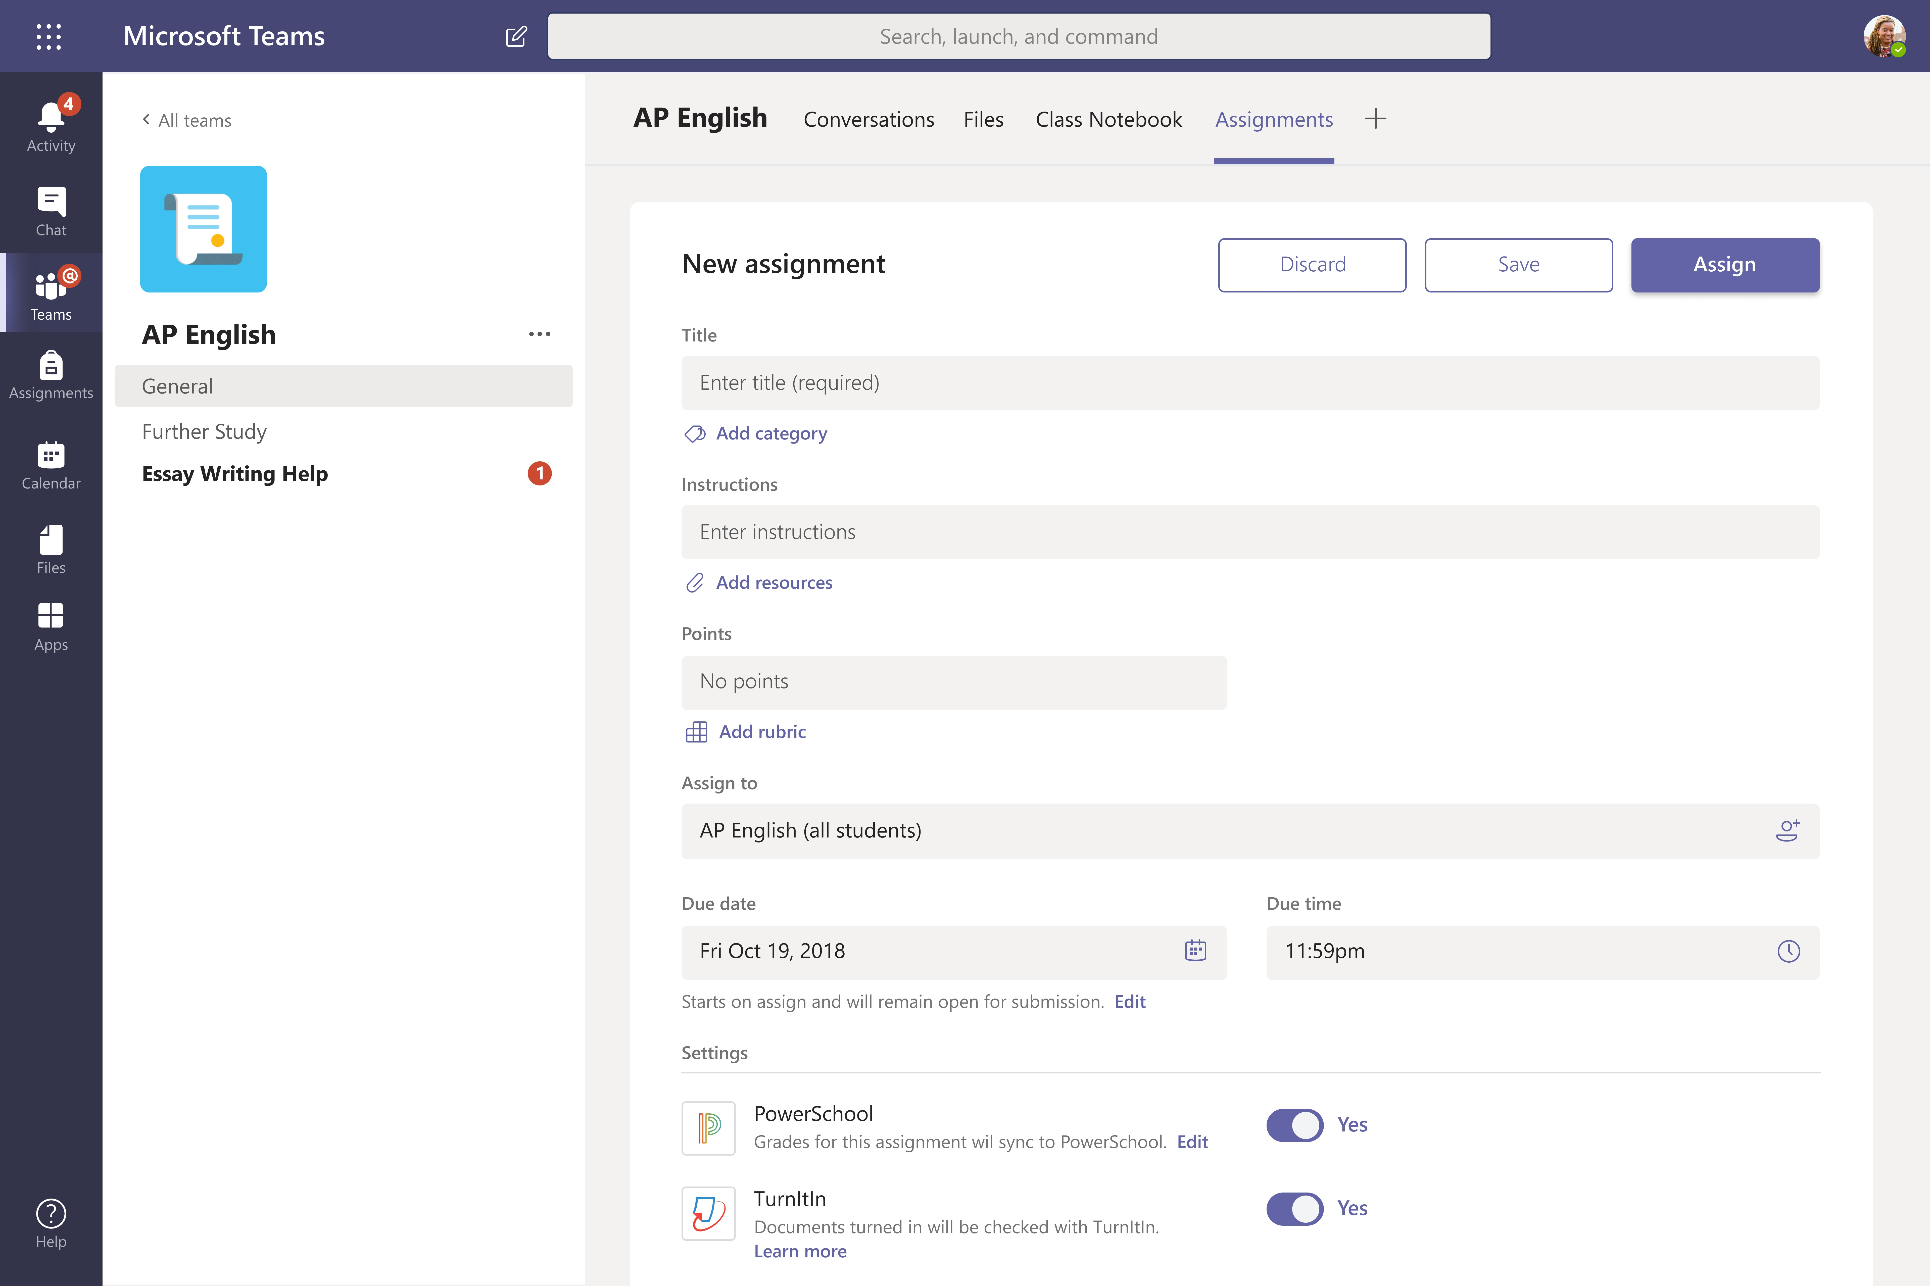
Microsoft Teams for Education
Microsoft
Learn more about Teams
Assignments
Create learning activities for students with integrated Office applications.
View upcoming assignments
View both upcoming and turned in assignments by class, or view them across all your classes. Selecting an assignment will allow you to turn it in or view feedback and scores.
Add resources
Customize the assignment with
content from OneDrive, your device, links, and more.
Assign to classes or individuals
Assignments can be distributed to multiple classes or personalized to the individual student.
Add a grading rubric
Use the rubrics tool to create customizable, reusable rubrics for students to reference and for you to evaluate their work.
Edit due dates, close date, and schedule to assign
Customize all the dates and times that are important to the assignment.

Slide 47


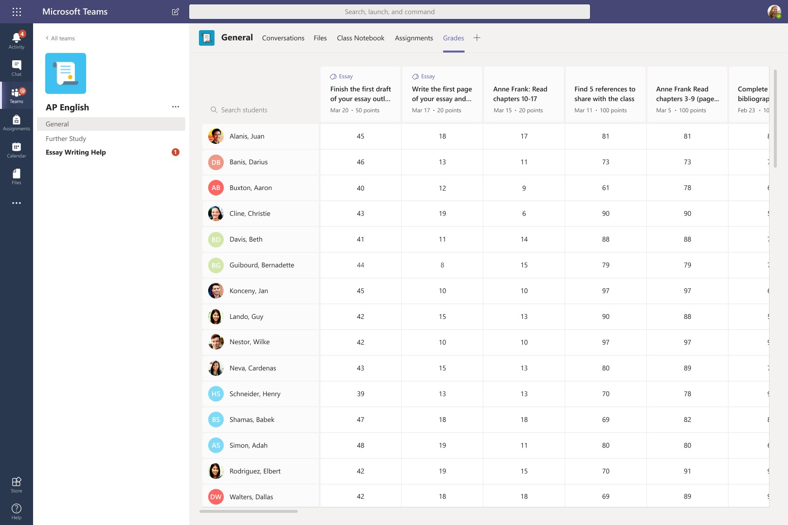
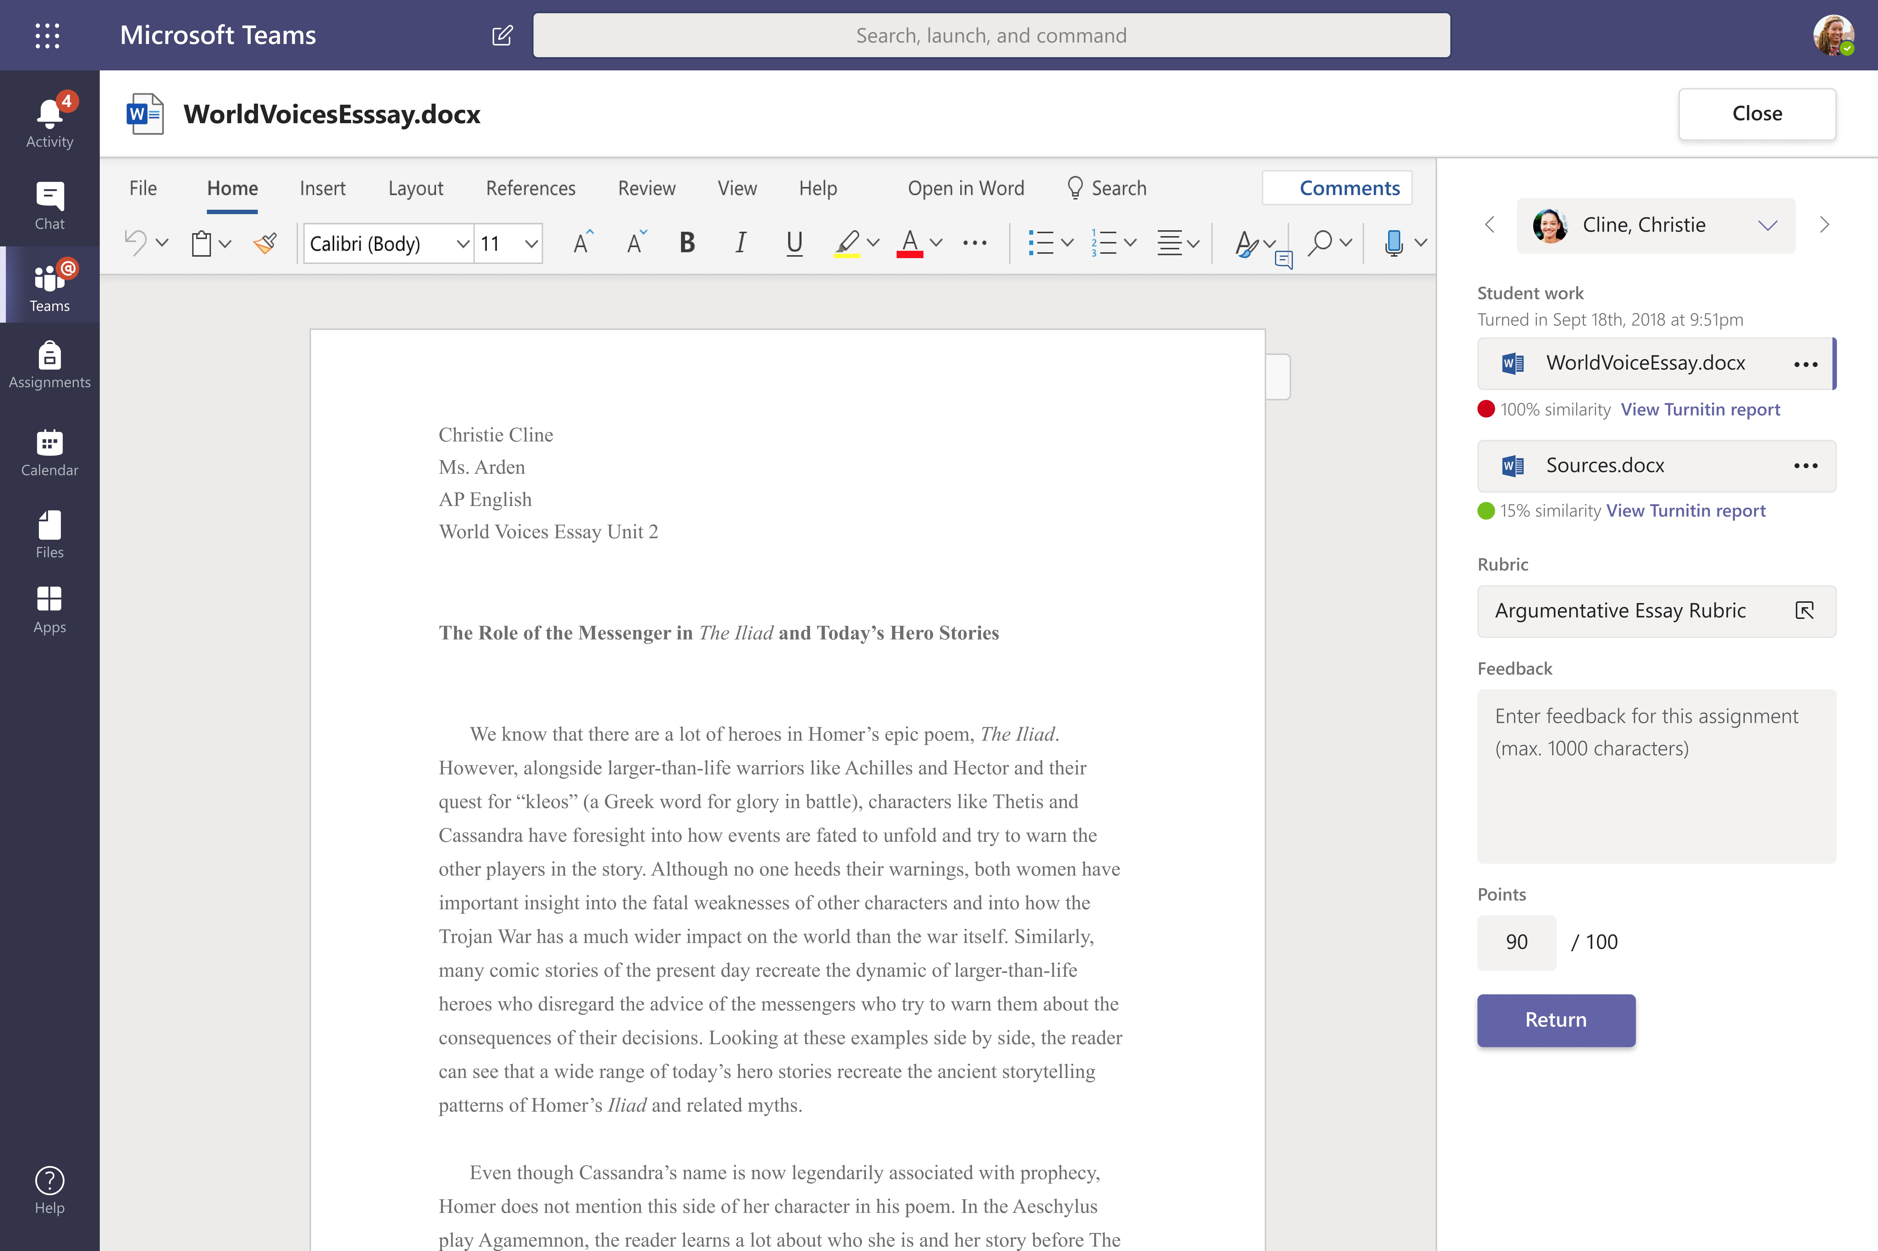
Microsoft Teams for Education
Microsoft
Learn more about Teams
Grades
Leave feedback for students, grade, and track student progress in the Grades tab.
See grades across all assignments and students
Each of your class teams has a Grades tab where you can view assignments at a glance, as well as track how individual students in your class are progressing.
Return and review assignments using the feedback loop Leave comments, make edits, grade with criteria/standards, check for similarity, and more in the grading view.

Slide 48

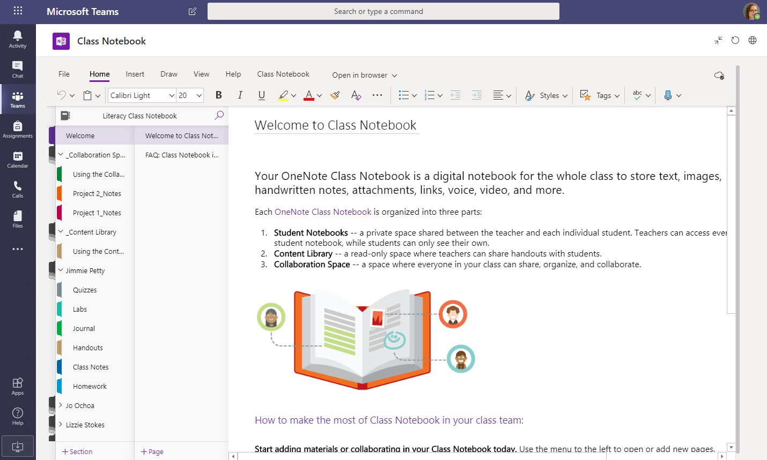
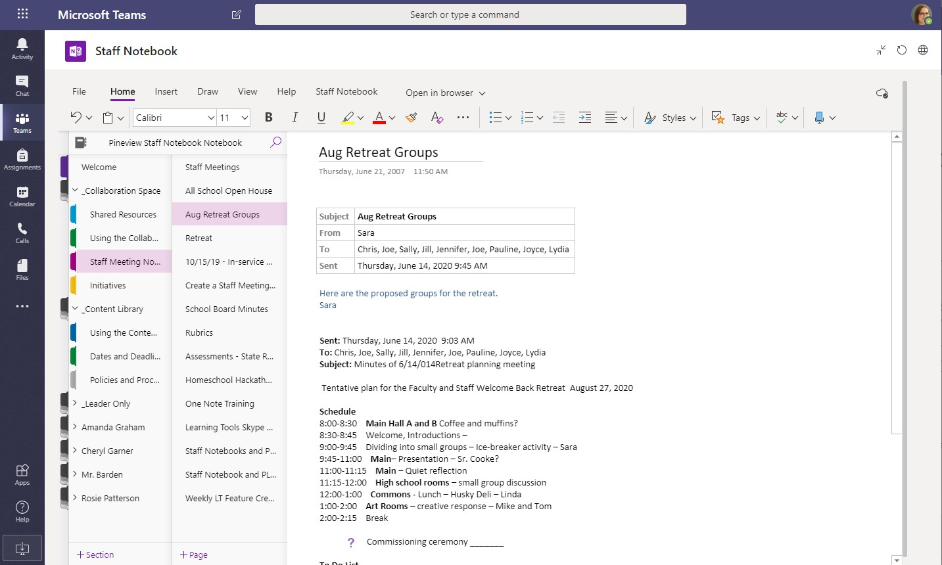
Microsoft Teams for Education
Microsoft
Learn more about Teams
OneNote Class and Staff Notebooks
A digital binder to use in your class or with your staff to take notes and collaborate
Personal notes, class notes, and collaboration
OneNote Class Notebooks have a personal workspace for every student, a Content Library for handouts, and a Collaboration Space for lessons and creative activities.
Great for staff meeting notes, brainstorming, and classroom observations
OneNote Staff Notebooks have a personal workspace for every staff member or teacher, a Content Library for shared information, and a Collaboration Space for everyone to work together, all within one powerful notebook.

Slide 49
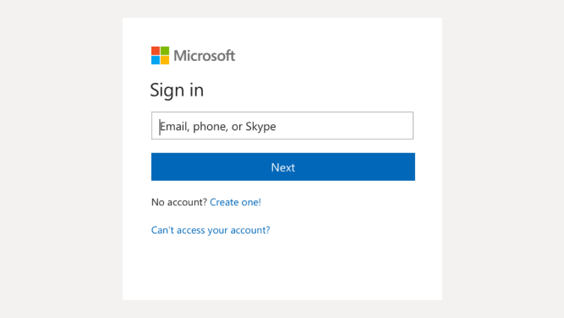

Microsoft Teams for Education
Microsoft
Learn more about Teams
Sign in
In Windows, click Start > Microsoft Teams.
On Mac, go to the Applications folder and click Microsoft Teams. On mobile, tap the Teams
icon. Then, sign in with your school email and password.
Start a conversation
With the whole team... Click Teams, pick a team and channel, write your message, and click
Send.
With a person or group... Click New chat, type the name of the person or group in the To field, write your message, and click Send.

Slide 50


Microsoft Teams for Education
Microsoft
Learn more about Teams
Enrich your channel posts
Create classroom announcements and posts. Edit your post to get your students' attention, control who replies, and post across multiple channels.
Change your message type Select if you want to start a new conversation topic or post an announcement.
Control who can reply Allow everyone to reply to your post or limit replies to moderators only.
Post in any channel or team
Post your message in any of your teams and channels all at once. Great for broadcasting
an important announcement!
Change the importance of your message
Mark your message as important if you want to draw more attention to the post.
Format your text
Change text color, format, and style.
Add a subject
Keep the topic of your new post clear by adding a subject.
Add a subject
Click here to enter a rich format mode for your message.

Slide 51




Microsoft Teams for Education
Microsoft
Learn more about Teams
Make video and audio calls
Click Video call or Audio call to call someone from a chat. To dial a number, click Calls on the left and enter a phone number. View your call history and voicemail in the same area.
@mention someone
To get someone’s attention, type @, then their name (or pick them from the list that appears). Type @team to message everyone in a team or @channel to notify everyone who favorited that channel.
Reply to a conversation
Channel conversations are organized by date and then threaded. Find the thread you want to reply to, then click Reply. Add your thoughts and click Send.
Add an emoji, meme, or GIF
Click Sticker under the box where you type your message, then pick a meme or sticker from one of the categories. There are also buttons for adding an emoji or GIF. Search for MicrosoftEDU in the GIF search box for extra fun!

Slide 52




Microsoft Teams for Education
Microsoft
Learn more about Teams
Stay on top of things
Click Activity on the left. The Feed shows you all your notifications and everything that's happened lately in the channels you follow. This is also where you'll see notifications about your assignments.
Share a file
Click Attach under the box where you type messages, select the file location and then the file you want. Depending on the location of the file, you’ll get options for uploading a copy, sharing a link, or other ways to share.
Add a tab in a channel
Click + by the tabs at the top of the channel, click the app you want, and then follow the prompts. Use Search if you don’t see the app you want.
Work with files
Click Files on the left to see all files shared across all of your teams. Click Files at the top of a channel to see all files shared in that channel. Click More options ... next to a file to see what you can do with it. In a channel, you can instantly turn a file into a tab at the top!

Slide 53



Microsoft Teams for Education
Microsoft
Learn more about Teams
Search for stuff
Type a phrase in the command box at the top of the app and press Enter. Then select the Messages, People, or Files tab. Select an item or click Filter to refine your search results.
Add apps
Click Apps on the left. Here, you can select apps you want to use in Teams, choose the appropriate settings, and Add.
Next steps with Microsoft Teams
Get how-to guidance for teaching and learning with Teams. You can also click the Help icon in Teams to access help topics and training.
Articles with how-to guidance for teaching in Teams.
1-hour online courses in the Microsoft Educator Center:
How teachers use Teams in their professional lives- Transform Learning with
Microsoft Teams.
Teaching in Class Teams-Crafting a Collaborative Learning Environment with Class Teams.
Get other Quick Start Guides
To download our free Quick Start Guides for your other favorite apps, go to
https://go.microsoft.com/fwlink/?linkid=2008317.
Find your personal apps
Click More added apps to see your personal apps. You can open or uninstall them here. Add more apps under Apps. These apps provide an aggregate and global view of that content type.

Slide 54
ORU owned Virtual Class Application Comparison Chart
Virtual Classroom Application | D2L Bongo | LifeSize | MS Teams | Zoom
Features Within Each Virtual Class Option
App was primary designed for: | Virtual Class | Meeting Space | Individual and team collaboration | Meeting and Virtual Class
App is embedded in D2L | Yes | No | No | No
Interfaces with D2L | Yes | W/programming | W/programming | Yes
Works from >90% of world-wide locations* | Yes | Yes | Yes | Yes
ORU owes Classrooms or connections with product | 4,000 | 15 per classroom/hour | Unlimited | 11,000
Virtual class-size limits | 50 – 7 simultaneous webcams | 300 | 1,000 | 300
Ability to record and archive lectures | Yes | Yes | Limited | Yes
Webinar feature and class limits | No | 1 webinars with 1,000 attendee limit. | No | 2 webinars with 1,000 attendee limit.
Breakout room functions | Yes | Limited | Limited | Yes
Whiteboard, screen sharing and annotation | Yes | Yes | Limited | Yes
Security concerns rated from 1 – 4 (1 Least concerns and 4 highest concerned). | 1 | 3 | 4 | 2
* Various countries continue to block certain virtual classroom apps. Some of this is due to security and others due to competition.

Slide 55
More Learning Resources for Lifesize
Desktop and mobile device app download
https://call.lifesizecloud.com/downloads
Record and sharing
https://www.youtube.com/watch?v=UllLmLslwqs&feature=emb_rel_end
Lifesize Live Stream Overview:
https://www.lifesize.com/~/media/Documents/Product%20Documentation/Live%20Stream/SS_LiveStream_US_0117.ashx
Using the Lifesize Live Stream Feature: https://youtu.be/oMkL0TH7z3c
Lifesize Admin Getting Started: https://www.lifesize.com/en/help/admin-console/get-started
Lifesize Computer App Help: https://www.lifesize.com/en/app-help
Lifesize Mobile App Help: https://www.lifesize.com/en/app-help/user/mobile

