Slide 1

Qualtrics: Academic Research & in the Classroomaltrics:
Rebecca Gunn
February 25, 2021

Slide 2
Qualtrics XM
-What it is
-Why use it
-How to use it for education purposes (academic research & in the classroom)
-Creating an Account
-Using the Platform & Support

Slide 3
What is Qualtrics
A cloud-based experience management company with software platforms that focuses on designing and improving products, services, and experiences for businesses and other organizations
- Survey software
- Academic research

Slide 4
Why Use Qualtrics
- Competitors include Google, SurveyMonkey, QuestionPro, Survey Gizmo
- Qualtrics is used by over 12,000+ brands worldwide
  * Microsoft, HP, ABC, Chobani, P&G, NASA, Zillow, IBM, Wharton, University of Cambridge…and ORU!
  - Over 2000 Universities & Colleges use Qualtrics

Slide 5

Why I like Qualtrics
-Industry-leader
-User-friendly
-Smart / AI
-Customer Service
-“Qualtrics is the BMW of survey platforms”

Slide 6
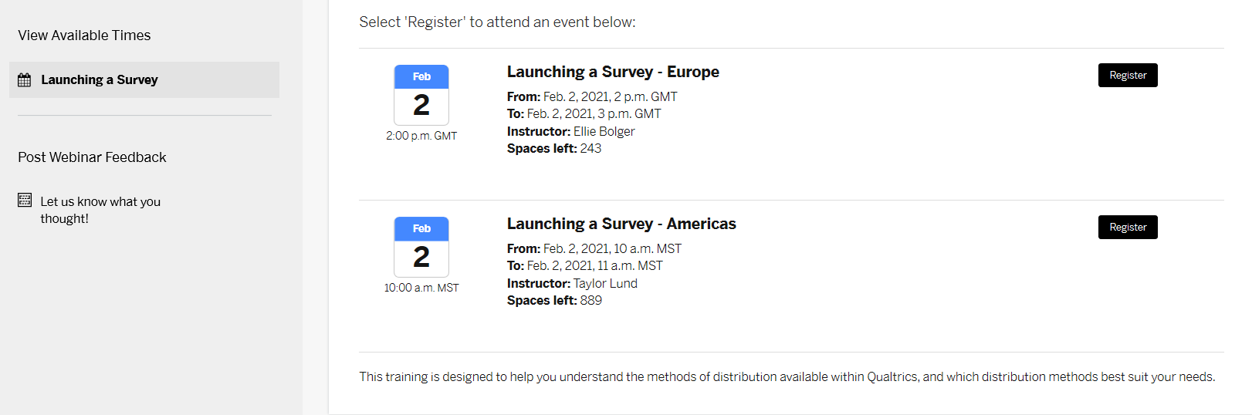
Qualtrics for Education
User-friendly survey platform (over 1 billion surveys a year)
Convert data into SPSS, Excel, other formats
Recording and live weekly webinars

Slide 7
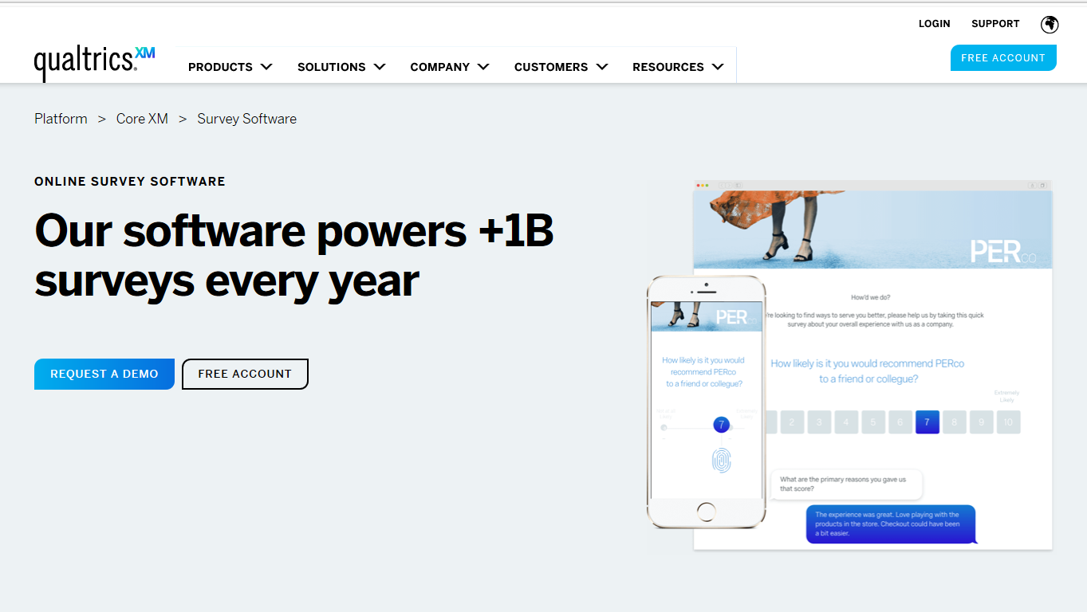
How to Use Qualtrics

Slide 8
How to Use Qualtrics
Creating an account
Go to https://oralroberts.qualtrics.com/
Enter in your University ID and password
Specify that you are not an existing user. You will then always log in through that website.

Slide 9
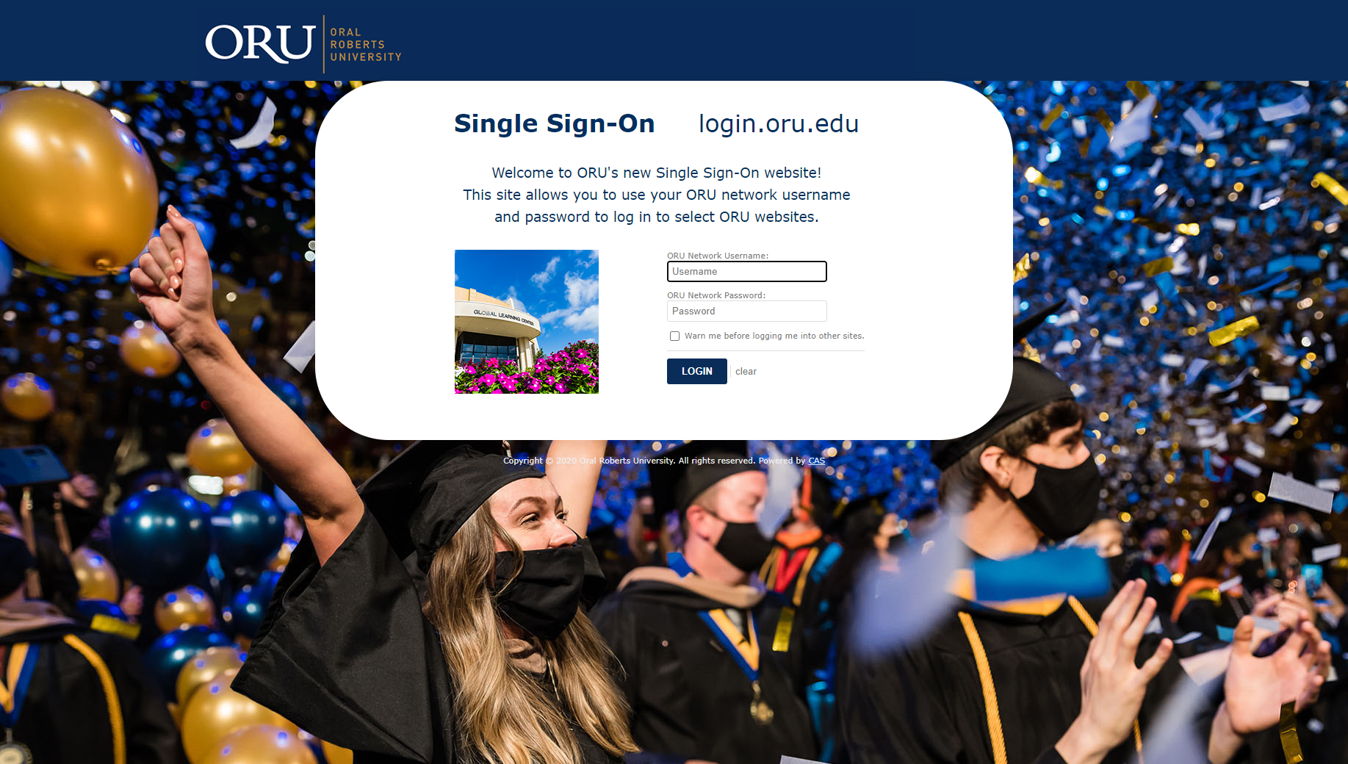

Slide 10
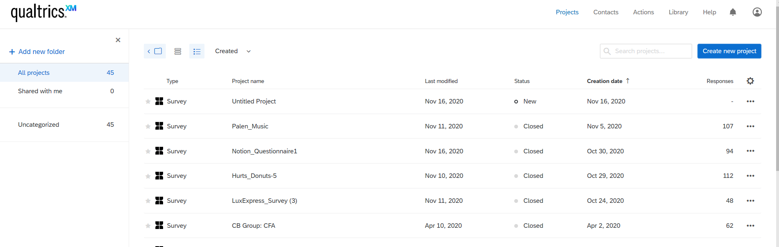
How to Use Qualtrics

Slide 11
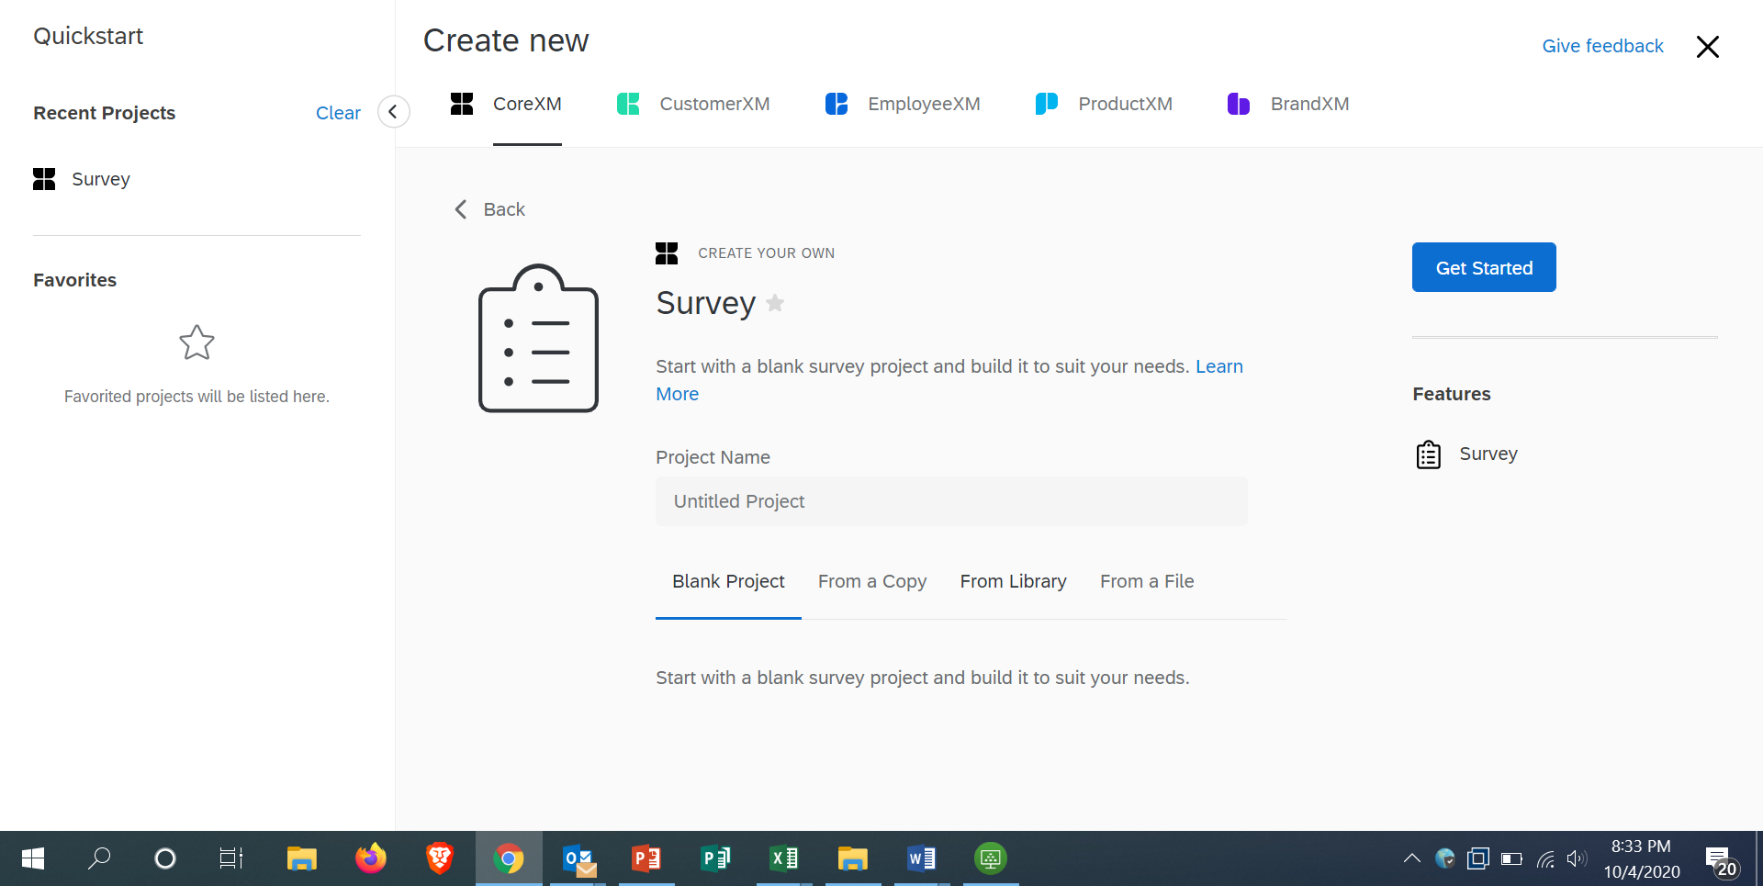
Qualtrics

Slide 12
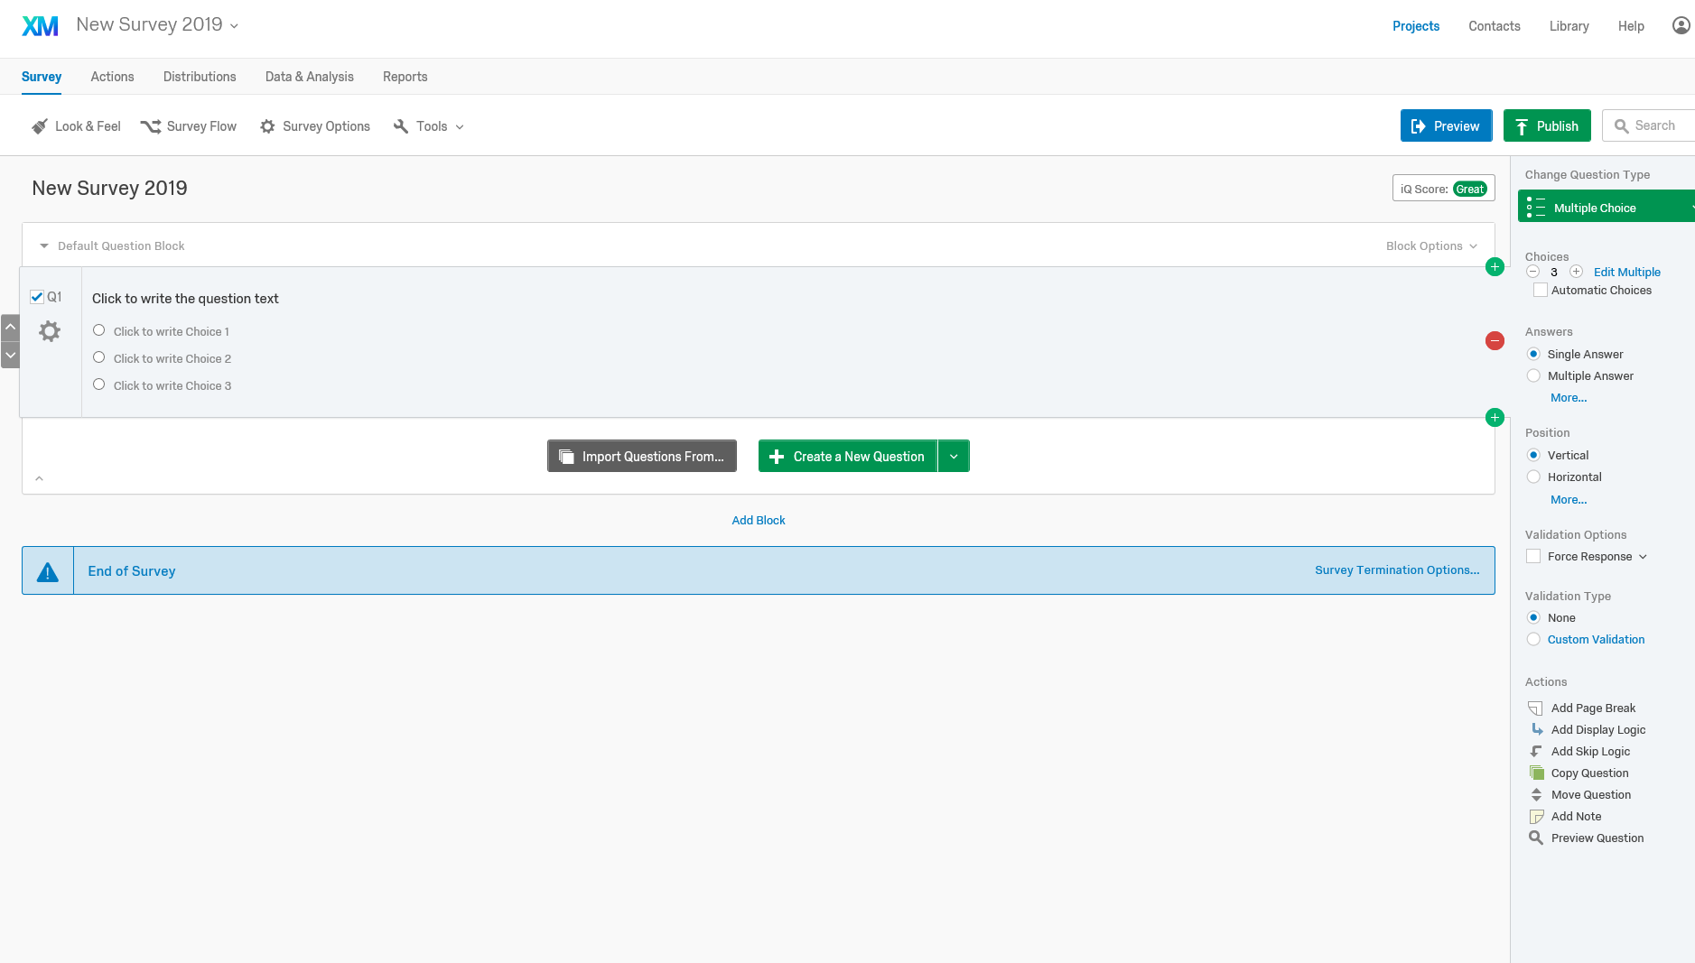
Notes:
Sampling – the process of selecting a few (a sample) from a bigger group (the sampling population) to become the basis for estimating or predicting a fact, situation or outcome regarding the bigger group

Slide 13
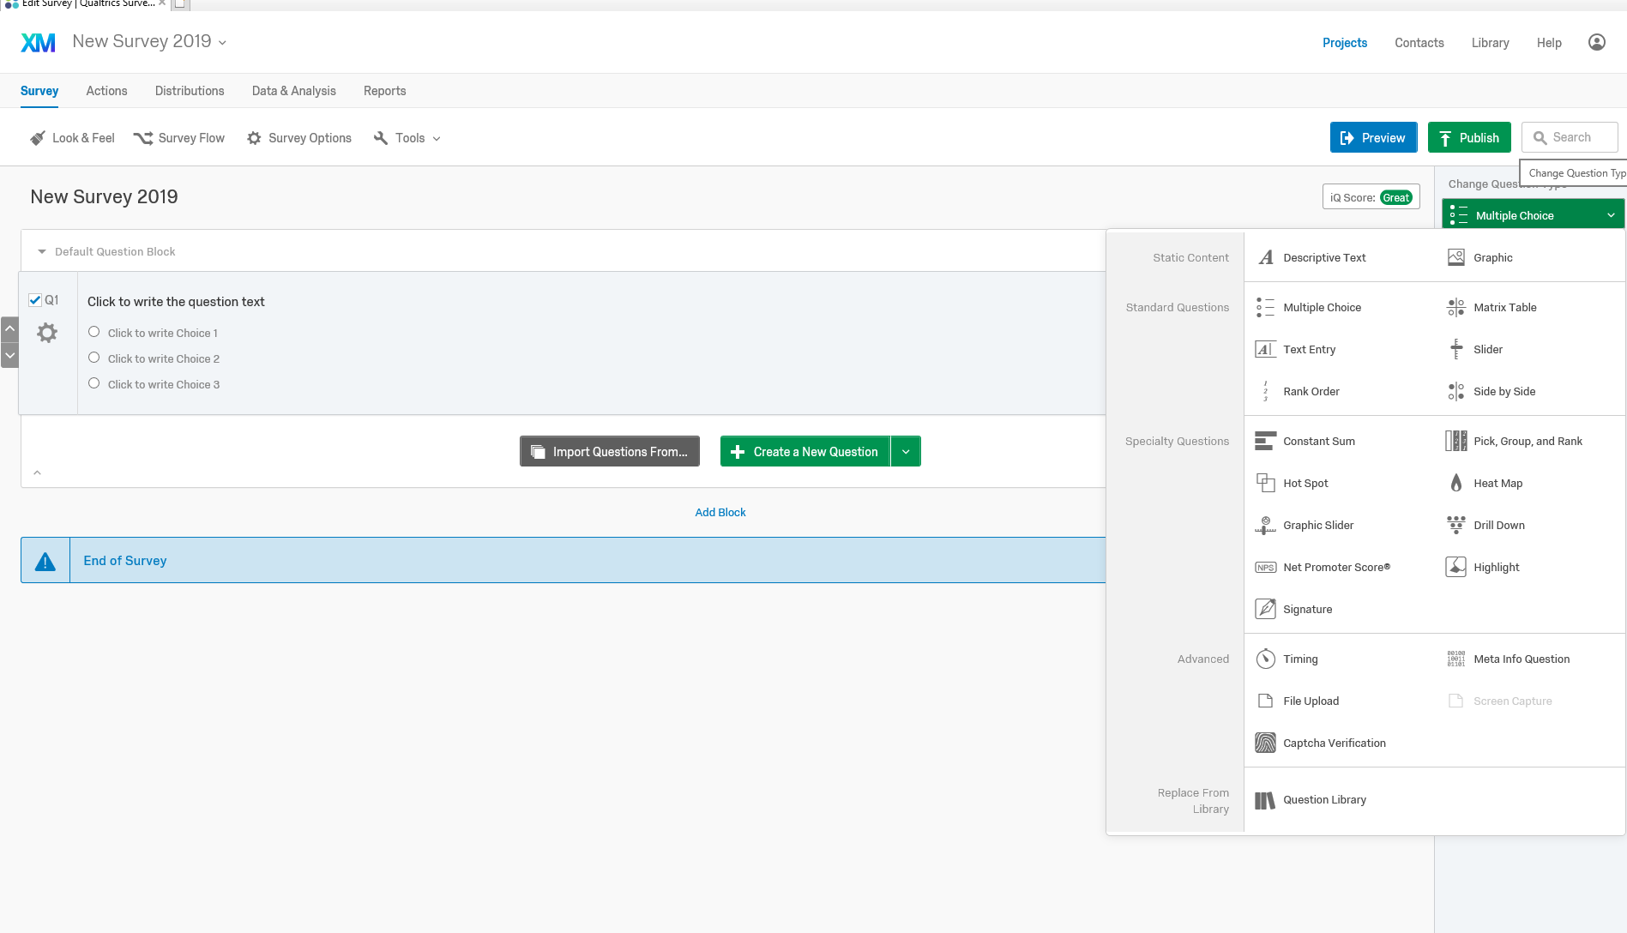
Notes:
Sampling – the process of selecting a few (a sample) from a bigger group (the sampling population) to become the basis for estimating or predicting a fact, situation or outcome regarding the bigger group

Slide 14
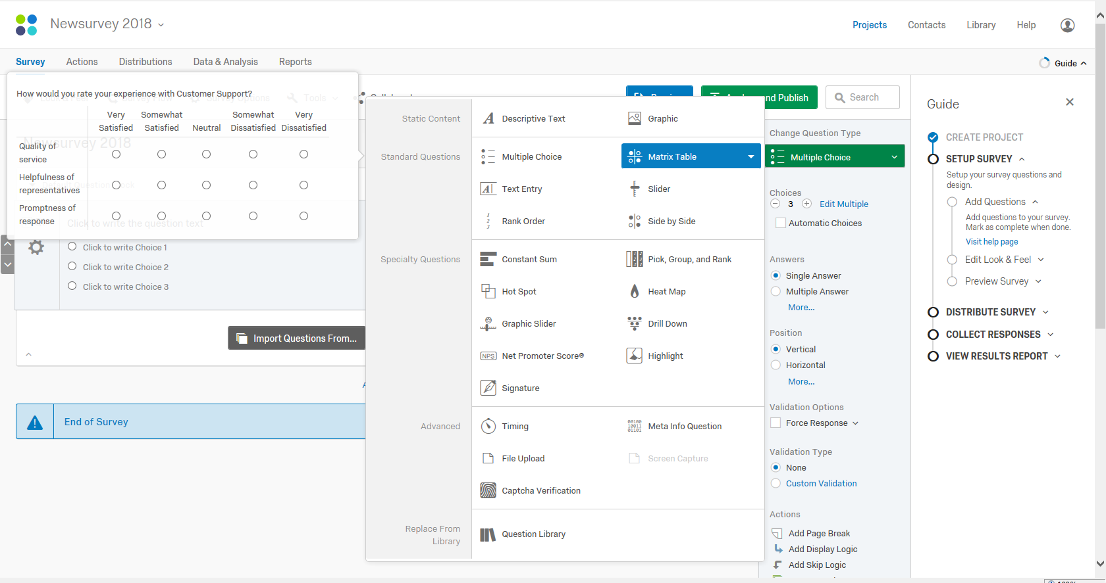
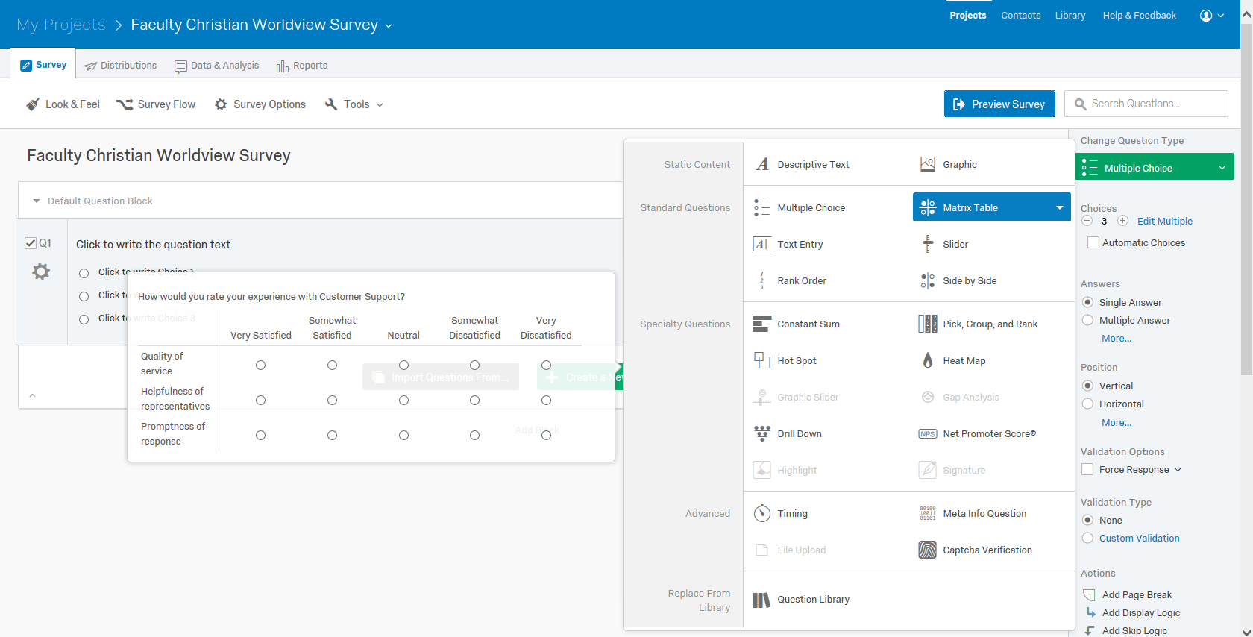
Qualtrics
Notes:
TERM
The number of respondents from whom you obtain the required info

Slide 15
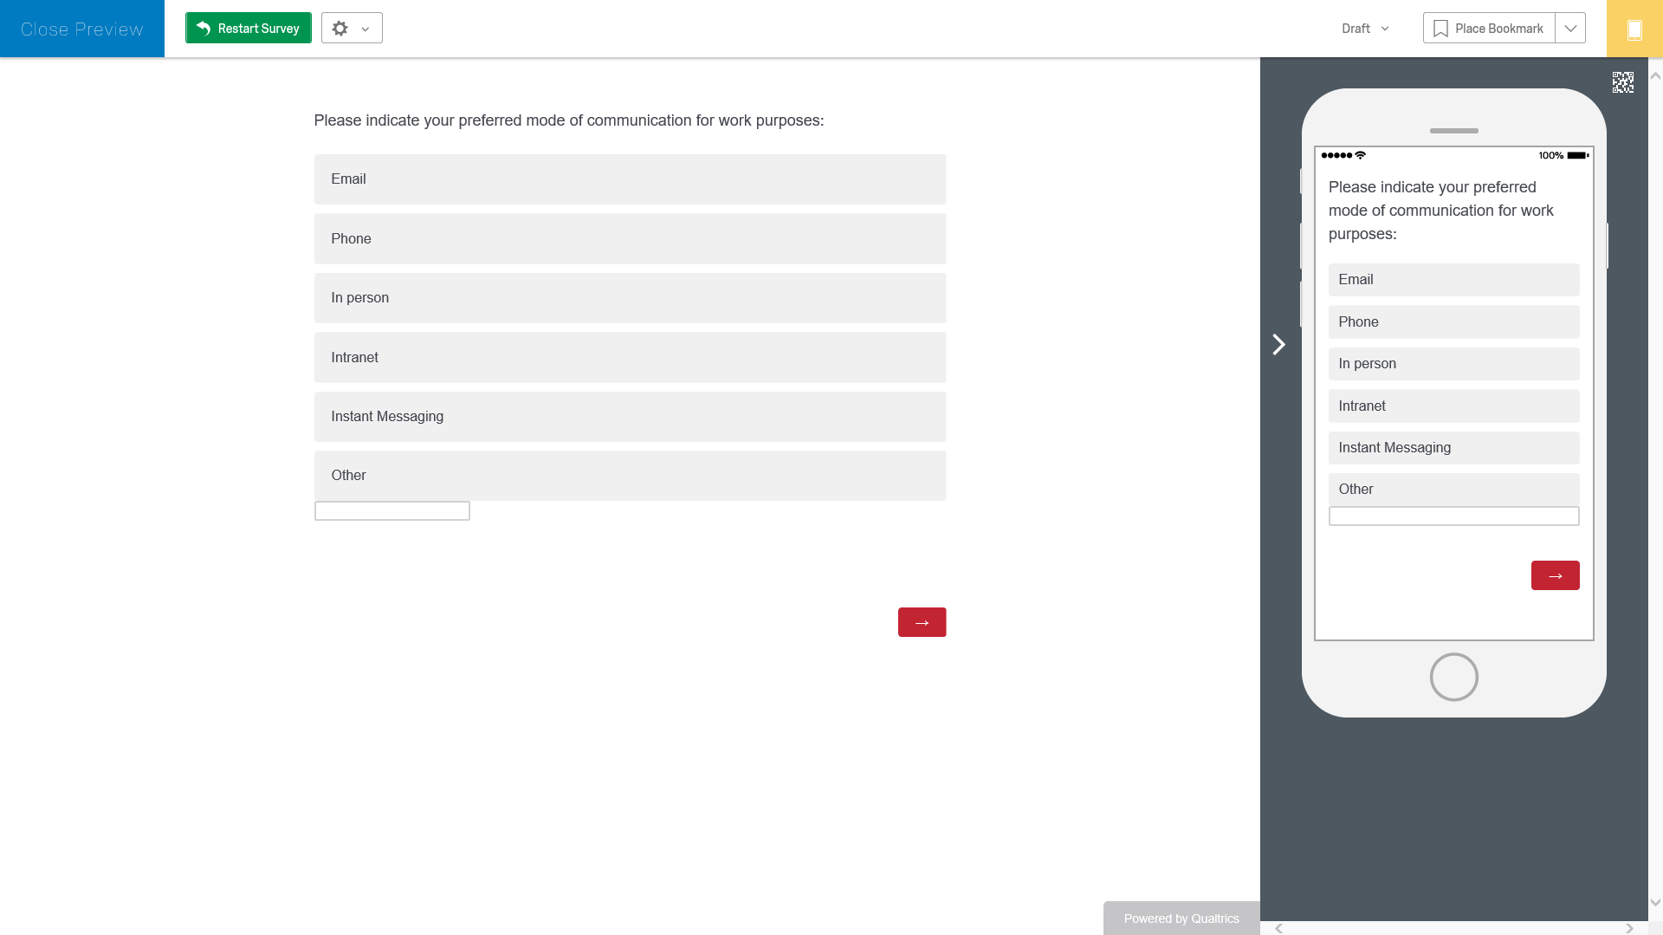
Qualtrics
Notes:
TERM
Collection of elements or objects that possesses the information sought by the researcher and about which infrerencesare to be made
Element – object about which or from which the information in desired (in survey research, usually respondent)

Slide 16
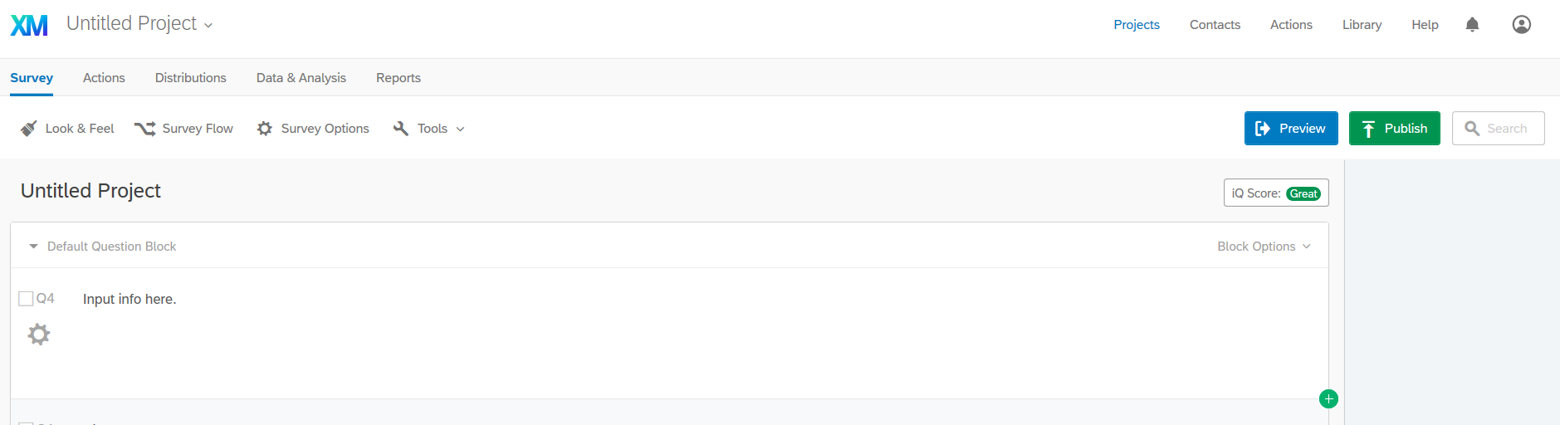
Qualtrics
Notes:
Sampling – the process of selecting a few (a sample) from a bigger group (the sampling population) to become the basis for estimating or predicting a fact, situation or outcome regarding the bigger group

Slide 17
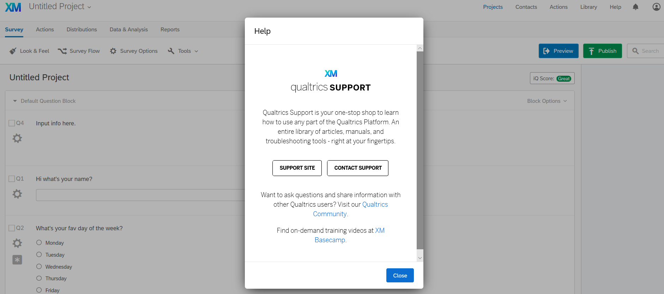
Qualtrics
Notes:
Sampling – the process of selecting a few (a sample) from a bigger group (the sampling population) to become the basis for estimating or predicting a fact, situation or outcome regarding the bigger group

Slide 18
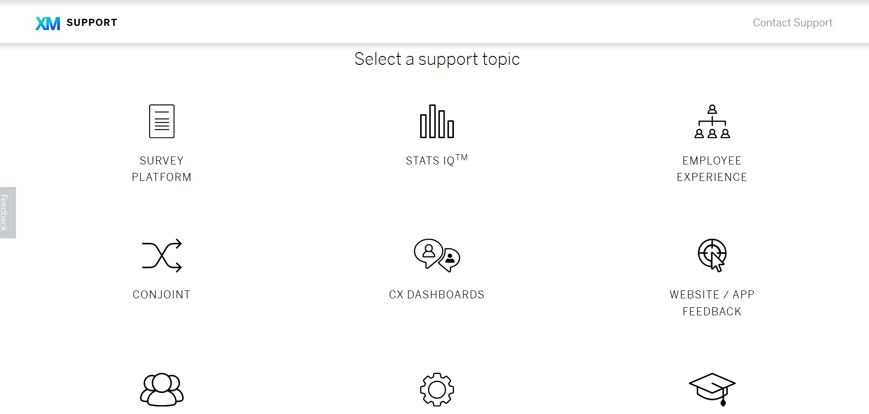
Qualtrics
Notes:
Sampling – the process of selecting a few (a sample) from a bigger group (the sampling population) to become the basis for estimating or predicting a fact, situation or outcome regarding the bigger group

Slide 19
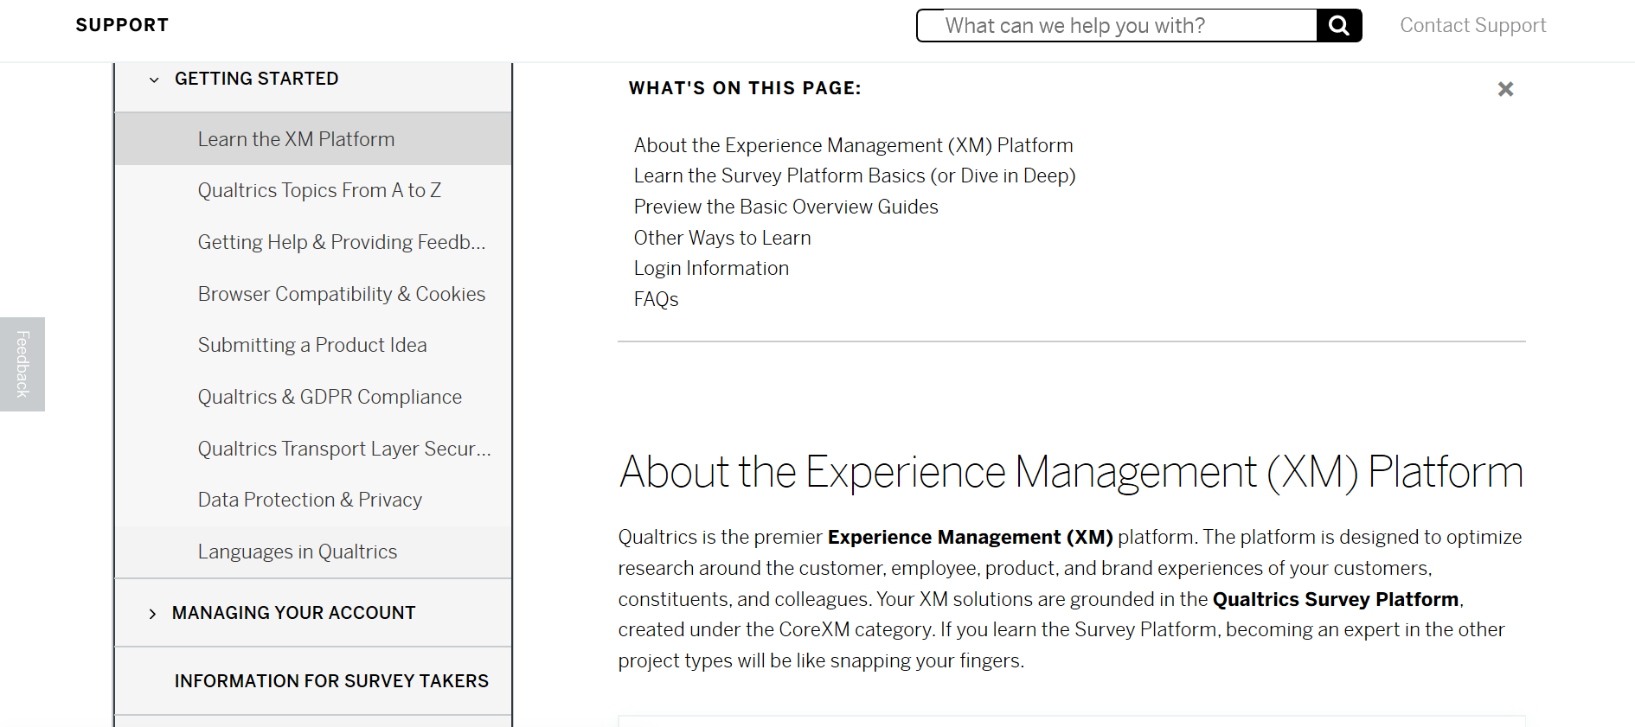
Qualtrics
Notes:
Sampling – the process of selecting a few (a sample) from a bigger group (the sampling population) to become the basis for estimating or predicting a fact, situation or outcome regarding the bigger group

Slide 20
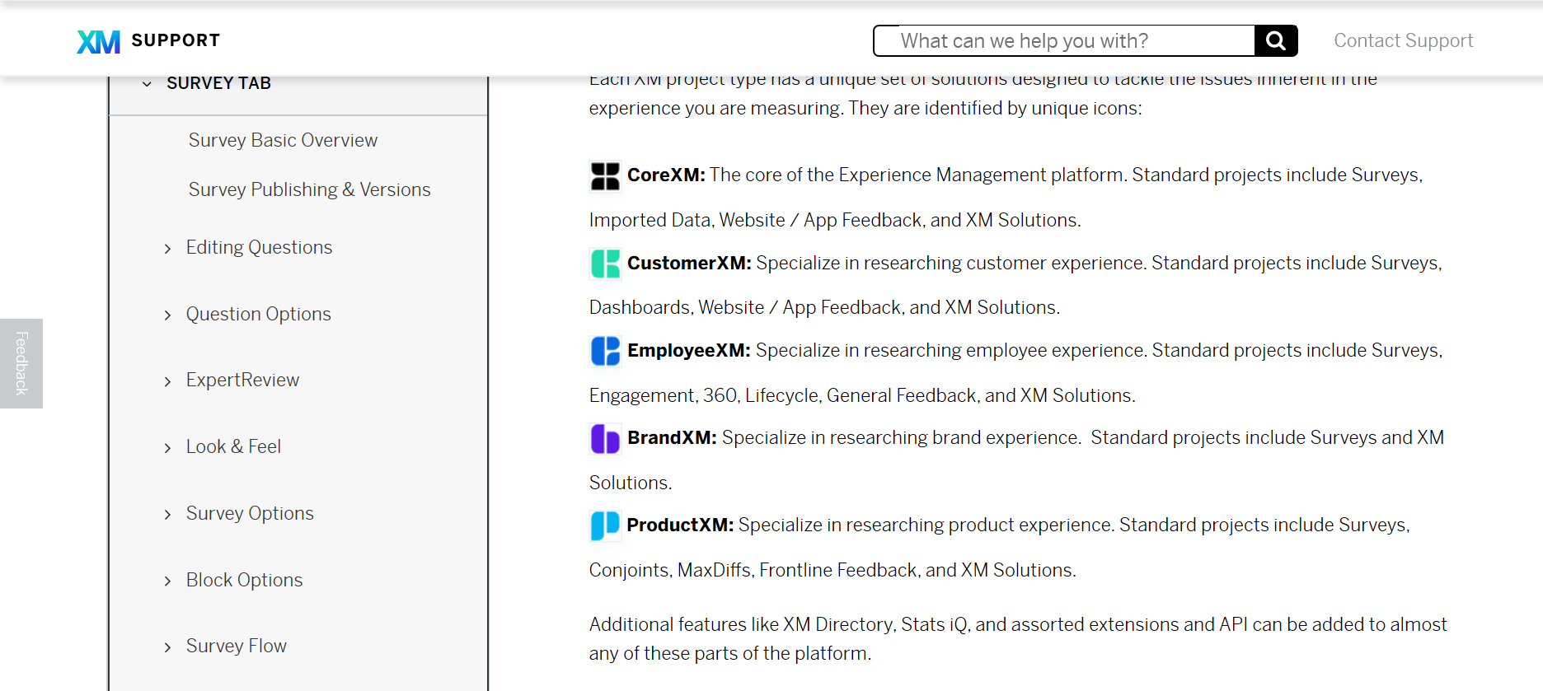
Qualtrics
Notes:
Sampling – the process of selecting a few (a sample) from a bigger group (the sampling population) to become the basis for estimating or predicting a fact, situation or outcome regarding the bigger group

Slide 21
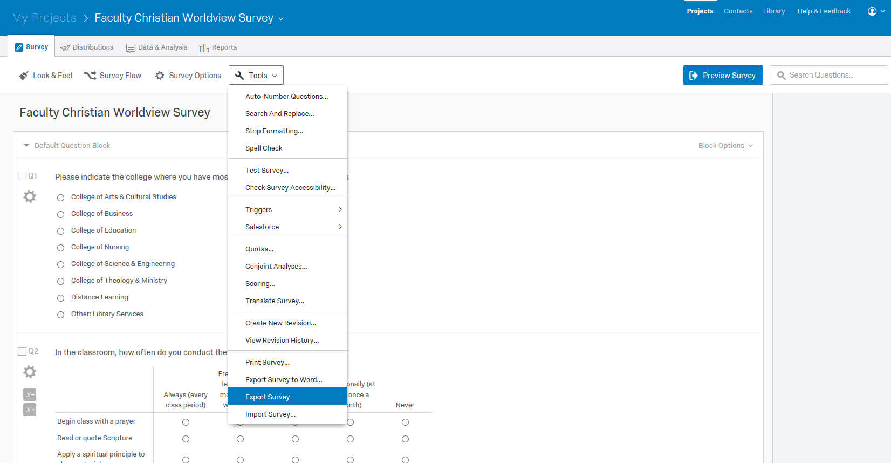
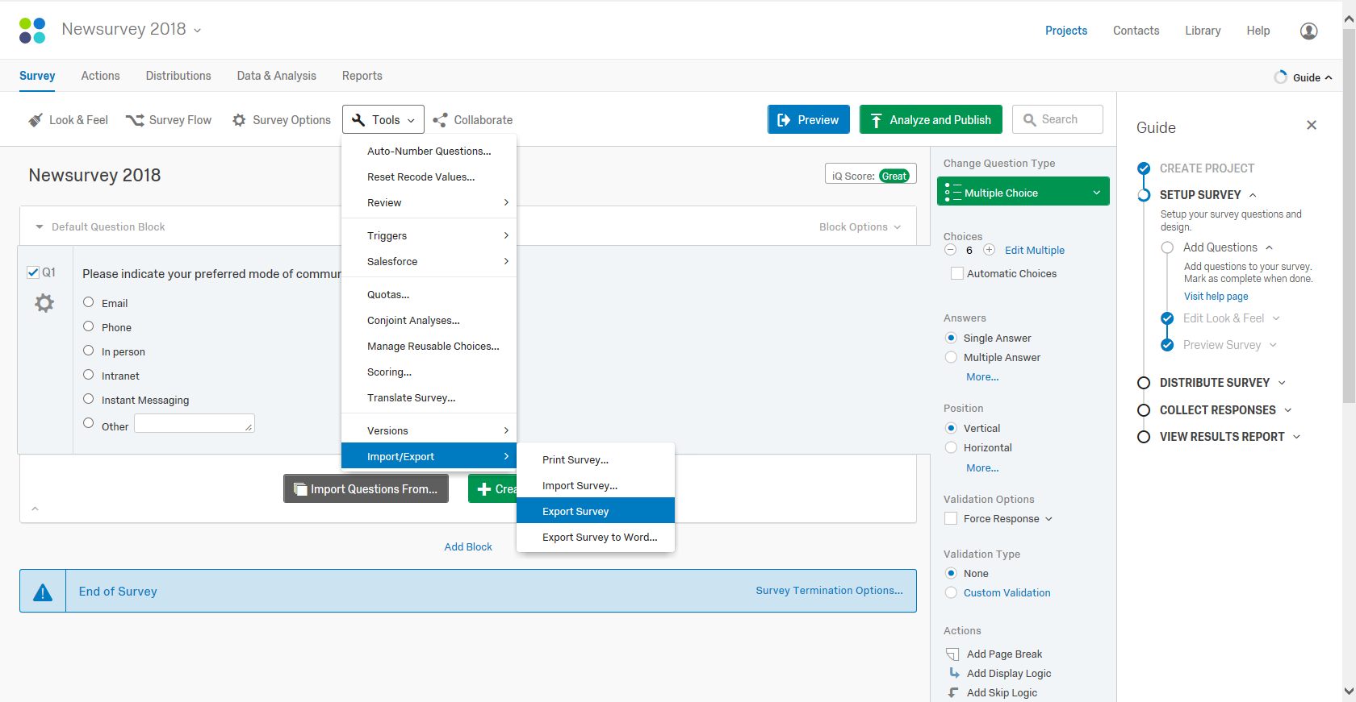
Qualtrics
Notes:
Step 4: Determine sample size (how many respondents you are looking for)
Qualitative factors that should be included in decision: 1) importance of the decision, 2) nature of the research, 3) nature of analysisk 4) sample sizes used in other students, 5) resource constraints
For exploratory research designs (i.e. qualitative research), sample size is usually small
For conclusive research designs (i.e. quant resarch), sample size is larger
If sophisticated analysis of data is needed, use large sample size

Slide 22
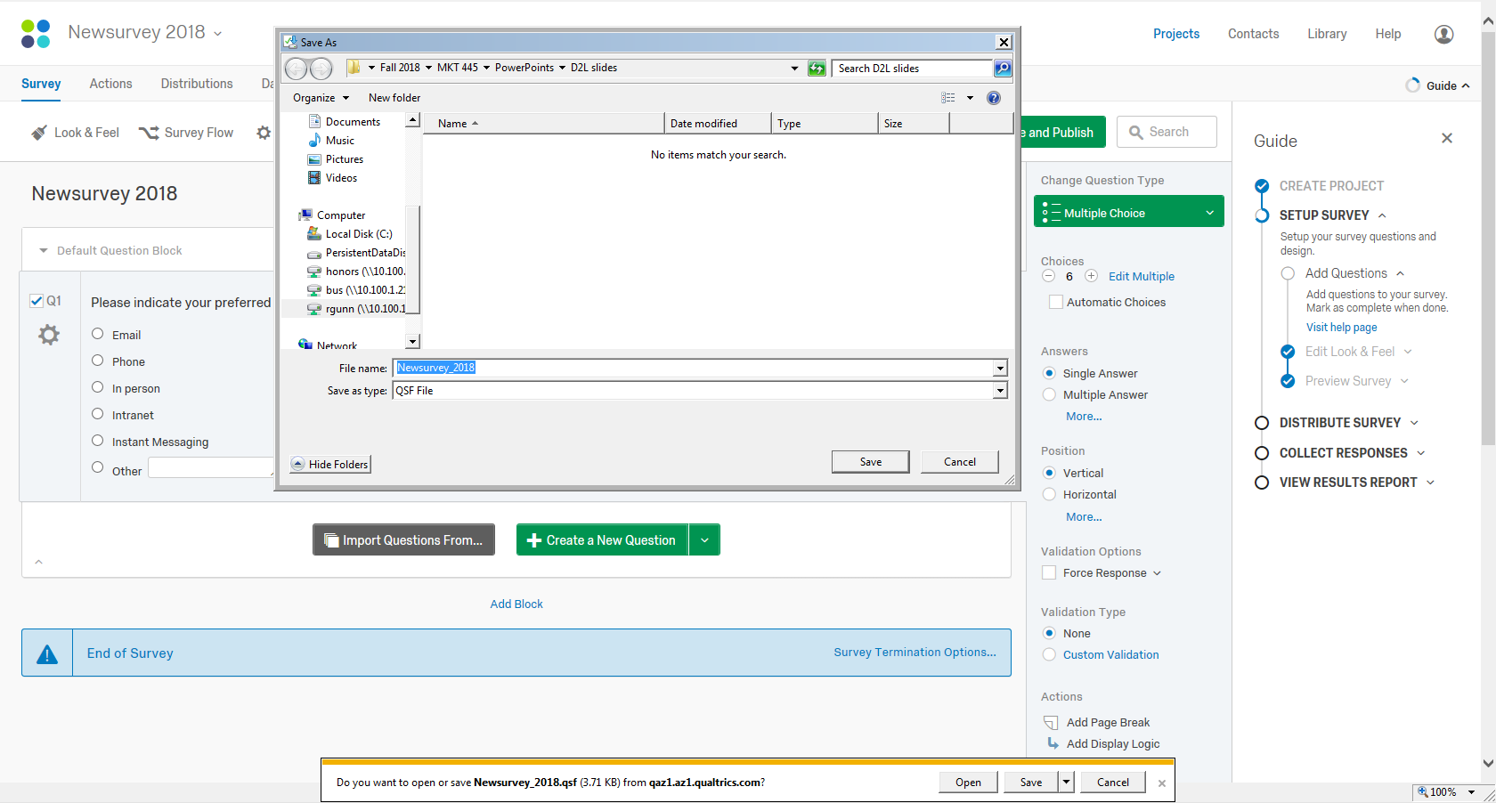
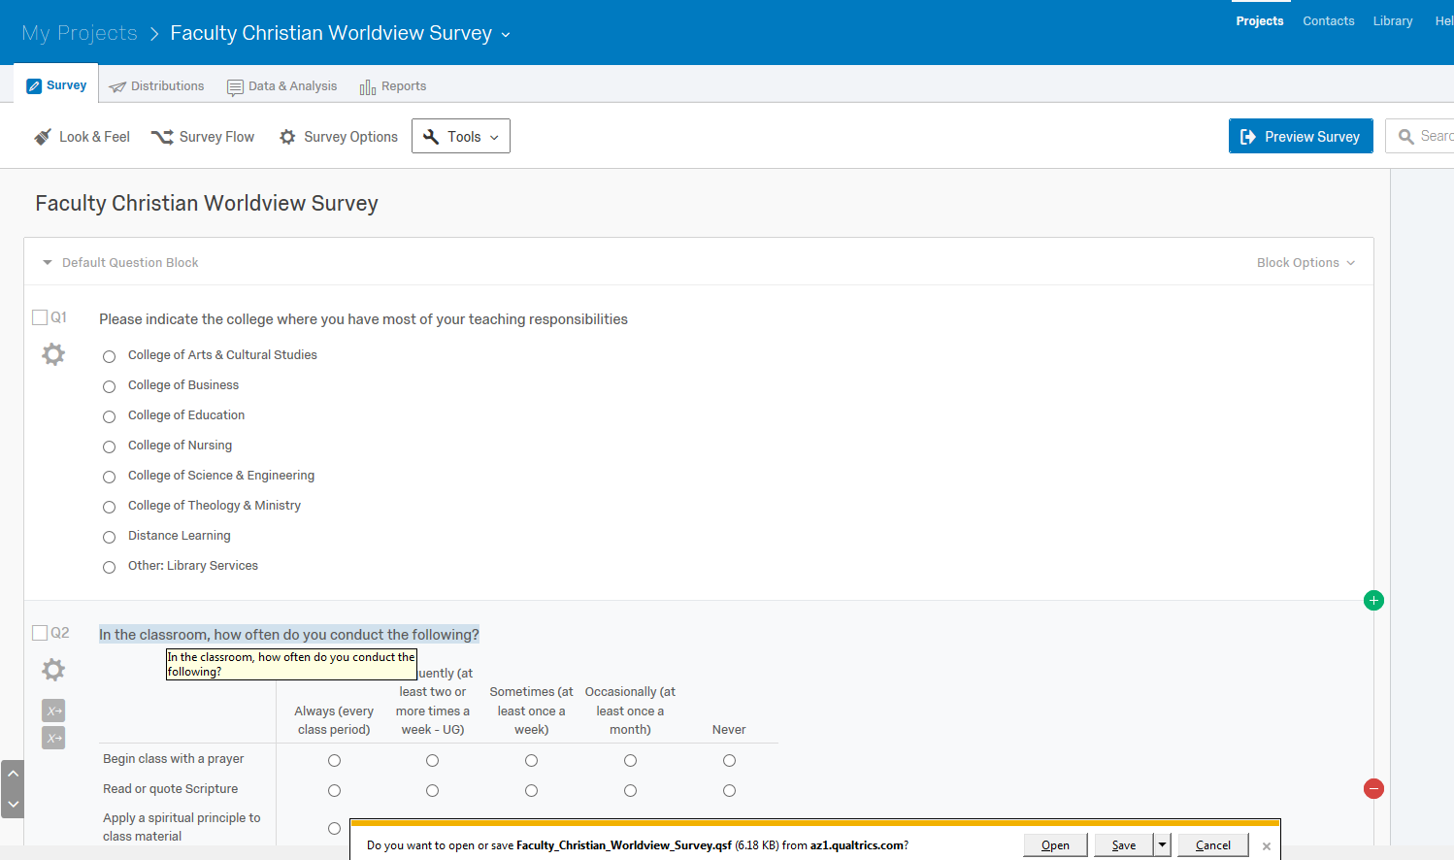
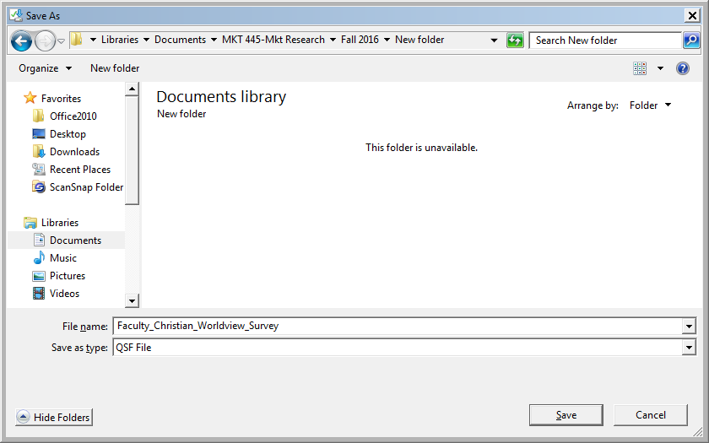
Qualtrics

Slide 23
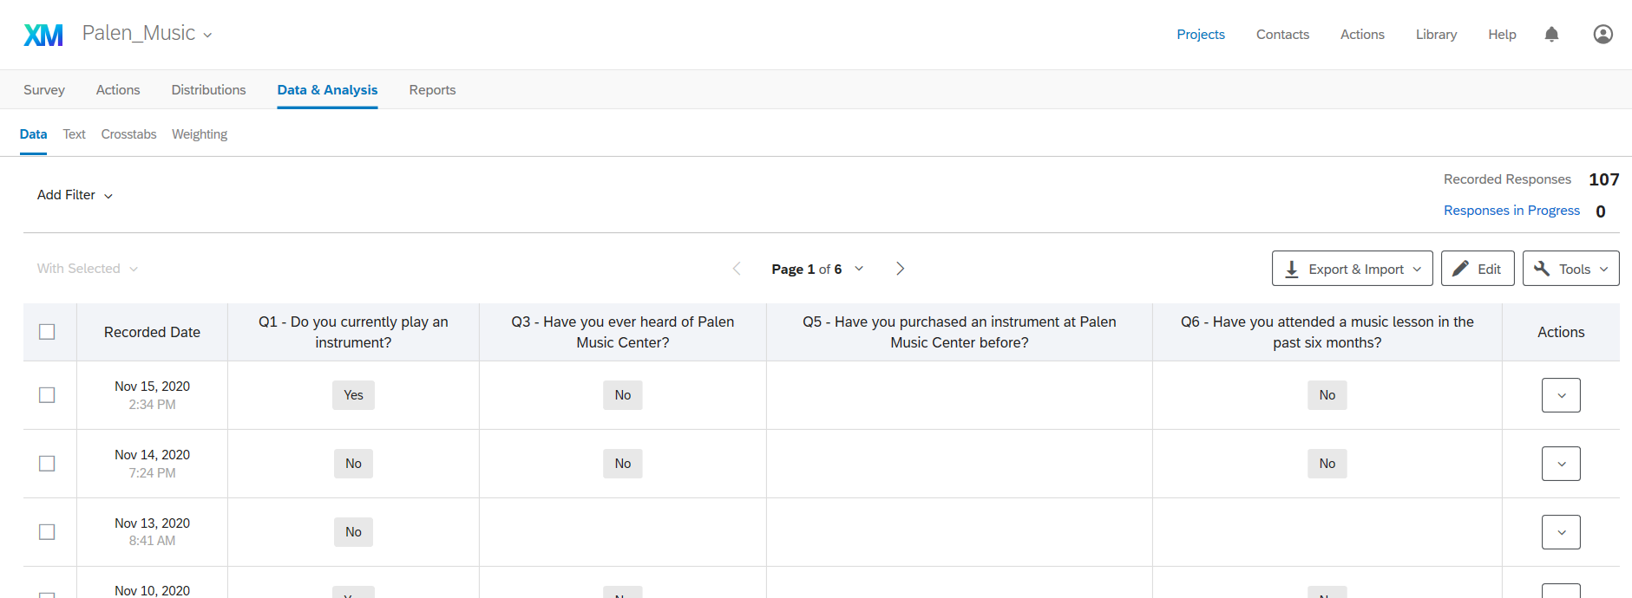
Qualtrics
Notes:
Sampling – the process of selecting a few (a sample) from a bigger group (the sampling population) to become the basis for estimating or predicting a fact, situation or outcome regarding the bigger group

Slide 24
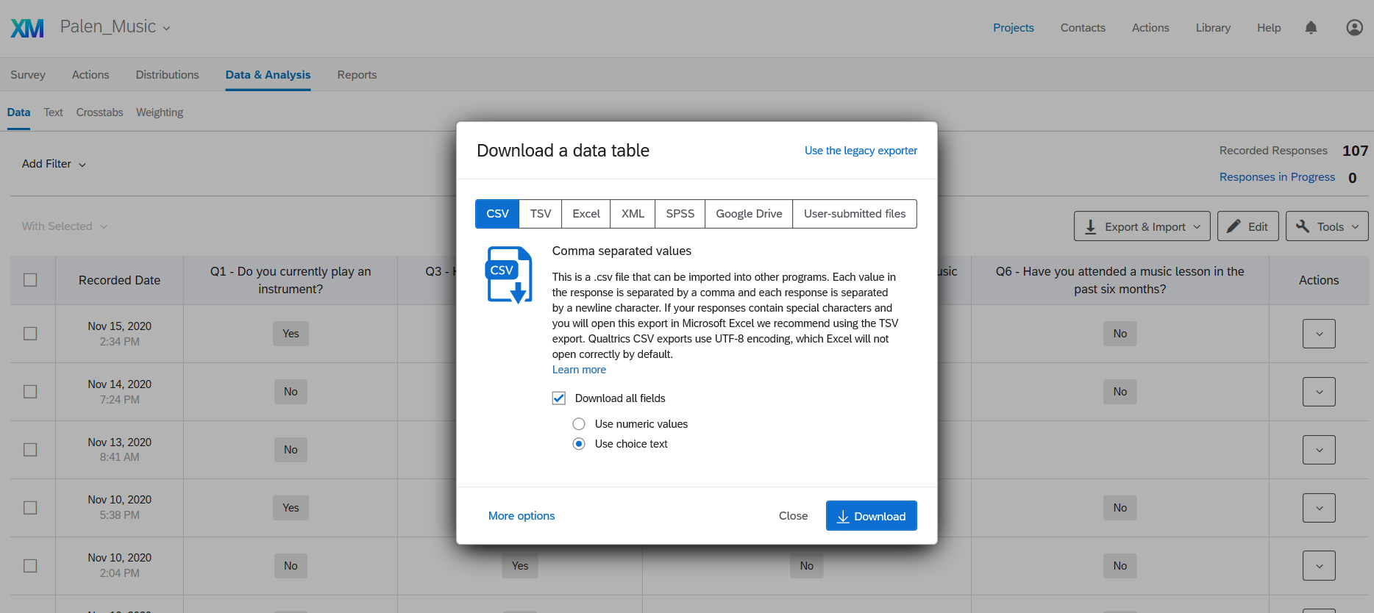
Qualtrics
Notes:
Sampling – the process of selecting a few (a sample) from a bigger group (the sampling population) to become the basis for estimating or predicting a fact, situation or outcome regarding the bigger group

Slide 25
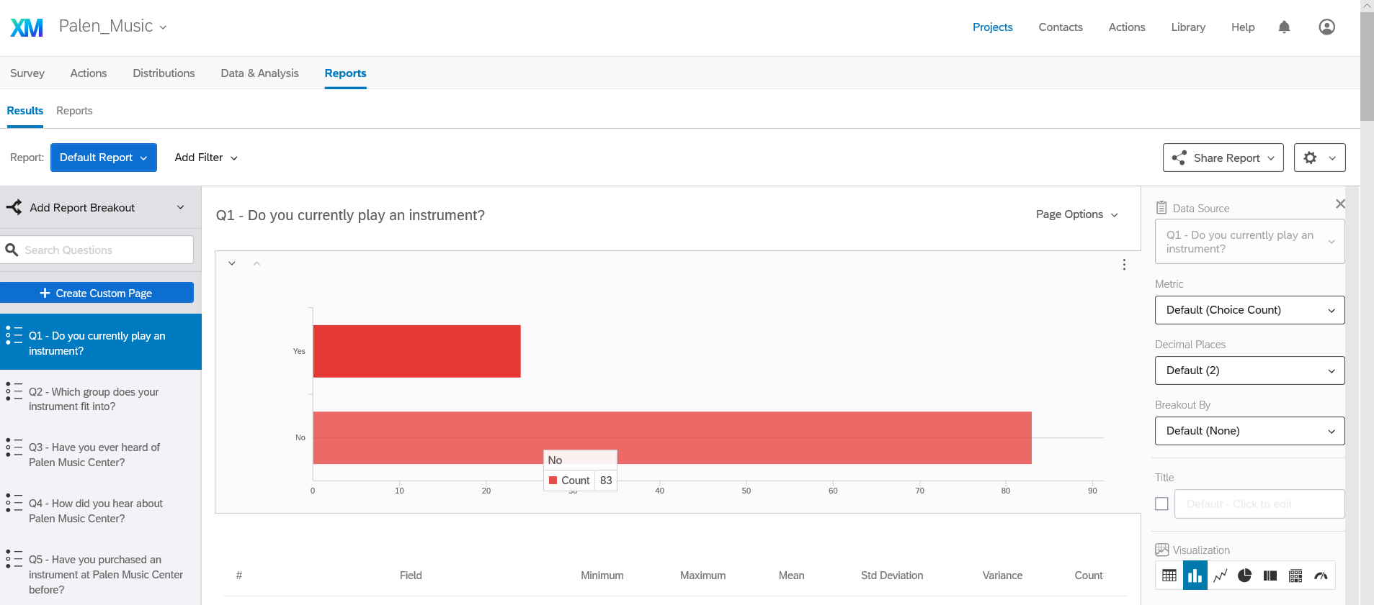
Qualtrics
Notes:
Sampling – the process of selecting a few (a sample) from a bigger group (the sampling population) to become the basis for estimating or predicting a fact, situation or outcome regarding the bigger group

Slide 26
Qualtrics
Qualtrics Example
https://oralroberts.qualtrics.com/
Notes:
Sampling – the process of selecting a few (a sample) from a bigger group (the sampling population) to become the basis for estimating or predicting a fact, situation or outcome regarding the bigger group

Slide 27
Qualtrics
Qualtrics Support
If you have any questions about using Qualtrics at Oral Roberts, please contact Qualtrics Support through qualtrics.com/contact-support.
Notes:
Sampling – the process of selecting a few (a sample) from a bigger group (the sampling population) to become the basis for estimating or predicting a fact, situation or outcome regarding the bigger group

Slide 28
Additional Resources
https://www.qualtrics.com/education/higher-education/
https://www.qualtrics.com/education/student-and-faculty-research/
https://www.qualtrics.com/community/categories/higher-education

